Slide 1
mammals
Ladushkina Sonya 3a

Slide 2
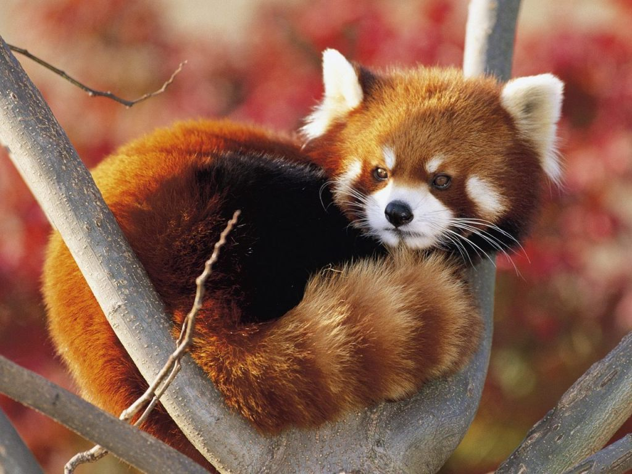
Red panda
This is a red panda. Red panda is from China. In China there are some red pandas’ farms. Red pandas has got small body,
big head, short legs and big, beautiful tail. They eat meat.

Slide 3
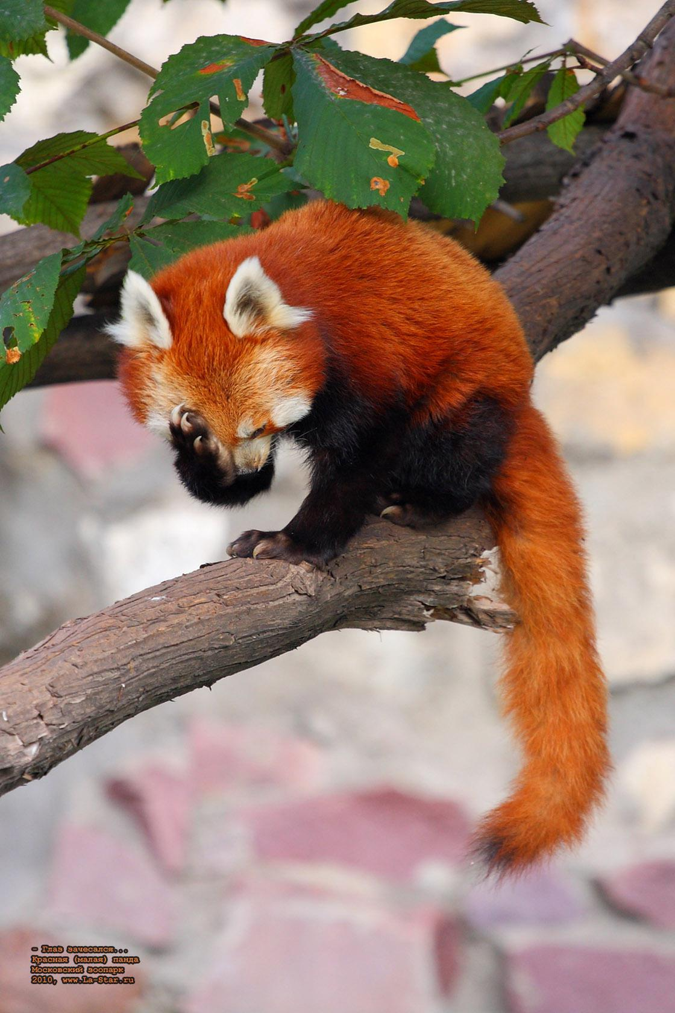
A red panda’s legs are orange and black, tail is orange and head is orange and white.

Slide 4
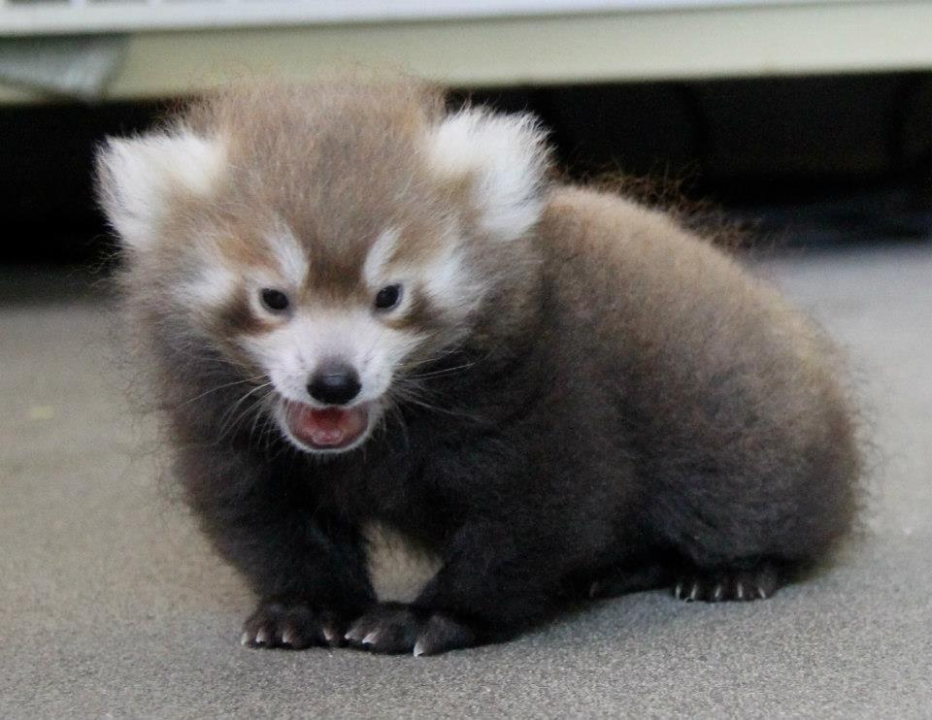
Their children are grey!

Slide 5
Red pandas are very interesting mammal!

