Slide 2
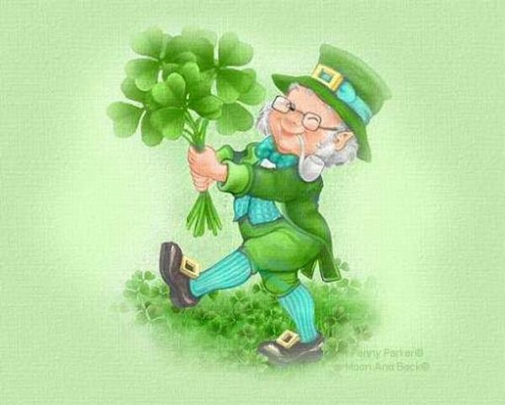
St. Patrick’s Day
St. Patrick’s Day is celebrated every year on the 17th of March in honor of Saint Patrick of Ireland. He was the patron of Ireland, and a saint who brought Christianity to the nation. Saint Patrick is also known for driving the snakes away from Ireland.

Slide 3
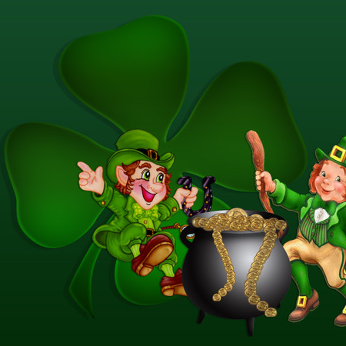
The national symbol of Ireland is a shamrock and according to the legend Saint Patrick chose this plant to illustrate the Holy Trinity to the Irish.

Slide 4
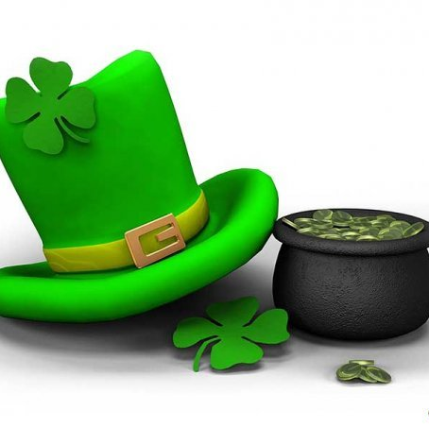
Nobody knows exactly why St. Patrick’s Day is celebrated on the 17th of March. However, there is a theory that on this day Saint Patrick died.

Slide 5
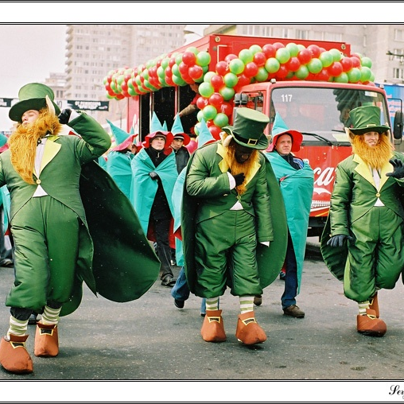
Originally the holiday was celebrated only in Ireland but today a lot of countries in the world celebrate it. Traditional activities include dressing up in green clothes, holding parades, arranging fireworks, singing and dancing in the streets, going to pubs, organizing fairs and festivals.

Slide 6
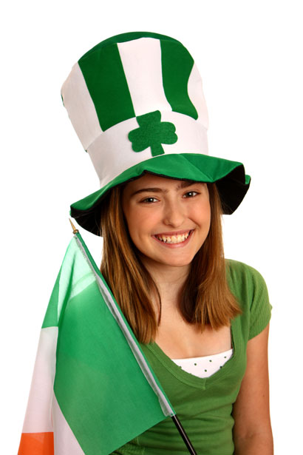
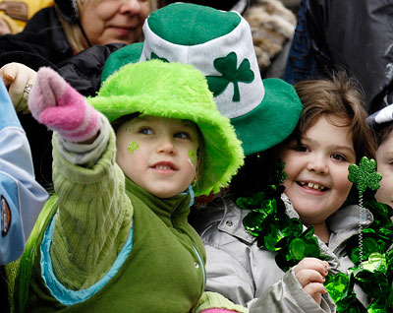
Green is the official colour of St. Patrick’s Day. It is also the national colour of the Irish and the symbol of spring. That’s why on this day people try to wear something green. It can be a T-shirt, a dress, a hat, a tie or simply a hair ribbon. They also paint green stripes on the city streets.

Slide 7
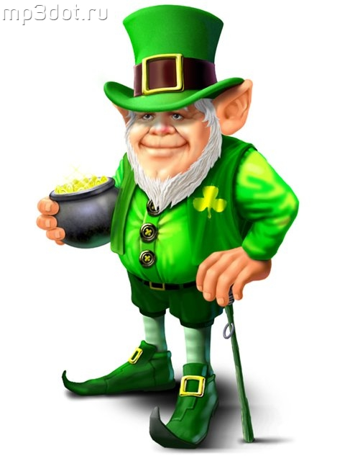
Another symbol of St. Patrick’s Day is a Leprechaun.
Leprechauns are little people who wear green clothes and carry the pot of gold. Leprechauns cannot be offended or hurt. People don’t work or study on this day.

