Slide 1
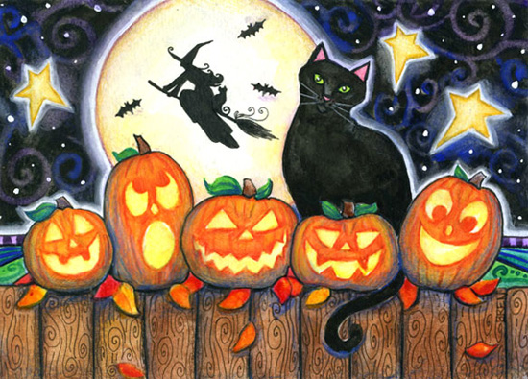
Five Little Pumpkins Sitting On A Gate
ç

Slide 2
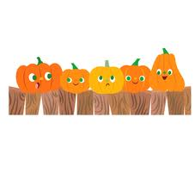
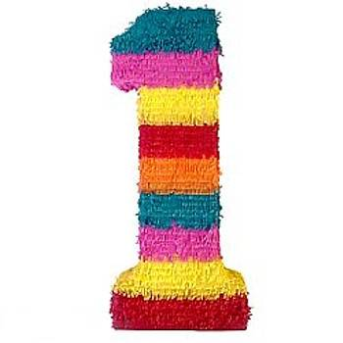
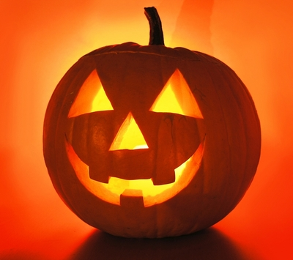
Five little pumpkins sitting on a gate,
The first one said,
"Oh my, it's getting late."

Slide 3
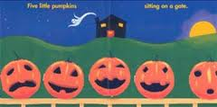
The second one said,
"But we don't care."

Slide 4
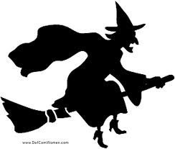
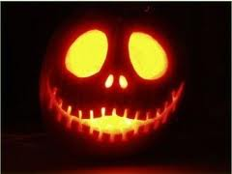
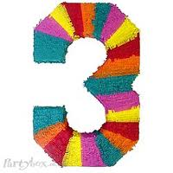
The third one said,
"I see witches in the air."

Slide 5
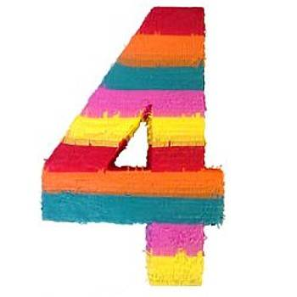
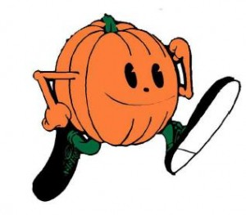
The fourth one said,
"Let's run, and run, and run."

Slide 6
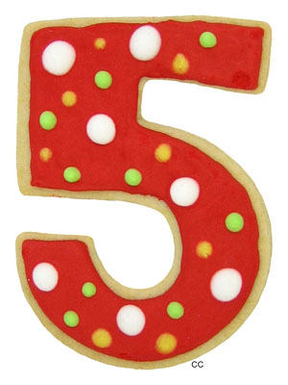
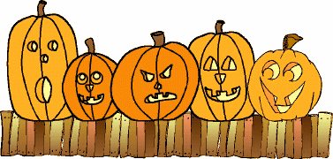
The fifth one said,
"Get ready for some fun."

Slide 7
Then whoosh went the wind,
And out went the lights

Slide 8
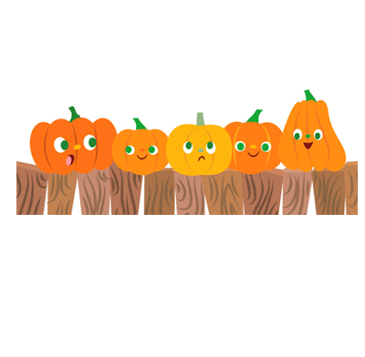
And five little pumpkins flew out of sight!

