Slide 1
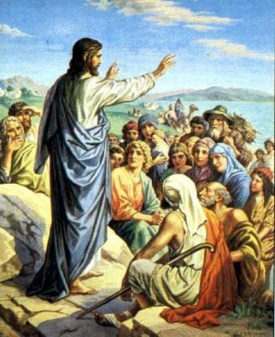

Slide 2
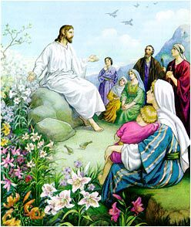

Slide 3
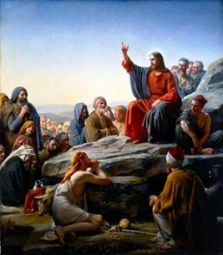

Slide 4
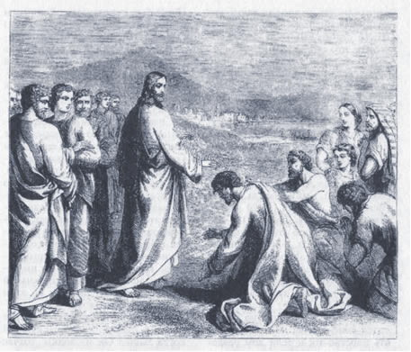

Slide 5
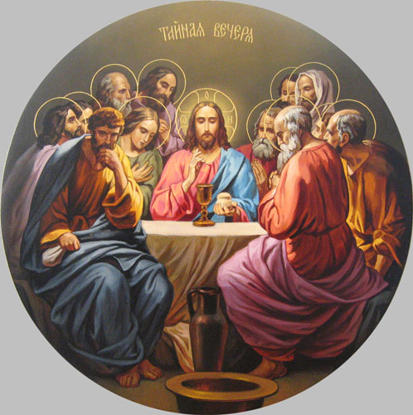

Slide 6
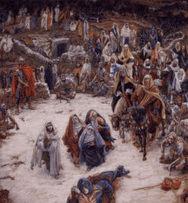

Slide 7
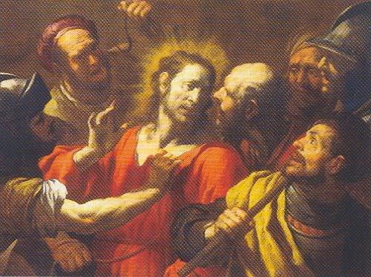

Slide 8
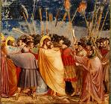

Slide 9
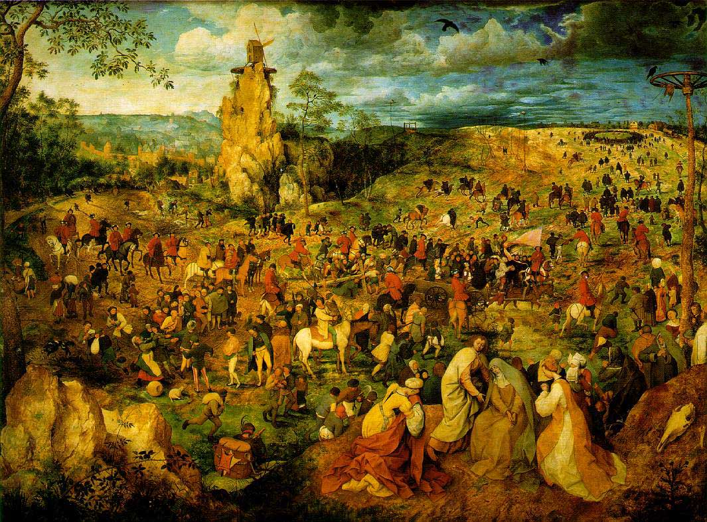

Slide 12
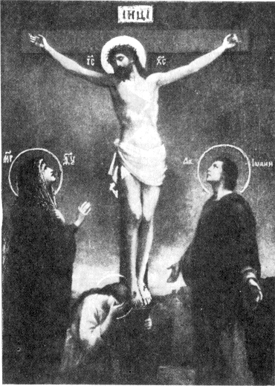

Slide 13
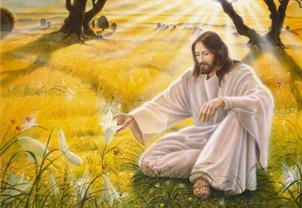

Slide 14
A merry Christmas
We wish you a merry Christmas We wish you a merry Christmas We wish you a merry Christmas And a happy New Year. We want some figgy pudding (3x) And a cup of good cheer. We won't go until we get some (3x) So bring it out here! We wish you a Merry Christmas (3x) And a happy New Year.

