Slide 1
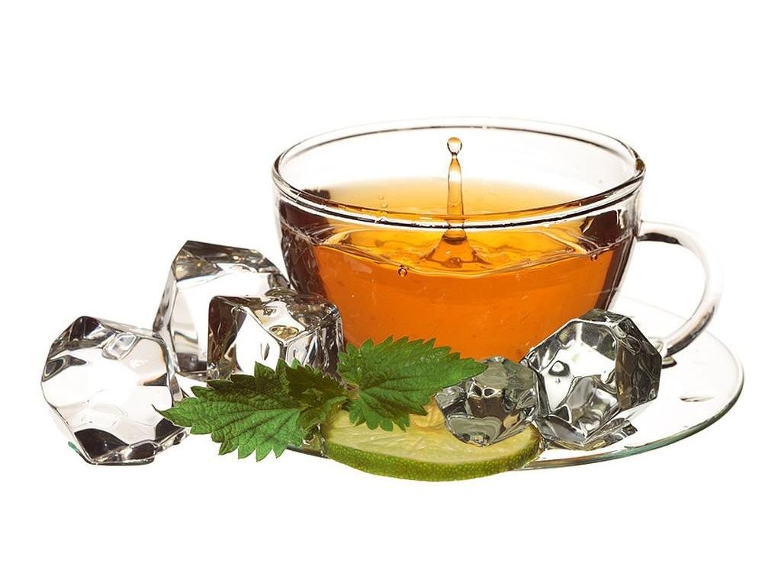
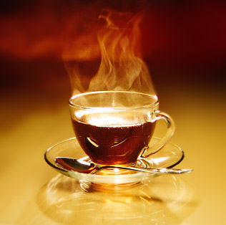
TEA PARTY

Slide 2
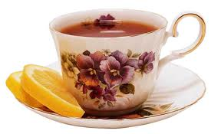
TEA IS A HOT BROWN DRINK MADE BY POURING BOILING WATER OVER THE DRIED LEAVES OF A TEA BUSH. TEA RANKS FIRST AS THE MOST POPULAR BEVERAGE IN THE WORLD.

Slide 3
TEA APPEARED FIRST IN:
CHINA
RUSSIA
AMERICA
JAPAN

Slide 4
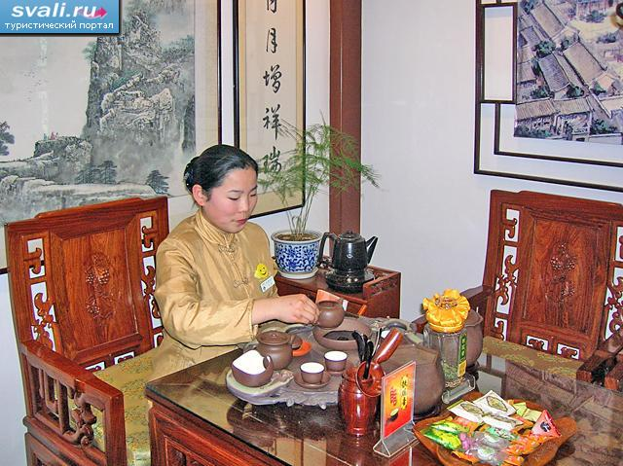
TEA CULTIVATION WAS DOCUMENTED IN CHINA IN A.D. 350, BUT ACCORDING TO THE CHINESE LEGEND IT HAD BEEN KNOWN THERE SINCE 2700 B.C. THE LEGEND HAS IT THAT LEAVES FROM A TREE DROPPED INTO EMPEROR SHEN NUNG’S CUP OF BOILNG WATER. BEING A SCIENTIST, THE EMPEROR WAS CURIOUS AND DECIDED TO TRY SOME OF THIS NEW LIQUID. HE FOUND THE LIQUID AROMATIC AND REFRESHING.

Slide 5
ANOTHER COUNTRY FOR TEA CEREMONY IS JAPAN. BUDDHIST MONKS INTRODUCED TEA TO JAPAN. THEY THOUTHT THAT TEA HAD MEDICAL QUALITIES. TEA BECAME AN INTEGRAL PART OF JAPANESE LIFE.

Slide 6
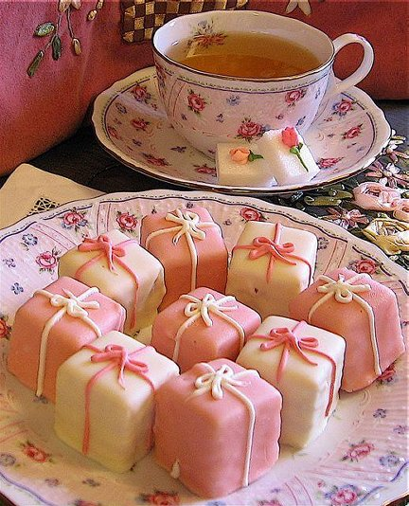
TEA MOVES TO EUROPE DURING THE 1600’S WITH THE PORTUGESE AND THE DUTCH SEAMEN. FIRST THIS DRINK WAS POPULAR AMONG THE WEALTHY. IN THE MID’S 1600’S THE DUTCH WERE FIRST TO BRING TEA TO AMERICA. AMERICANS WERE HEAVY TEA DRINKERS THAT CONSUMED MORE TEA THAN ENGLISHMEN.

Slide 7
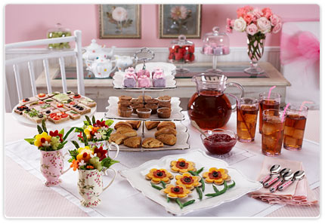
ENGLISH TEA TRADITIONS HAVE A LONG HISTORY. TEA WAS BROUGHT TO ENGLAND IN THE SEVENTEENTH CENTURY BY A PORTUGESES PRINCESS WHO MARRIED KING OF ENGLAND.FIVE O’CLOCK TEA IS NOT ONLY A CEREMONY BUT IT IS WORK OF ART. TEA IS TRADITIONALLY SERVED WITH MILK AND LEMON.TEA WAS USED TO DRINK BLACK BUT AS PEOPLE BECAME MORE AND MORE IN A HURRY THEY STARTED TO ADD MILK TO TEA. OR THEY SAY THAT TEA WAS COOL DOWN WHEN THE HOSTESS DID NOT WANT TO HAVE THEIR GUESTS TOO LONG.

Slide 8
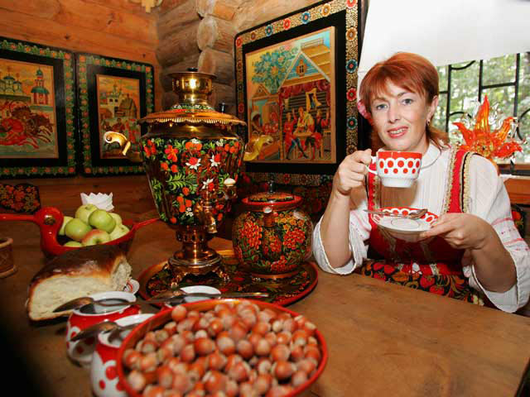
RISSIAN PEOPLE LIKE DRINKING TEA VERY MUCH. TEA WAS INTRODUCED TO RUSSIA IN THE EARLY SEVENTEENTH CENTURY BY CHINA. TODAY TEA REMAINS THE MOST POPULAR NON-ALCOHOLOIC DRINK. IN RUSSIA TEA IS DRUNK AFTER MEALS AND DURING MID-AFTERNOON BREAKS. IT IS OLD RUSSIAN TRADITION TO SERVE TEA FROM THE SAMOVAR AFTER SUPPER.

