Slide 1
«Крестики - нолики»
для 5 класса
Быкова Валентина Владимировна
МОУ СОШ № 35
г. Братск
Notes:
Welcome to Power Jeopardy
© Don Link, Indian Creek School, 2004
You can easily customize this template to create your own Jeopardy game. Simply follow the step-by-step instruc-tions that appear on each slide.
Print the notes for slides 1 through 3 by doing the following:
Under File select Print…
In the section entitled Print Range, click the radio button for Slides and in the box to its right, type in 1-3.
Under Print what:, select Notes Pages.
At this point, the Print pop-up should look like the picture at the right.
Click OK
2. Now that you have printed instructions for tailoring the game, you can make the needed changes to each slide by moving into Slide View. Simply double click the blue slide above.
Change Slide 1:
Double click on the word Subject, and type in the subject you want in its place (e.g., Math).
Double click on the word Teacher in the bottom right of the slide, and type over it with your name (e.g., Mr. Link).
After doing this, the new slide will look something like this:
4. Go on to the next slide.
Slide 1-Title
This slide begins the game. When you first start the presentation, the screen appears all blue. When you click the mouse button, the Jeopardy theme song plays, and the title and “Hosted by” text slowly move into place.
To tailor this slide, follow these instructions:

Slide 2
«Корзина загадок»
«Что лишнее»
«Живая буква»
«Стоп кадр»
«Найди ошибку»
«Поймай птицу»
Кроссворд
«Гриб»
«Я рисую
натюрморт»
Кроссворд
«Природоведение»
Notes:
2. Now, repeat Step 1 for the remaining four category placeholder names:
Slide 2-Category Selection
This slide is the main game board. You go here to begin the game, and you return here after each Question/Answer slide. This is where the “contestant” selects one of the five categories and a dollar value for the question. The higher the value, the more difficult the question. When you open this slide, the categories appear one at a time, and the dollar values appear at random with an accompanying laser beep. Here’s how it works: if the contestant selects the first category for $300, you would click on the $300 text under
To tailor this slide, follow these instructions:
Five different categories are used in the game. The category names appear at the top of the columns on this slide and on the five associated Question/ Answer slides (one for each dollar value). Rather than changing all of these separately, you will use the Replace command to change each placeholder category name only once.
1. Under Edit, choose Replace
Type the placeholder name for category 1 as shown in the pop-up at the right.
Type in your category name (e.g., Mixed Numbers) under Replace with:
The Replace pop-up should now look like the one on the right, only with your category name.
Click the Replace All button to make the changes.
You will then see this pop-up
Click the OK button. This replaces the six occurrences of the specified placeholder category name with your category name. After this, the top of the slide will look like this:
the 1st category (i.e., the 3rd dollar box in column one). As a result, the corresponding Question/Answer slide will automatically appear. Once the question, and then the answer, for that slide have been shown, you will click on the arrow in the bottom right of that slide to return to this main slide. When you return to this slide, the dollar amount for the box you selected will have changed from white to blue to show that that particular question has already been used. Below, you will see how to tailor the game for your particular categories.
Notice that in this case, “Mixed Numbers” doesn’t fit on the line. To fix this, simply click on the text right before the “N” and press Backspace followed by Enter. Now it’s on two lines:

Slide 3
Загадка 1
Золотая середина, и лучи идут кругом.
Это может быть картина:
солнце в небе голубом.
Нет, не солнце на бумажке,
На лугу цветы …
Ответ
Ромашки
Notes:
Slide 3-Question/Answer (Cat1, $100)
This slide is the first Question/Answer slide. It corresponds to Category 1 for $100. Once you have followed the instructions on Slide 2 to replace category name placeholders with your actual categories, the text “Cat1” on this slide will be replaced with your 1st category name.
When you click on Category 1 for $100 on the main slide, this slide opens automatically, with the Question appearing at the top. (Note: On TV Jeopardy, the contestant is actually shown an
answer and is asked to offer a related question. Since this concept is sometimes difficult to understand and implement, this PowerPoint version shows a question followed by the corresponding answer.)
One way to play the game in class is to set up three teams. For each round, have one person from each team stand up as contestants. Have one pick the category and dollar value; click on that box and then ready the question that appears. Call on the first contestant that raises his or her hand for the answer. If they are correct, their team gets corresponding points or dollars (e.g., 1 point for each $100). If the first contestant misses the question or does not answer quickly enough, his or her team loses the corresponding points. Then, offer the question to the remaining two contestants in order of their raised hands. After the question has been answered correctly, or after all three contestants miss it, or after no contestant wants to try, return to the main slide by clicking on the yellow arrow. The current contestants then sit down, and the game moves to the next round.
Note that this Jeopardy game does not have a Double Jeopardy question.
To tailor this slide, follow these instructions:
You are now ready to put in your questions and answers, but you might want to go ahead and save this file first, using Save As and giving it a new name—one that makes sense for this particular Jeopardy game (e.g., Fractions Jeopardy).
If your Question is short, simply double click on the word “Question” and type in your specific question (e.g., “50% of 150” or “Capitol of France”). If the text you enter will not fit on one line, there’s room for two lines at this font size. If you need more room, reduce the font size by triple clicking on the text and using the Font Size selector in the toolbar. In some cases, your question may need a drawn figure or graphic. You can use PowerPoint features to draw the figure you need or to insert graphics. A few examples are show below.
Double click on the word “Answer” and type in your answer in the same way.
Do the same steps to tailor the remaining Question/Answer slides, remembering to make questions of higher dollar value more difficult. Also remember to save your work.
Example Questions:

Slide 4
Загадка 2
Подрастёт – нарядится в беленькое платьице,
Лёгкое, воздушное, ветерку послушное.
А пока стоит одетый в жёлтый сарафанчик.
А зовут его, ребята, просто …
Ответ
Одуванчик
Notes:
Welcome to Power Jeopardy
© Don Link, Indian Creek School, 2004
You can easily customize this template to create your own Jeopardy game. Simply follow the step-by-step instructions that appear on Slides 1-3.

Slide 5
Загадка 3
На солнечной опушке в траве стоит она,
Лиловенькие ушки тихонько подняла.
И тут поможет вам смекалка –
Все знают, что зовут цветок …
Ответ
Фиалкой
Notes:
Welcome to Power Jeopardy
© Don Link, Indian Creek School, 2004
You can easily customize this template to create your own Jeopardy game. Simply follow the step-by-step instructions that appear on Slides 1-3.

Slide 6
Загадка 4
Нам каждому весенняя природа дорога,
Ручьями распускаются холодные снега.
От снега очищаются и поле, и валежник,
И первый появляется в проталине …
Ответ
Подснежник
Notes:
Welcome to Power Jeopardy
© Don Link, Indian Creek School, 2004
You can easily customize this template to create your own Jeopardy game. Simply follow the step-by-step instructions that appear on Slides 1-3.

Slide 7
Загадка 5
В траве густой, зелёной он выглядит нарядно,
Но с пашни, как сорняк, он изгнан беспощадно.
Головка голубая и длинный стебелёк –
Ну кто ж его не знает, ведь это …
Ответ
Василёк
Notes:
Welcome to Power Jeopardy
© Don Link, Indian Creek School, 2004
You can easily customize this template to create your own Jeopardy game. Simply follow the step-by-step instructions that appear on Slides 1-3.

Slide 8
Загадка 6
Ранним утром распускает лепестки свои цветок,
А как вечер наступает, гаснет красный огонёк,
Погляди-ка, погляди-ка, что за красный веерок?
Это яркая … новый празднует денёк.
Ответ
Гвоздика
Notes:
Welcome to Power Jeopardy
© Don Link, Indian Creek School, 2004
You can easily customize this template to create your own Jeopardy game. Simply follow the step-by-step instructions that appear on Slides 1-3.

Slide 9
«Что лишнее»
Дождевой червь, многоножка, личинка майского жука, стрекоза.
Стрекоза
Летучая мышь, голубь, страус, бабочка, летучая рыба.
Страус
Лошадь, заяц, суслик, кошка, хомяк.
Кошка
Собака, рысь, коза, корова, лошадь.
Рысь
Notes:
Welcome to Power Jeopardy
© Don Link, Indian Creek School, 2004
You can easily customize this template to create your own Jeopardy game. Simply follow the step-by-step instructions that appear on Slides 1-3.

Slide 10
«Что лишнее»
Белый медведь, лев, антилопа, койот, гиена.
Белый медведь
Кит, морж, осьминог, носорог, акула.
Носорог
Лещ, камбала, щука, осётр, сом.
Камбала
Белая куропатка, песец, олень, крокодил
Крокодил.
Notes:
Welcome to Power Jeopardy
© Don Link, Indian Creek School, 2004
You can easily customize this template to create your own Jeopardy game. Simply follow the step-by-step instructions that appear on Slides 1-3.

Slide 11
«Живая буква»
 | Б | О
Цветок
Дерево
Насекомое
Рыба
Птица
Зверь
Notes:
Welcome to Power Jeopardy
© Don Link, Indian Creek School, 2004
You can easily customize this template to create your own Jeopardy game. Simply follow the step-by-step instructions that appear on Slides 1-3.

Slide 12
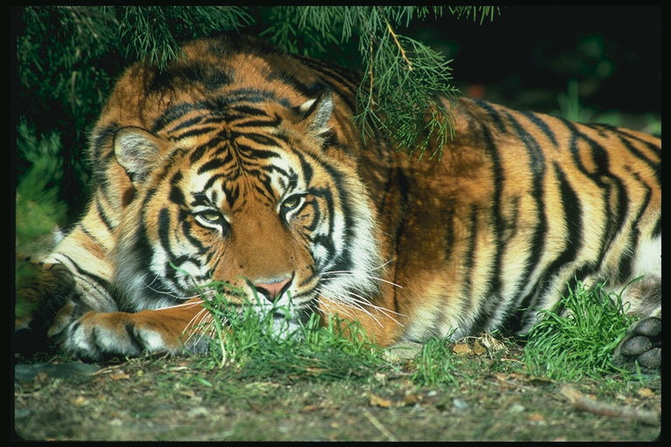
«Стоп кадр»
Амурский тигр
Notes:
Welcome to Power Jeopardy
© Don Link, Indian Creek School, 2004
You can easily customize this template to create your own Jeopardy game. Simply follow the step-by-step instructions that appear on Slides 1-3.

Slide 13
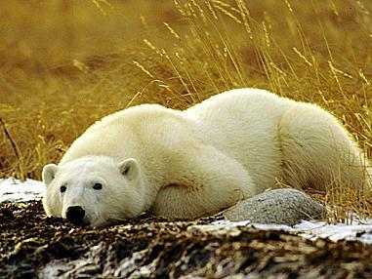
Белый медведь
Notes:
Welcome to Power Jeopardy
© Don Link, Indian Creek School, 2004
You can easily customize this template to create your own Jeopardy game. Simply follow the step-by-step instructions that appear on Slides 1-3.

Slide 14
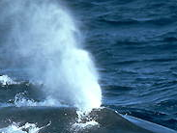
Синий кит
Notes:
Welcome to Power Jeopardy
© Don Link, Indian Creek School, 2004
You can easily customize this template to create your own Jeopardy game. Simply follow the step-by-step instructions that appear on Slides 1-3.

Slide 15
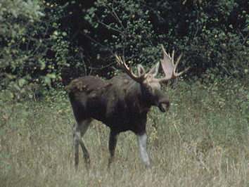
Лось
Notes:
Welcome to Power Jeopardy
© Don Link, Indian Creek School, 2004
You can easily customize this template to create your own Jeopardy game. Simply follow the step-by-step instructions that appear on Slides 1-3.

Slide 16
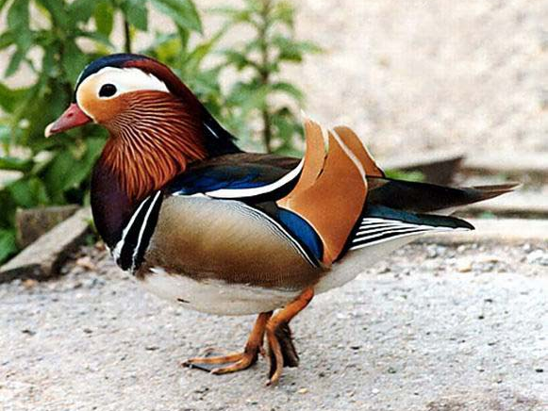
Мандаринка
Notes:
Welcome to Power Jeopardy
© Don Link, Indian Creek School, 2004
You can easily customize this template to create your own Jeopardy game. Simply follow the step-by-step instructions that appear on Slides 1-3.

Slide 17
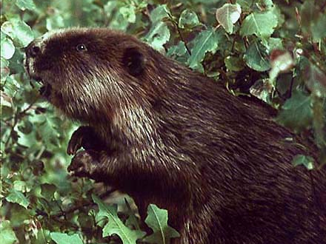
Речной бобр
Notes:
Welcome to Power Jeopardy
© Don Link, Indian Creek School, 2004
You can easily customize this template to create your own Jeopardy game. Simply follow the step-by-step instructions that appear on Slides 1-3.

Slide 18
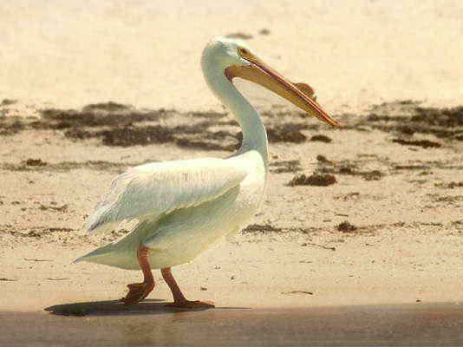
Пеликан
Notes:
Welcome to Power Jeopardy
© Don Link, Indian Creek School, 2004
You can easily customize this template to create your own Jeopardy game. Simply follow the step-by-step instructions that appear on Slides 1-3.

Slide 19
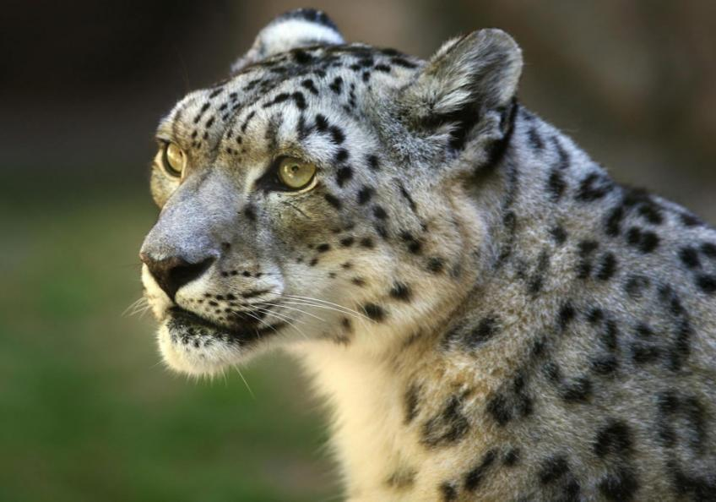
Снежный леопард
Notes:
Welcome to Power Jeopardy
© Don Link, Indian Creek School, 2004
You can easily customize this template to create your own Jeopardy game. Simply follow the step-by-step instructions that appear on Slides 1-3.

Slide 20
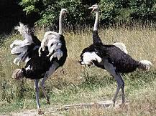
Страусы
Notes:
Welcome to Power Jeopardy
© Don Link, Indian Creek School, 2004
You can easily customize this template to create your own Jeopardy game. Simply follow the step-by-step instructions that appear on Slides 1-3.

Slide 21
«Найди ошибку»
1. Глухари вернулись с юга
Дома очень много дел:
Гнёзда нужно свить повыше,
Чтобы их медведь не съел.
Ответ
Глухари на зиму не улетают,
гнездятся на земле.
Notes:
Welcome to Power Jeopardy
© Don Link, Indian Creek School, 2004
You can easily customize this template to create your own Jeopardy game. Simply follow the step-by-step instructions that appear on Slides 1-3.

Slide 22
«Найди ошибку»
2. Ананасы собираем
Мы с деревьев поскорей,
Их склюёт иначе стая
Перелётных глухарей.
Ответ
Ананас – травянистое растение;
Глухари питаются лесными ягодами,
почками, хвоёй; глухари – осёдлые птицы.
Notes:
Welcome to Power Jeopardy
© Don Link, Indian Creek School, 2004
You can easily customize this template to create your own Jeopardy game. Simply follow the step-by-step instructions that appear on Slides 1-3.

Slide 23
«Поймай птицу»
а | й | р | о | г
а | л | к | е | в
о | с | н | и | л
к | ч | ь | а | к
т | к | л | с | о
о | с | а | о | а
Из данного количества букв составить названия птиц
Notes:
Welcome to Power Jeopardy
© Don Link, Indian Creek School, 2004
You can easily customize this template to create your own Jeopardy game. Simply follow the step-by-step instructions that appear on Slides 1-3.

Slide 24
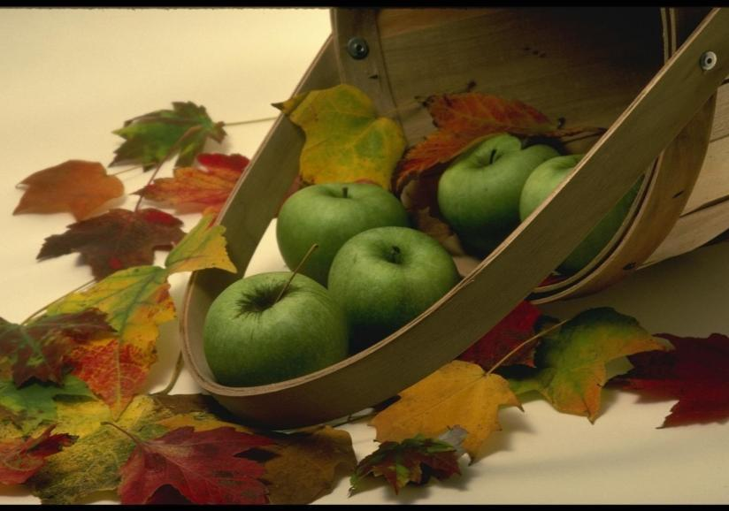
«Я рисую натюрморт»
Notes:
Welcome to Power Jeopardy
© Don Link, Indian Creek School, 2004
You can easily customize this template to create your own Jeopardy game. Simply follow the step-by-step instructions that appear on Slides 1-3.

Slide 25
Кроссворд «Гриб»
1. Пока дети – каждый в берете,
Повзрослели – шляпы надели.
Стоит на полянке в красном платье Татьянка, а платье всё в белых крапинках.
Под деревцем, под осинкой стоит мальчик с пальчик, на нём сер сарафанчик, красна шапочка.
Не спорю, не белый –
Я, братцы, попроще…
Расту я обычно в берёзовой роще.
Ответ
1. Грибы.
2.Мухомор.
3.Подосиновик.
4.Подберёзовик
Notes:
Welcome to Power Jeopardy
© Don Link, Indian Creek School, 2004
You can easily customize this template to create your own Jeopardy game. Simply follow the step-by-step instructions that appear on Slides 1-3.

Slide 26
Кроссворд
Домашнее насекомое.
Нелетающая птица.
Самое крупное животное.
Птица приносящая весну на крыльях.
Друг человека.
«След белого человека».
Дерево-гигант.
Лучший певец.
Царь зверей.
Дачный враг.
Первый весенний цветок.
Символ Канады.
Птица – цветок.
Русская красавица.
1 п ч е л а
2 с т р а у с
3 к и т
4 г р а ч
5 с о б а к а
6 п о д о р о ж н и к
7 б а о б а б
8 с о л о в е й
9 л е в
10 м е д в е д к а
11 п о д н е ж н и к
12 к л ё н
13 к о л и б р и
14 б е р ё з к а
Notes:
Welcome to Power Jeopardy
© Don Link, Indian Creek School, 2004
You can easily customize this template to create your own Jeopardy game. Simply follow the step-by-step instructions that appear on Slides 1-3.

