Slide 1
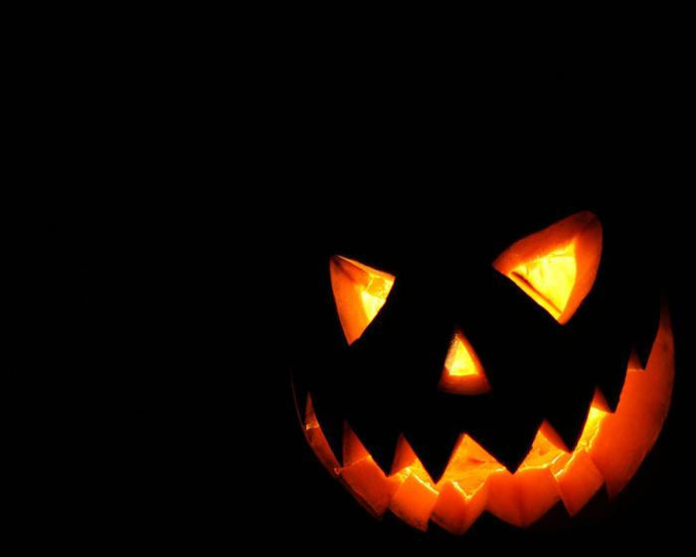
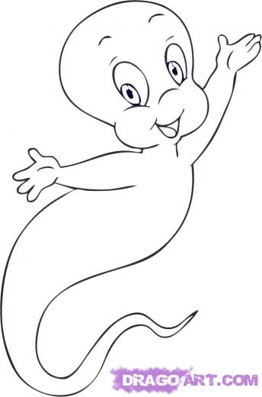
The first team is “Ghosts”
We are not boring
Don’t be worry!

Slide 2
The second team is “Ghost hunters”
Ghost hunters are the best,
you won't have a rest

Slide 3
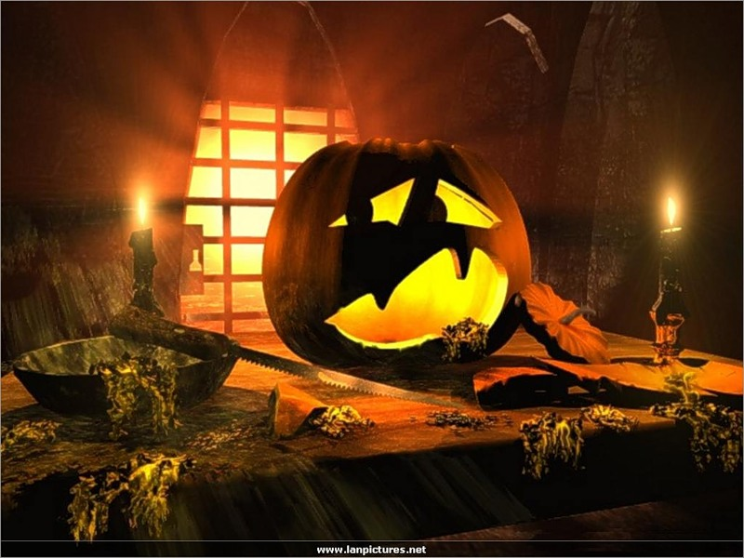
4 IMPORTANT FACTS ABOUT HALLOWEEN
1. Halloween is one of the oldest festivals in Great Britain.
2. Halloween is celebrated on October 31st.
3. The full name of the festival is “All Hallows Eve”.

Slide 4
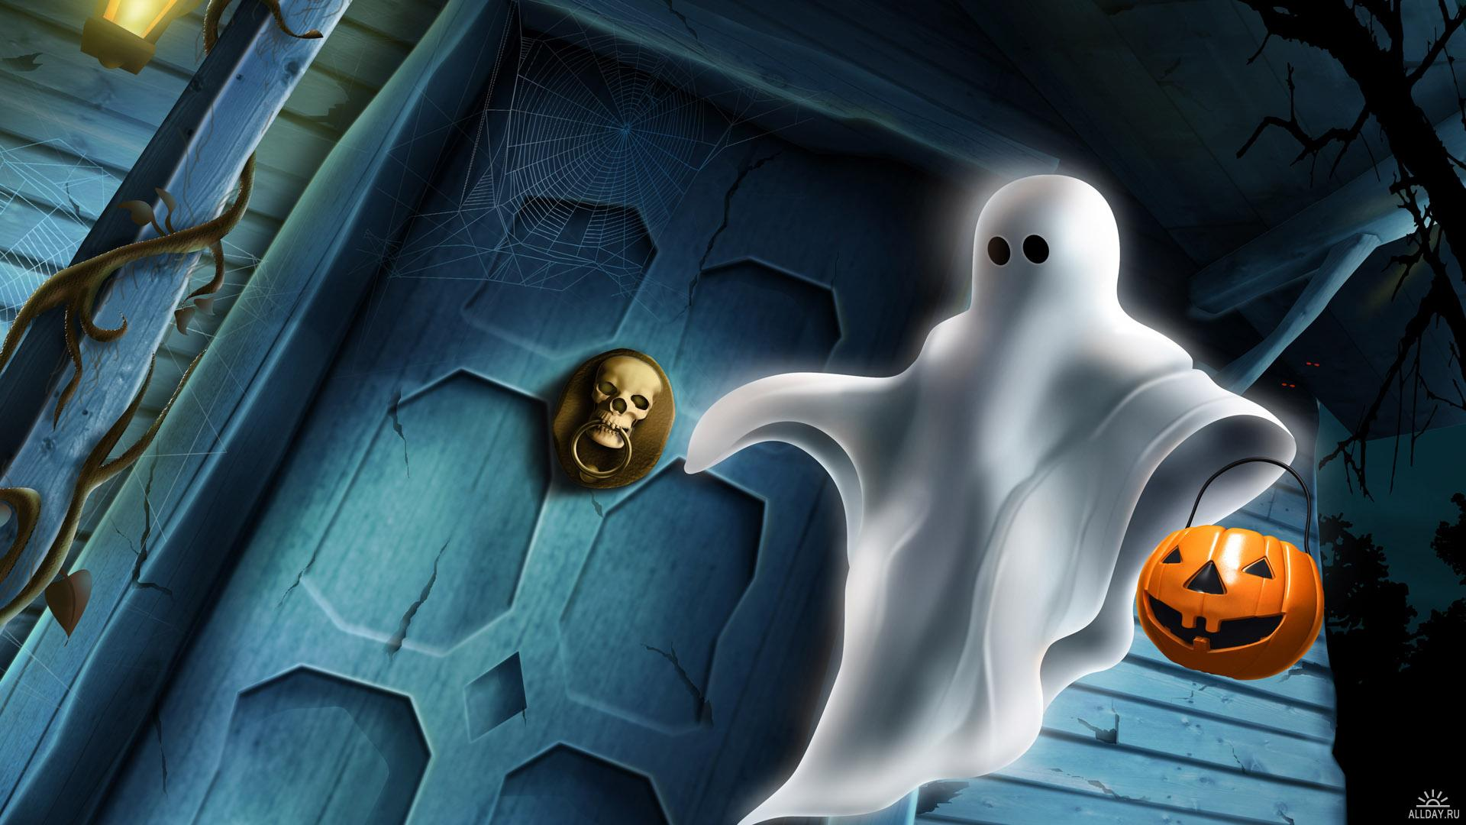
Halloween

Slide 5
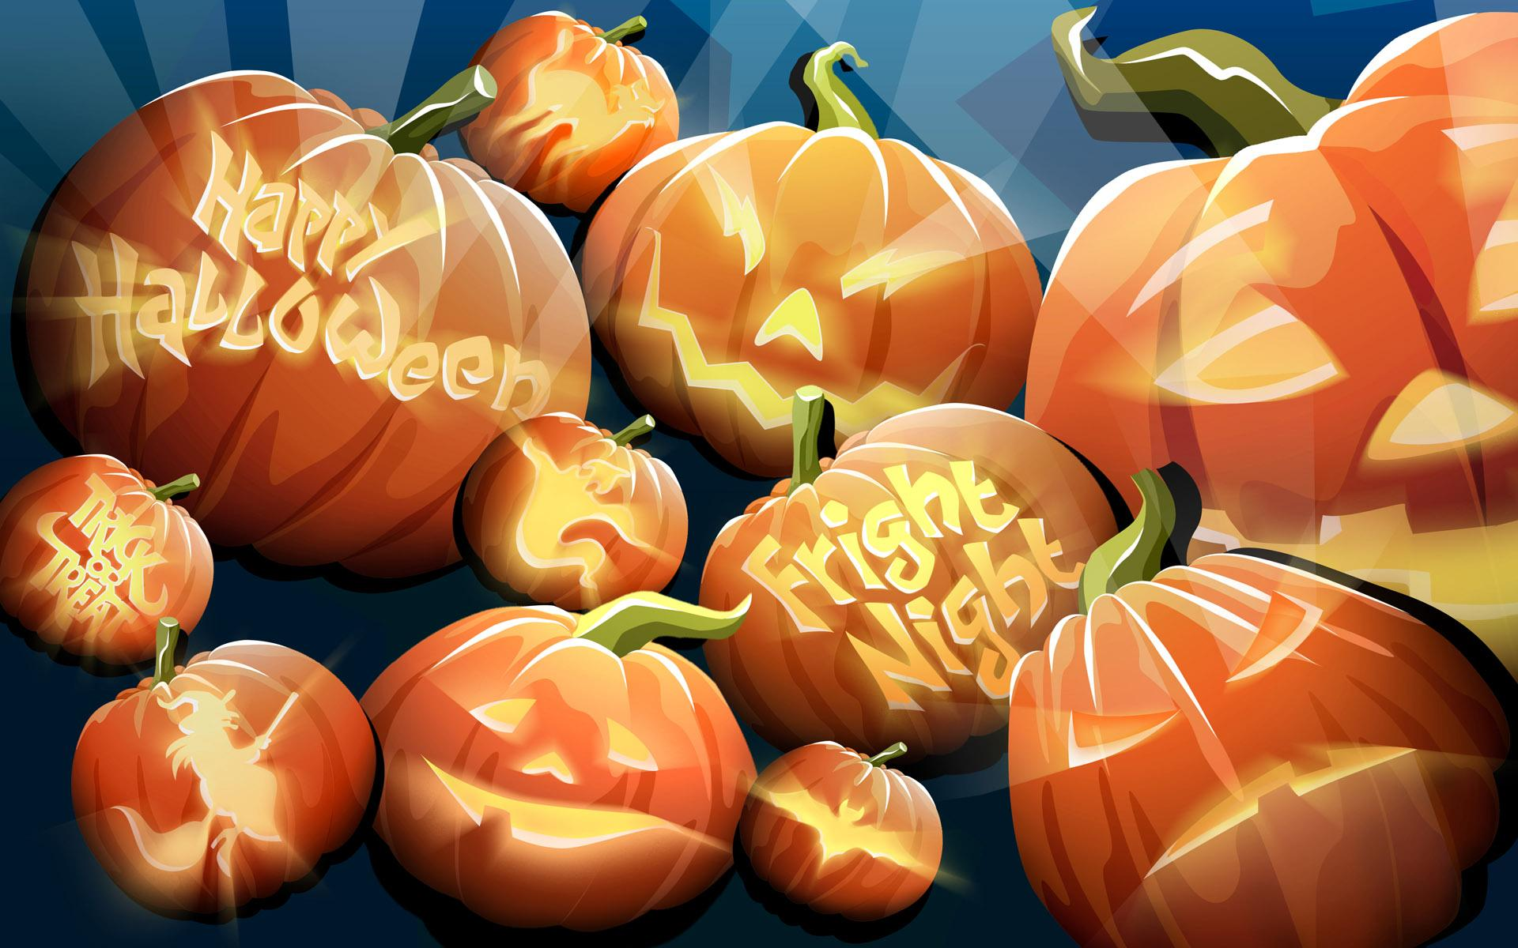
The history of Halloween
People celebrated New Year on November 1st. It was a holiday of the end of the“Sun Season” and the start of the “Dark and Cold Season”. People made lamps of pumpkins and said «These lamps help the sun to live in winter»

Slide 6
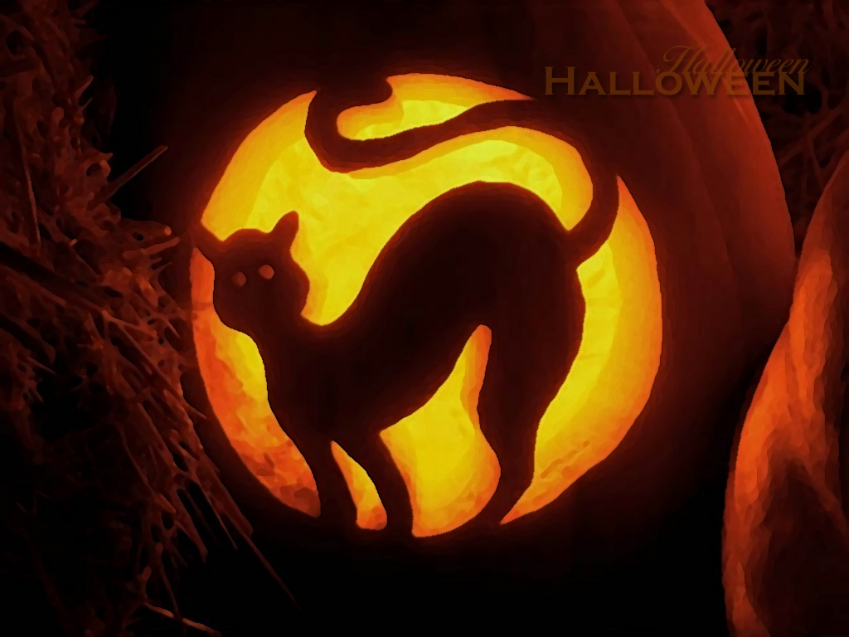
In the year 835 the Roman Catholic Church made the 1st of November a church holiday of all saints, who do not have a special day in the year.

Slide 7
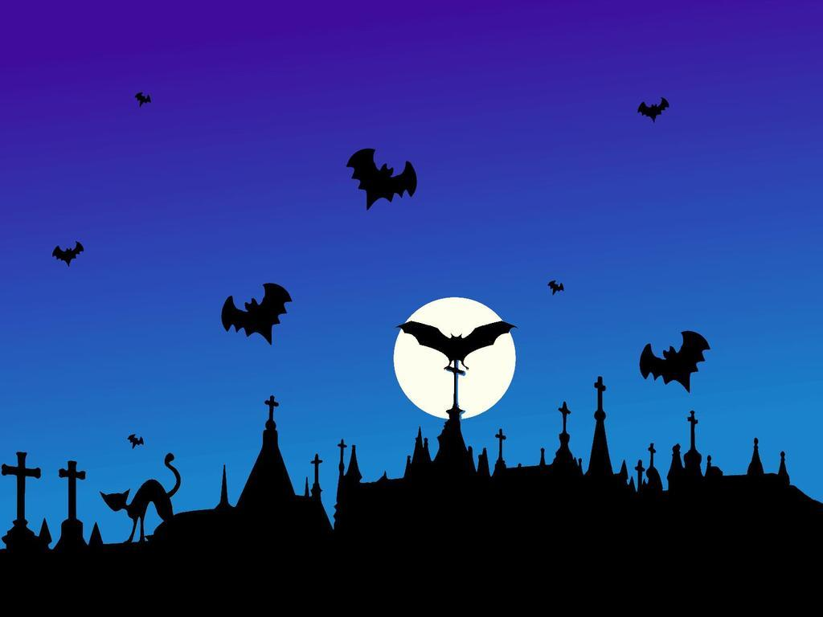
This holiday was called “All Saints Day” or “All Hallows Day”.

Slide 8
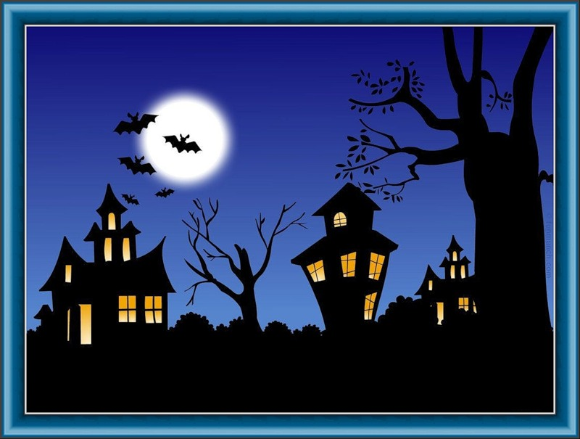
People started to celebrate another holiday on October 31st “All Hallows Eve”. Now we call this festival “Halloween”.

Slide 9
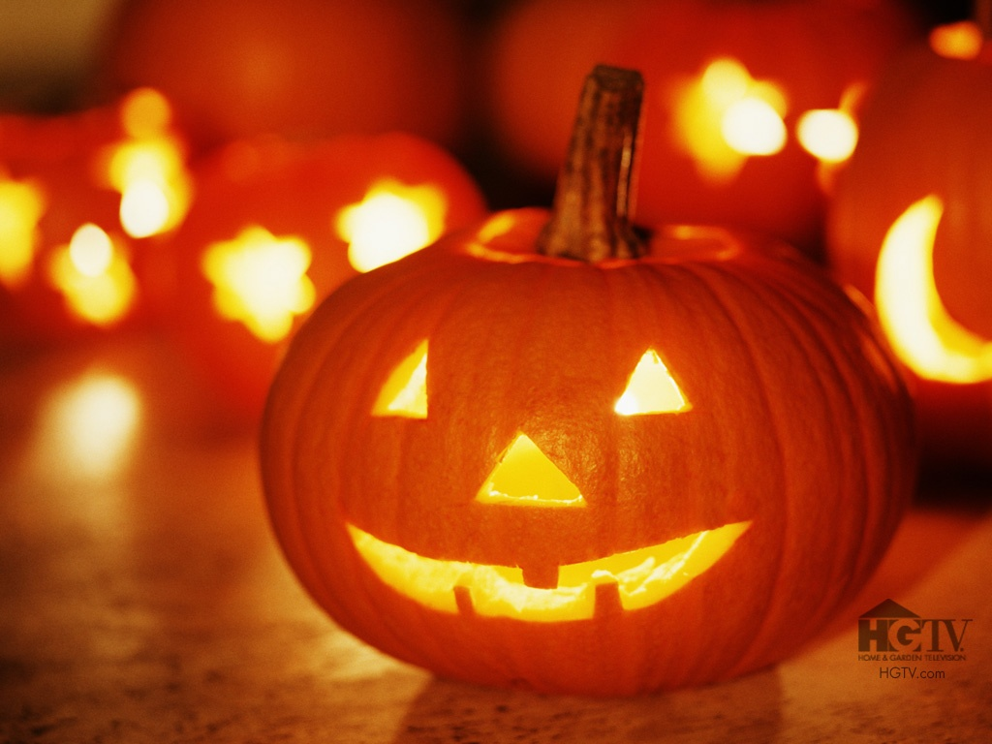
Traditions of Halloween

Slide 10
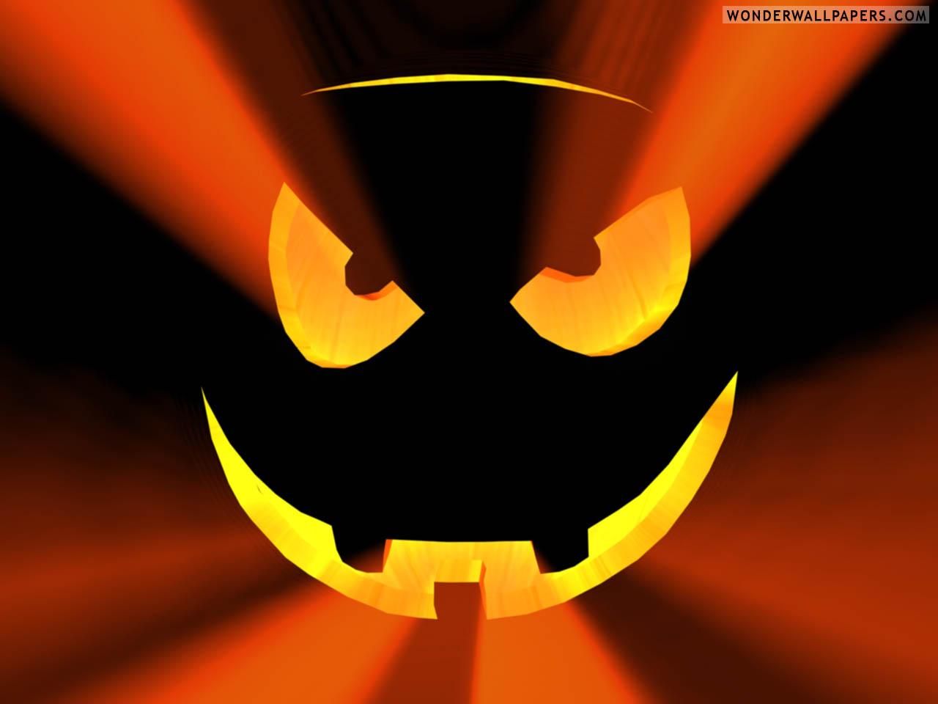
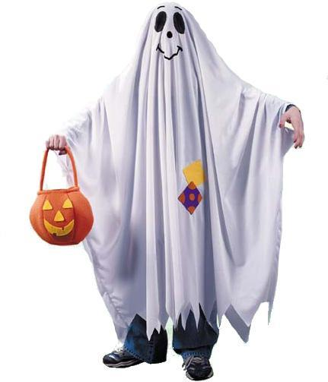
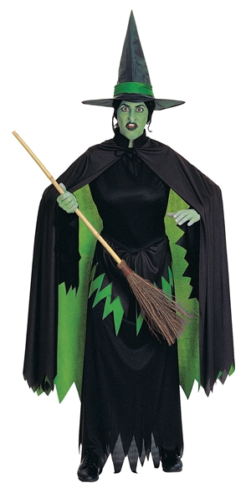
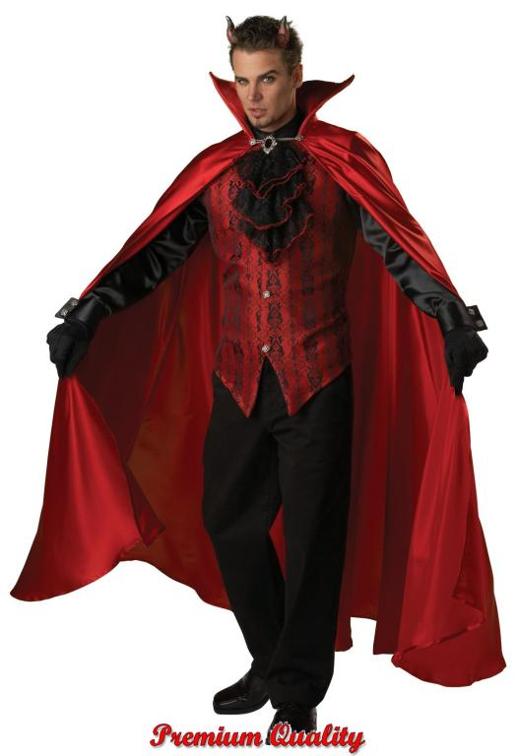
People dress up as witches, ghosts, devils, cats or bats

Slide 11
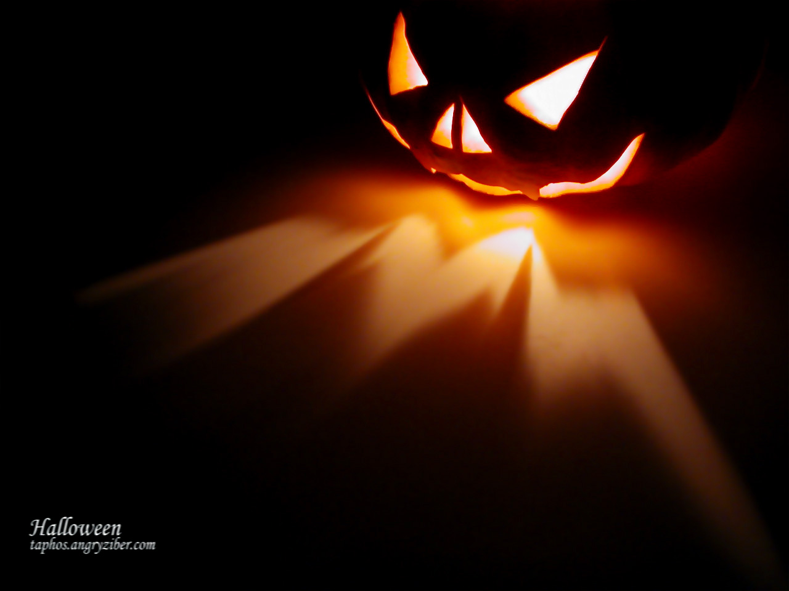
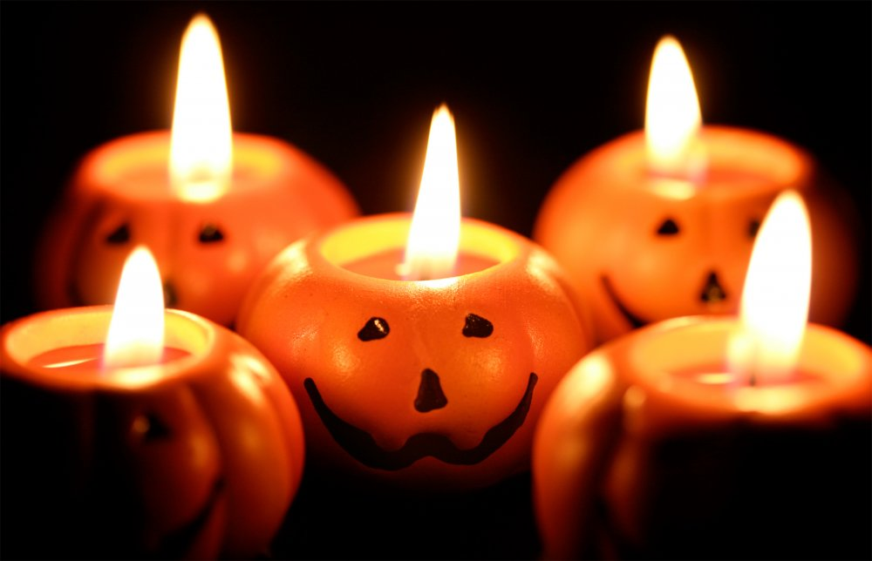
Houses are decorated with pumpkins, candles and lamps

Slide 12
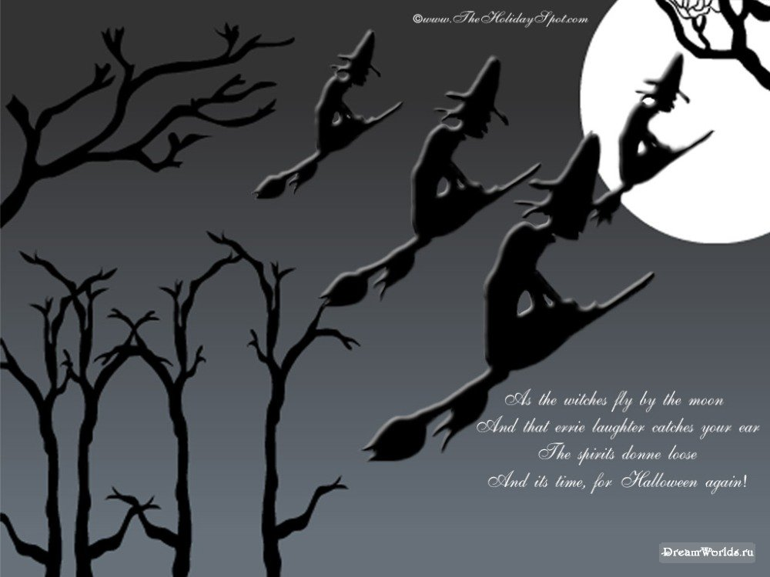
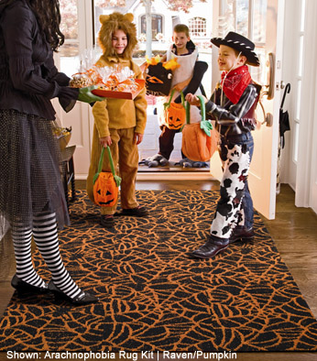
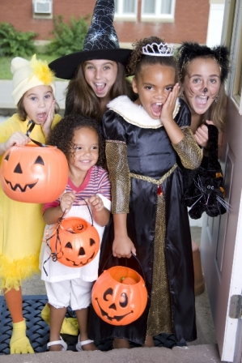
Trick or Treat

