Slide 1
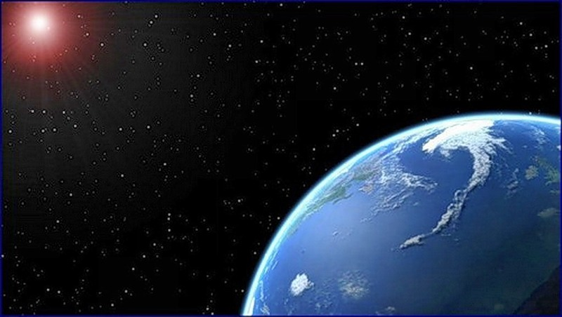
«The Earth is in the illuminator»

Slide 2
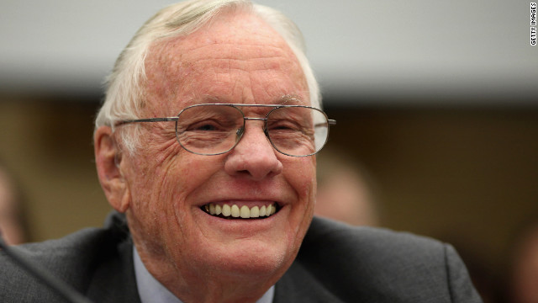
The first man on the moon.
Nil Armstrong

Slide 3
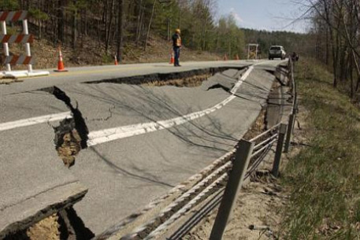
A sudden shaking of the ground.
An earthquake

Slide 4
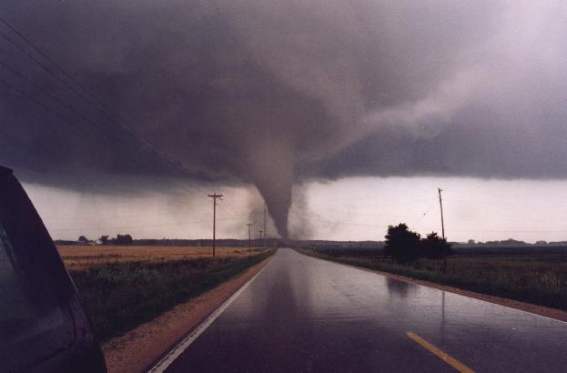
Tornadoes are most often in…
the USA

Slide 5
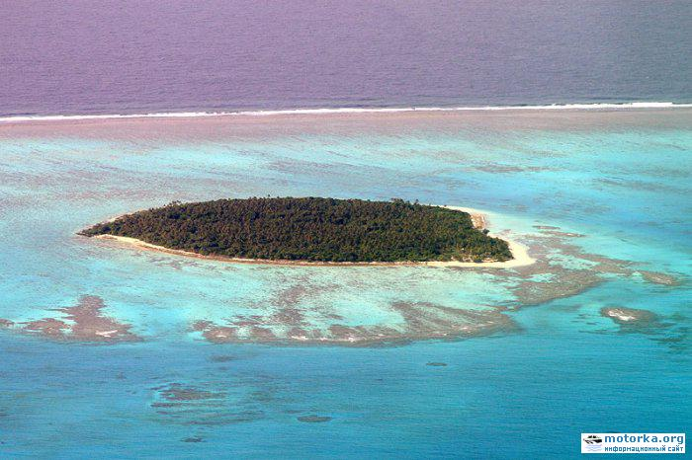
Six Robinsons lived on the island of…
Ata

Slide 6
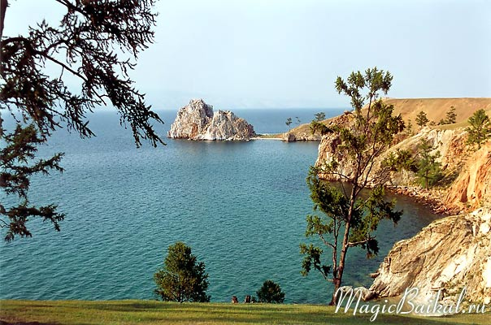
The deepest lake in the world.
Lake of Baikal

Slide 7
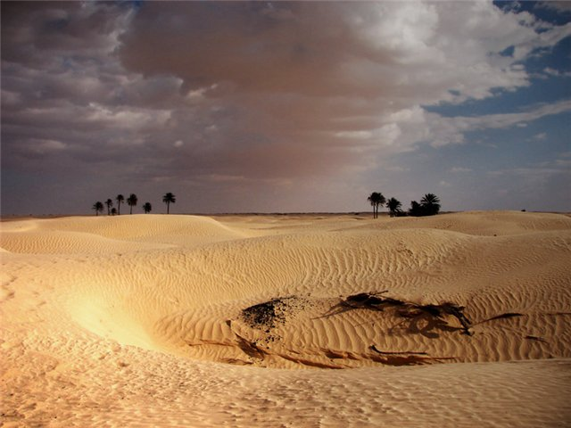
The hottest place in the world.
Sahara Desert

Slide 8
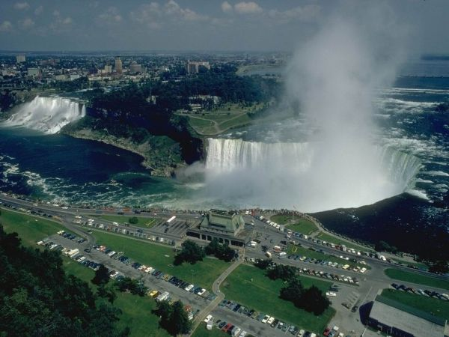
The Niagara Falls is in …
the USA

Slide 9
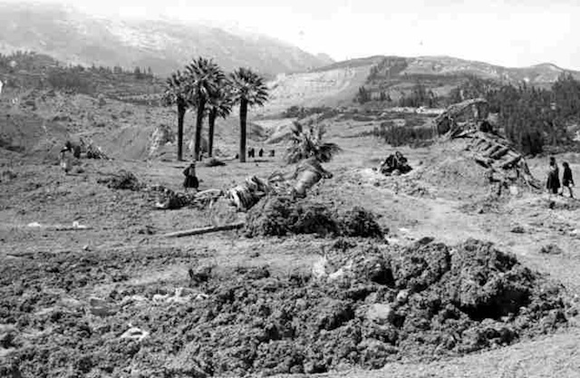
The Yungay Earthquake happened on May 31st
1970

Slide 10
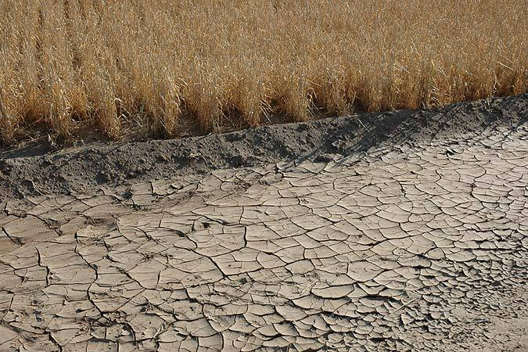
A long period of dry weather when there is not enough water.
A drought

Slide 11
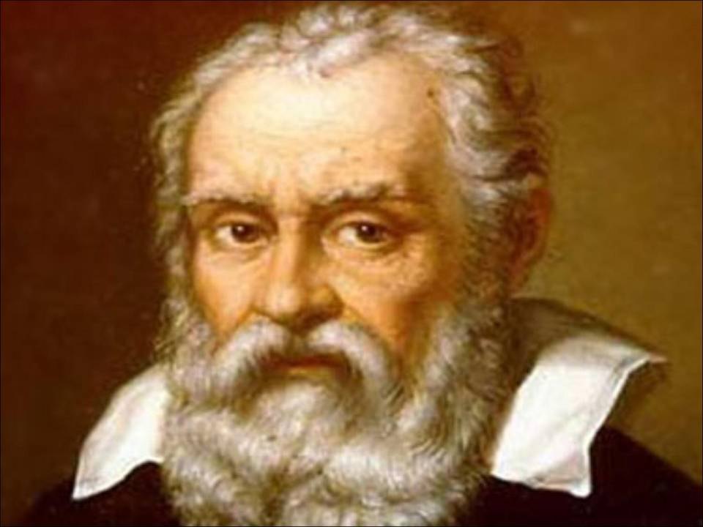
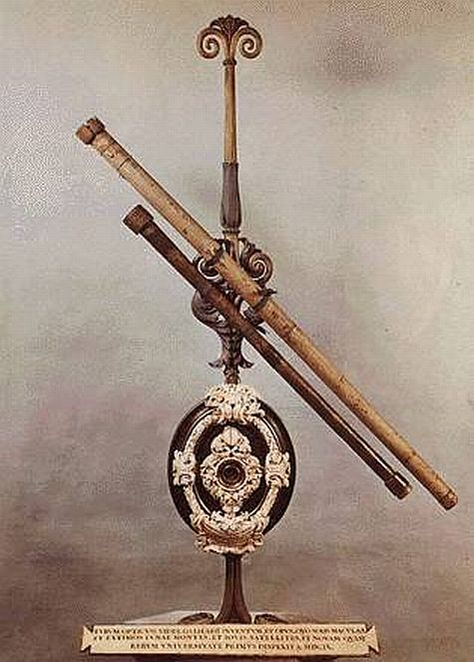
A man who made the first telescope.
Galileo

Slide 12
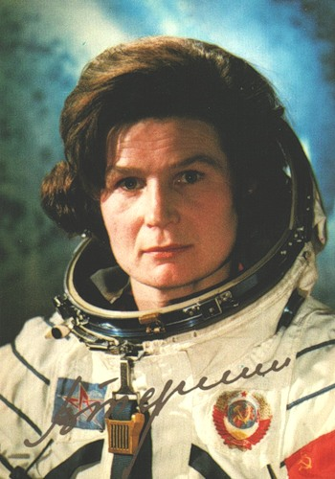
The first woman in space.
Valentine Tereshkova

Slide 13
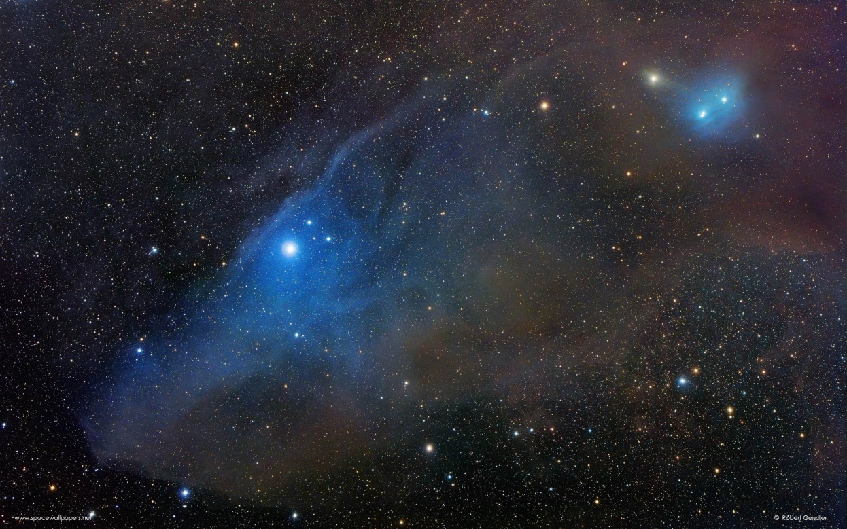
All space and everything that exists in it.
The Universe

Slide 14
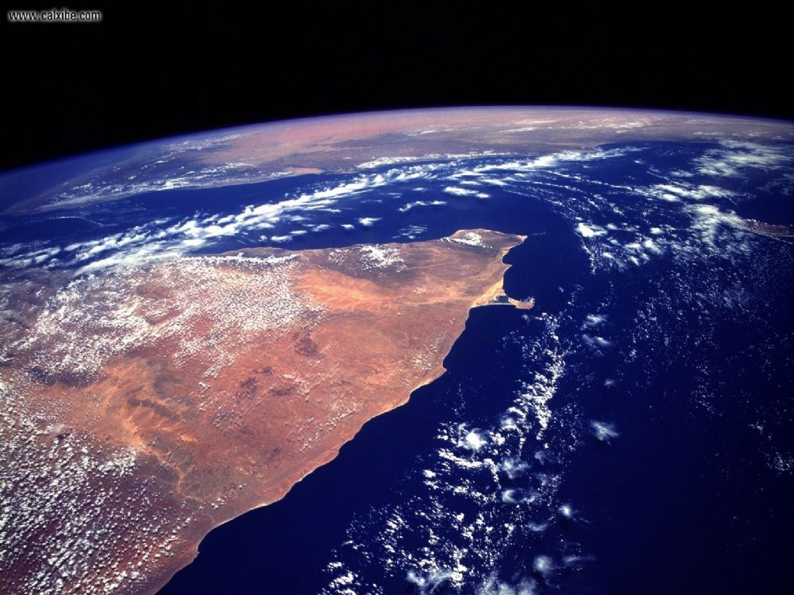
The oceans contain … % of all the water on the Earth.
97

Slide 15
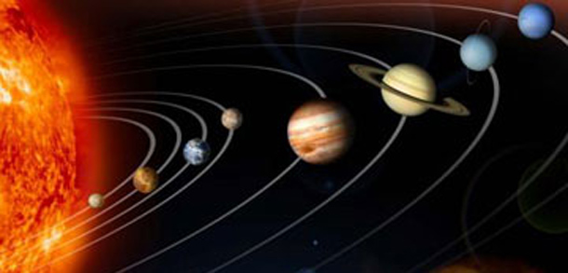
The Sun together with the planets going round it.
The Solar System

Slide 16
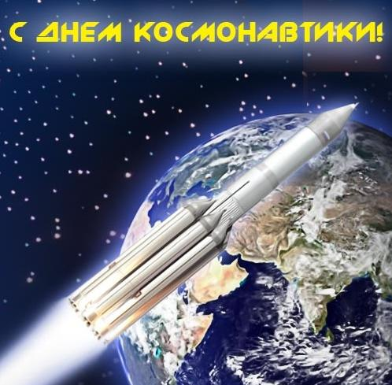
Space day in Rassia.
12th of April

Slide 17
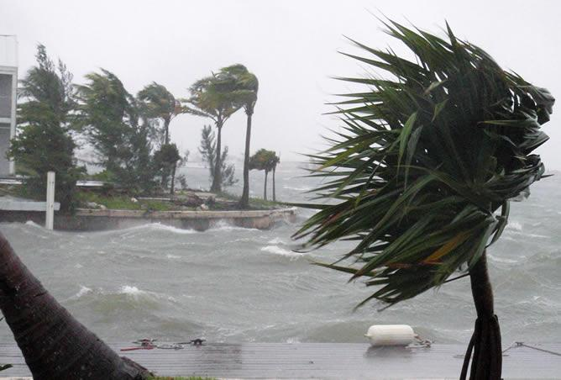
A very violent wind of storm.
A hurricane

Slide 18
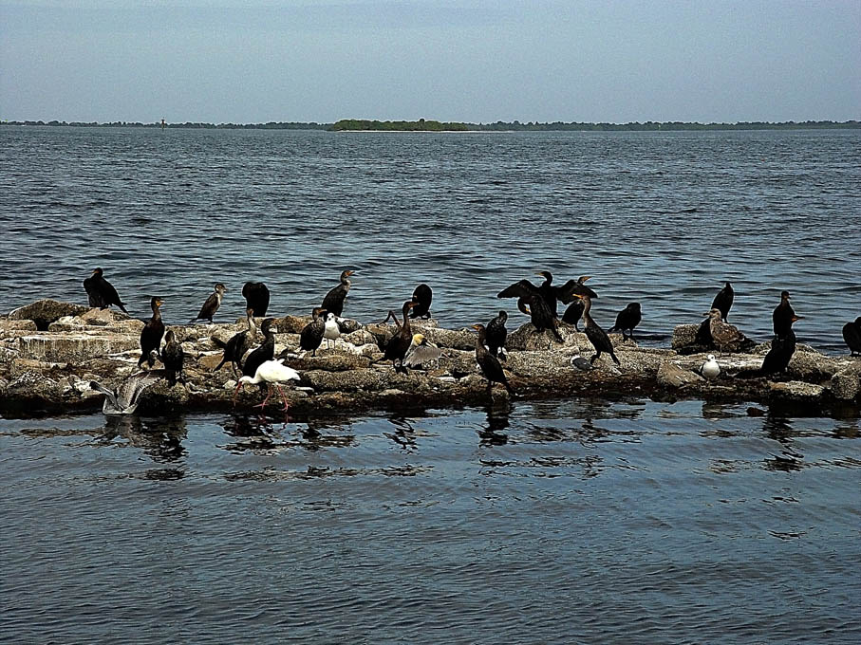
Kingdom of birds.
New Zealand

Slide 19
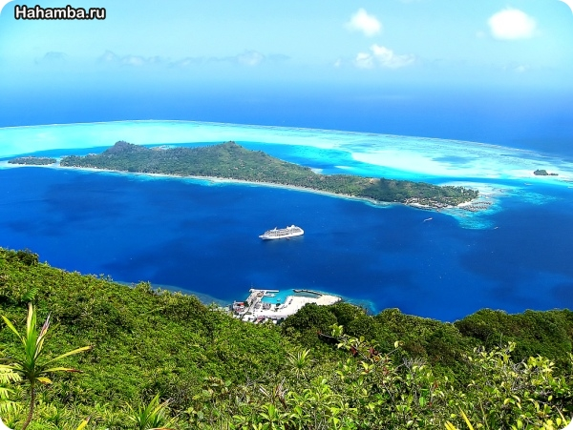
The largest ocean in the world.
The Pacific Ocean

Slide 20
Thank you for your attention.

