Slide 3
The Golden Age of the Russian Avant-Garde

Slide 4
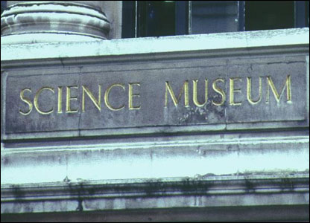
Exhibition at the Science Museum, London about Russian space exploration

Slide 5
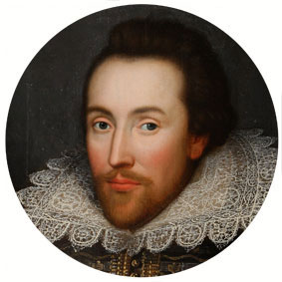
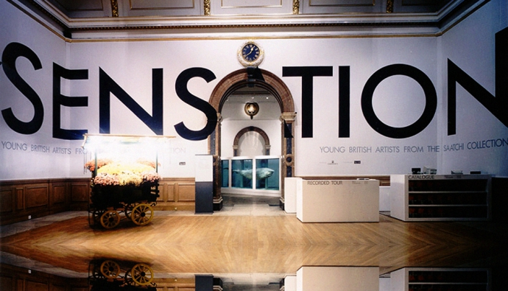
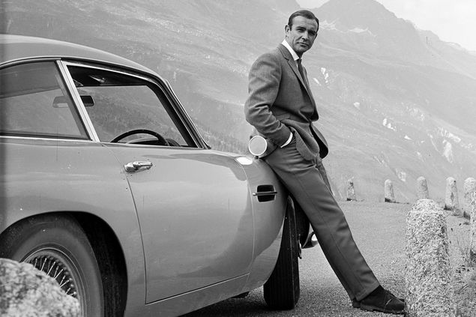
Shakespeare’s 450th birthday
Designing 007: Fifty Years of Bond Style
Challenging Boundaries: Breakthroughs in British Art

Slide 6
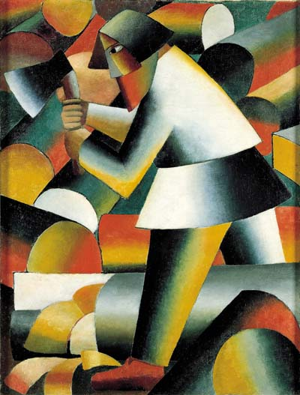
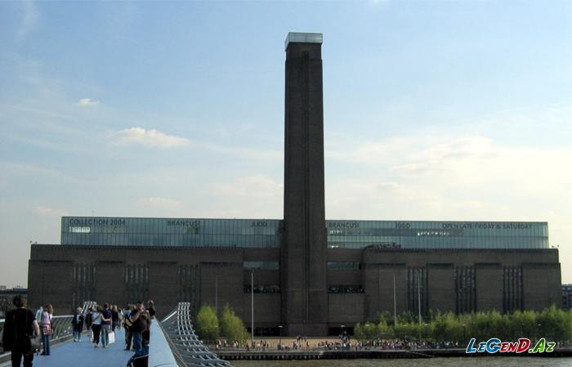
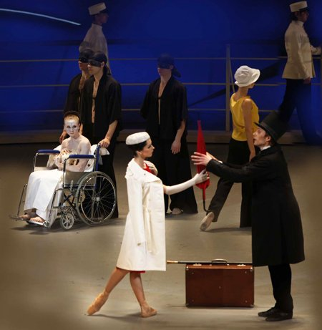
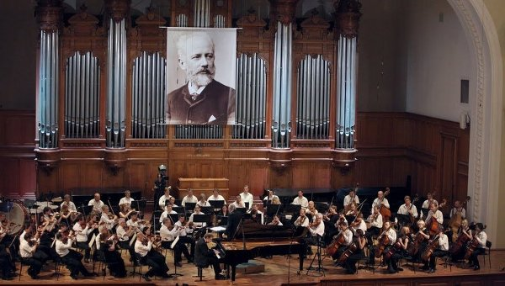
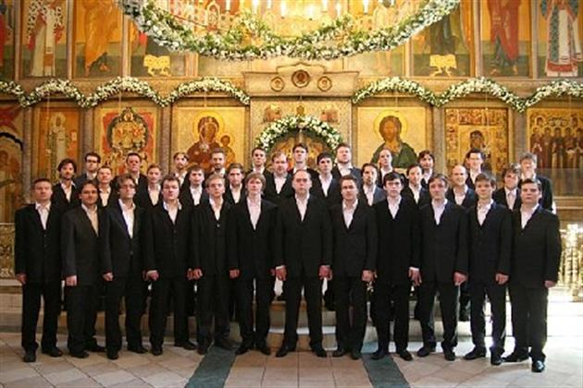
the Tate Modern
Malevich
the Stanislavsky and Nemirovich-Danchenko Moscow Musical Academic Theatre
the Tchaikovsky Symphony Orchestra
Sretensky Monastery Choir

Slide 7
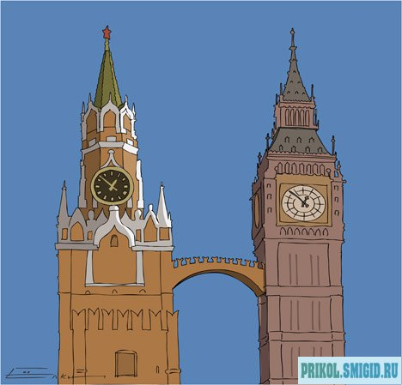
30.04.2014

Slide 8
In our Program Today:
Meet the Teams! (Team Greetings)
Brain Ring “Explore Great Britain”
Warm up
Buy a Piggie in a Poke
Celebrities
Auction
Actors contest (Acting out Jazz Chants)
Speaker’s contest (The Greatest Monarchs of the UK)
Let’s Sing!

