Slide 1
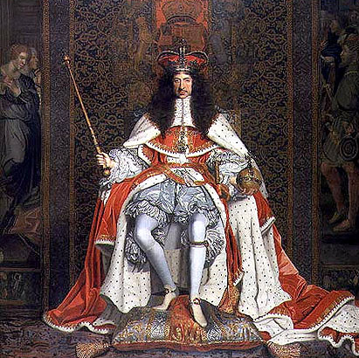
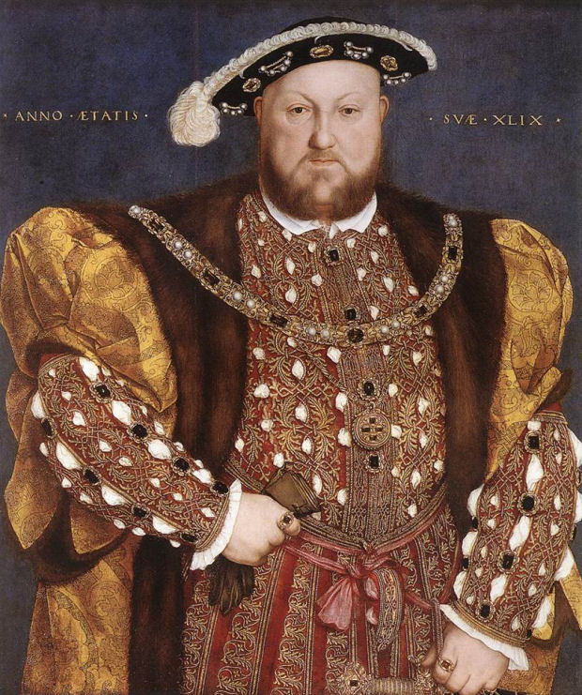
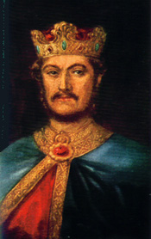
HISTORY
1. Who was King of England first?
Charles II,
Henry VIII,
Richard I

Slide 2
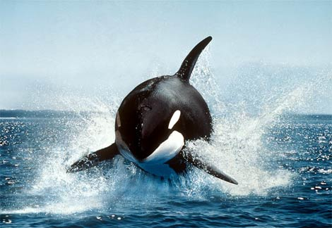
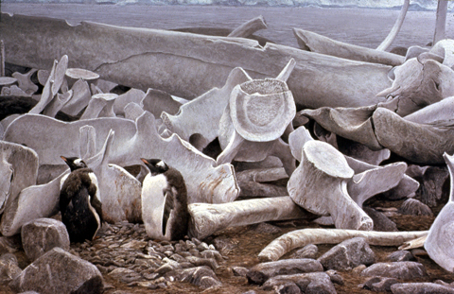
HISTORY
2. In Tudor times, did women use whalebones for
cooking,
clothing,
cleaning

Slide 3
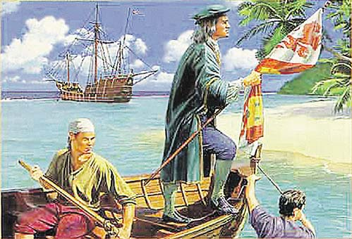
HISTORY
3. When did Christopher Columbus discover America ?
In 1592,
In 1302,
In 1492

Slide 4
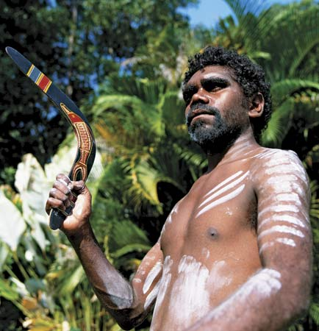
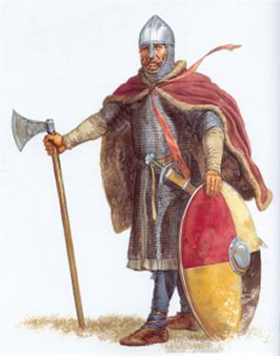
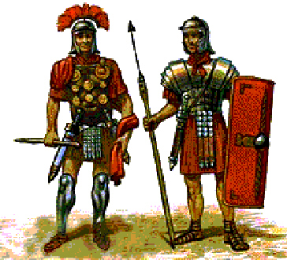
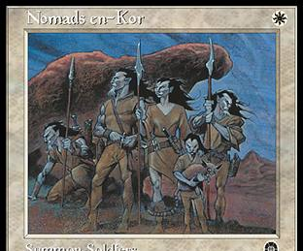
HISTORY
4. Which people were Australian aborigines?
The Vikings,
The Romans,
The Nomads

Slide 5
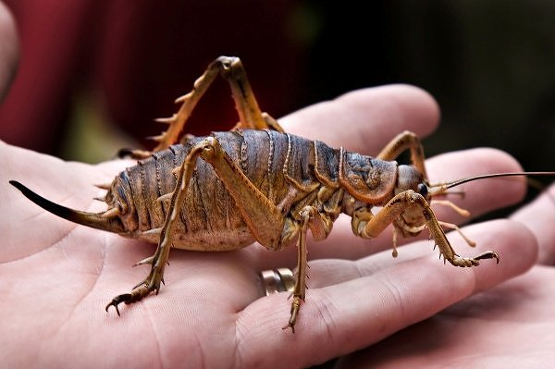
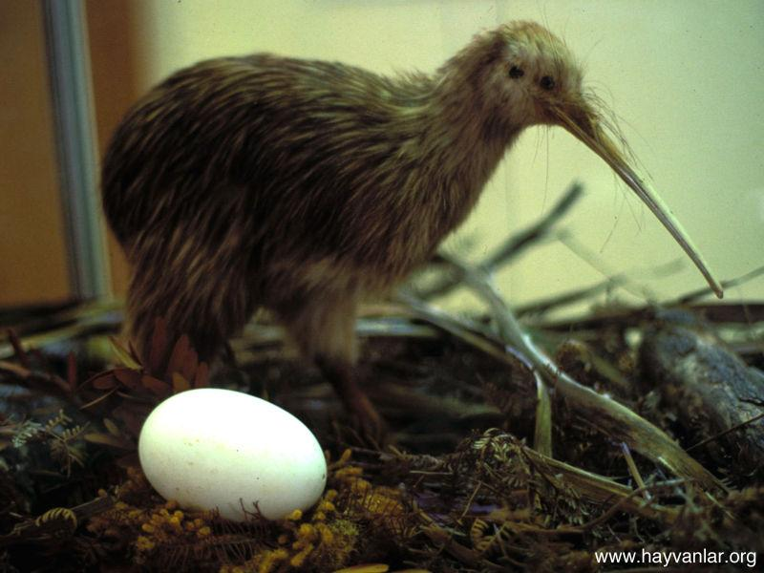
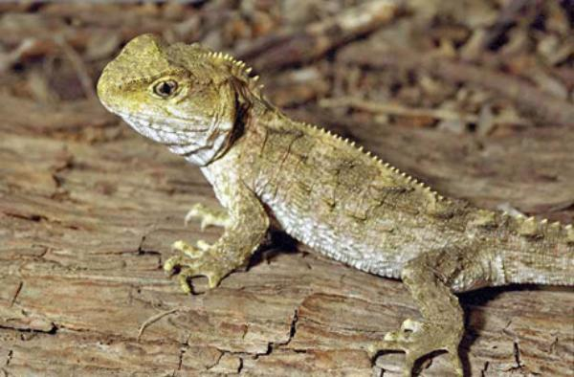
HISTORY
5. Which of the following has survived in New Zealand from the era of the dinosaurs?
Weta (the largest and heaviest insect in the world),
Kiwi (a bird which cannot fly),
tuatara (a reptile)

Slide 6
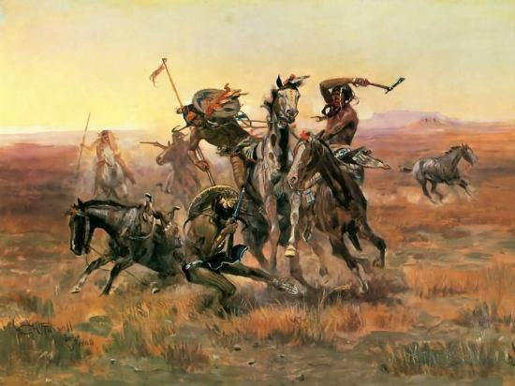
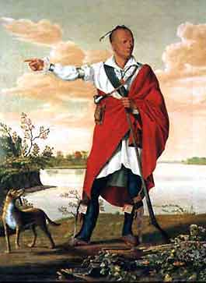
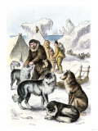
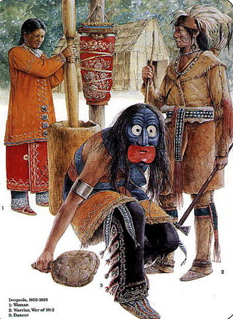
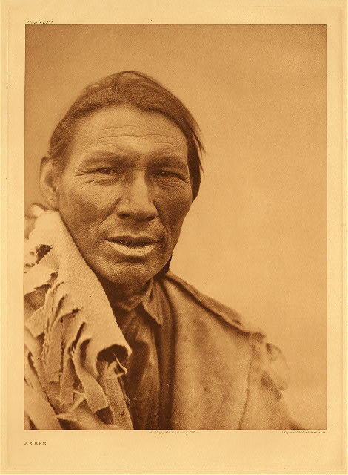
HISTORY
6. The Crees, Mohawks, Iroquois, Sioux, Innuits - are these native peoples from
Canada
America
Australia

Slide 7
HISTORY

Slide 8
HISTORY
1. Who was King of England first?
Charles II,
Henry VIII,
Richard I

Slide 9
HISTORY
Who was King of England first?
Charles II, 1649-1685
Henry VIII, 1509-1547
Richard I – 1189-1199

Slide 10
HISTORY
2. In Tudor times, did women use whalebones for
cooking,
clothing,
cleaning

Slide 11
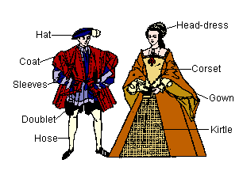
HISTORY
2. In Tudor times, did women use whalebones for
cooking,
clothing,
cleaning

Slide 12
HISTORY
3. When did Christopher Columbus discover America ?
In 1592,
In 1302,
In 1492

Slide 13
HISTORY
3. When did Christopher Columbus discover America ?
In 1592,
In 1302,
In 1492

Slide 14
HISTORY
4. Which people were Australian aborigines?
The Vikings,
The Romans,
The Nomads

Slide 15
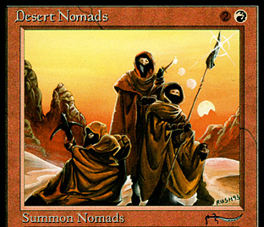
HISTORY
4. Which people were Australian aborigines?
The Vikings,
The Romans,
The Nomads

Slide 16
HISTORY
5. Which of the following has survived in New Zealand from the era of the
dinosaurs?
Weta (the largest and heaviest insect in the world),
Kiwi (a bird which cannot fly),
tuatara (a reptile)

Slide 17
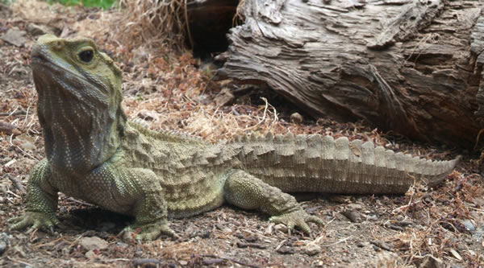
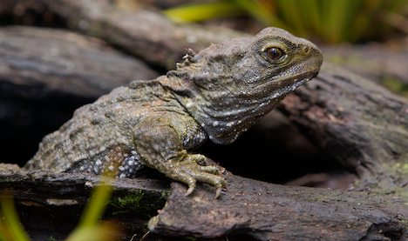
HISTORY
5. Which of the following has survived in New Zealand from the era of the
dinosaurs?
Weta (the largest and heaviest insect in the world),
Kiwi (a bird which cannot fly),
tuatara (a reptile)

Slide 18
HISTORY
6. The Crees, Mohawks, Iroquois, Sioux, Innuits - are these native peoples from
Canada
America
Australia

Slide 19
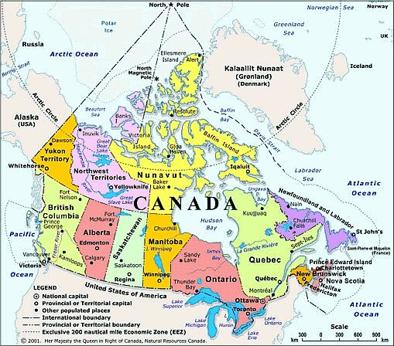
HISTORY
6. The Crees, Mohawks, Iroquois, Sioux, Innuits - are these native peoples from
Canada
America
Australia

