Slide 1
Этот трудный звук Р
Выполнила Шишкина Наталья Геннадьевна,
Учитель-логопед МБУ детского сада № 147 «Сосенка»
г.о.Тольятти

Slide 2
Давайте поиграем
Произнеси звук Р
Назови картинки со звуком Р
Отбери картинки со звуком Р

Slide 3
«Произнеси звук «Р»

Slide 4
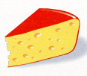
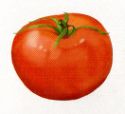
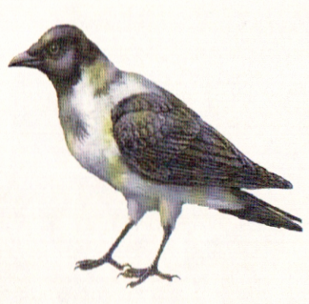
Назови картинки со звуком Р

Slide 5
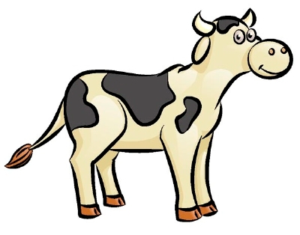
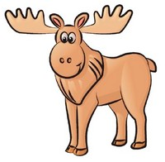
Отбери картинки со звуком Р

Slide 6
Информационные источники
http://karapuzya.com.ua/storage/products/0/0/4/3/8/6/305-20100115_120630.jpg
http://go.mail.ru/search_images?q=%D0%BA%D0%B0%D1%80%D1%82%D0%B8%D0%BD%D0%BA%D0%B8%20%D0%B0%D1%80%D1%82%D0%B8%D0%BA%D1%83%D0%BB%D1%8F%D1%86%D0%B8%D0%BE%D0%BD%D0%BD%D0%B0%D1%8F%20%D0%B3%D0%B8%D0%BC%D0%BD%D0%B0%D1%81%D1%82%D0%B8%D0%BA%D0%B0&rch=l&jsa=1&fr=web&fs=1#w=250&h=236&s=34196&pic=http%3A%2F%2Flogoportal.ru%2Fwp-content%2Fuploads%2F2011%2F12%2Fbaraban.jpg&page=http%3A%2F%2Flogoportal.ru%2Fartikulyatsionnyie-uprazhneniya%2F.html&descr=%D0%90%D1%80%D1%82%D0%B8%D0%BA%D1%83%D0%BB%D1%8F%D1%86%D0%B8%D0%BE%D0%BD%D0%BD%D0%B0%D1%8F%20%D0%B3%D0%B8%D0%BC%D0%BD%D0%B0%D1%81%D1%82%D0%B8%D0%BA%D0%B0%20-%20%D1%83%D0%BF%D1%80%D0%B0%D0%B6%D0%BD%D0%B5%D0%BD%D0%B8%D0%B5%20%D0%91%D0%B0%D1%80%D0%B0%D0%B1%D0%B0%D0%BD
http://go.mail.ru/search_images?q=%D0%BA%D0%B0%D1%80%D1%82%D0%B8%D0%BD%D0%BA%D0%B8%20%D0%B0%D1%80%D1%82%D0%B8%D0%BA%D1%83%D0%BB%D1%8F%D1%86%D0%B8%D0%BE%D0%BD%D0%BD%D0%B0%D1%8F%20%D0%B3%D0%B8%D0%BC%D0%BD%D0%B0%D1%81%D1%82%D0%B8%D0%BA%D0%B0&rch=l&jsa=1&fr=web&fs=1#w=200&h=197&s=72508&pic=http%3A%2F%2Fvoproskmame.com%2Fpages5%2Fa2.jpg&page=http%3A%2F%2Fvoproskmame.com%2Findex%2Fzarjadka_dlja_jazychka_i_gub_ot_julii_kasparovoj%2F0-141&descr=%D0%90%D1%80%D1%82%D0%B8%D0%BA%D1%83%D0%BB%D1%8F%D1%86%D0%B8%D0%BE%D0%BD%D0%BD%D0%B0%D1%8F%20%D0%B3%D0%B8%D0%BC%D0%BD%D0%B0%D1%81%D1%82%D0%B8%D0%BA%D0%B0%20%D0%B4%D0%BB%D1%8F%20%D1%8F%D0%B7%D1%8B%D1%87%D0%BA%D0%B0
http://go.mail.ru/search_images?q=%D0%BA%D0%B0%D1%80%D1%82%D0%B8%D0%BD%D0%BA%D0%B8%20%D0%B0%D1%80%D1%82%D0%B8%D0%BA%D1%83%D0%BB%D1%8F%D1%86%D0%B8%D0%BE%D0%BD%D0%BD%D0%B0%D1%8F%20%D0%B3%D0%B8%D0%BC%D0%BD%D0%B0%D1%81%D1%82%D0%B8%D0%BA%D0%B0&rch=l&jsa=1&fr=web&fs=1#w=742&h=606&s=98412&pic=http%3A%2F%2Fwww.school2.lubino.omskedu.ru%2Fstr32.files%2Fimage008.gif&page=http%3A%2F%2Fwww.school2.lubino.omskedu.ru%2Fstr32.htm&descr=%D0%BB%D0%BE%D0%B3%D0%BE%D0%BF%D0%B5%D0%B4%20%7C%20image008%20%7C%20%D0%9B%D1%8E%D0%B1%D0%B8%D0%BD%D1%81%D0%BA%D0%B0%D1%8F%20%D0%A1%D0%9E%D0%A8%20%E2%84%962%20%7C%20%D0%A3%D1%87%D0%B8%D1%82%D0%B5%D0%BB%D1%8C-%D0%BB%D0%BE%D0%B3%D0%BE%D0%BF%D0%B5%D0%B4...
http://go.mail.ru/search_images?q=%D0%BA%D0%B0%D1%80%D1%82%D0%B8%D0%BD%D0%BA%D0%B8%20%D0%B0%D1%80%D1%82%D0%B8%D0%BA%D1%83%D0%BB%D1%8F%D1%86%D0%B8%D0%BE%D0%BD%D0%BD%D0%B0%D1%8F%20%D0%B3%D0%B8%D0%BC%D0%BD%D0%B0%D1%81%D1%82%D0%B8%D0%BA%D0%B0&rch=l&jsa=1&fr=web&fs=1#w=236&h=354&s=45309&pic=http%3A%2F%2Fdetsad-kitty.ru%2Fuploads%2Fposts%2F2010-08%2F1281456614_a.jpg&page=http%3A%2F%2Fdetsad-kitty.ru%2Fmetod%2Fkonsp%2Fprint%3Apage%2C1%2C3898-kartochki-dlya-artikulyacionnoj-gimnastiki.html&descr=%D0%9A%D0%B0%D1%80%D1%82%D0%BE%D1%87%D0%BA%D0%B8%20%D0%B4%D0%BB%D1%8F%20%D0%B0%D1%80%D1%82%D0%B8%D0%BA%D1%83%D0%BB%D1%8F%D1%86%D0%B8%D0%BE%D0%BD%D0%BD%D0%BE%D0%B9%20%D0%B3%D0%B8%D0%BC%D0%BD%D0%B0%D1%81%D1%82%D0%B8%D0%BA%D0%B8.
http://900igr.net/datai/doshkolnoe-obrazovanie/Avtomatizatsija-zvuka-R/0005-004-Avtomatizatsija-zvuka-r-na-urovne-slov.png
http://900igr.net/datai/doshkolnoe-obrazovanie/Avtomatizatsija-zvuka-R/0006-017-Avtomatizatsija-zvuka-r-na-urovne-slovosochetanij.png
http://900igr.net/datai/doshkolnoe-obrazovanie/Avtomatizatsija-zvuka-R/0007-029-Rastsveli-na-klumbe.png
http://logoped.ru/images/agadav02j.jpg

