Slide 1


Slide 2
____ + _____ = ?
____ - _____ = ?

Slide 3
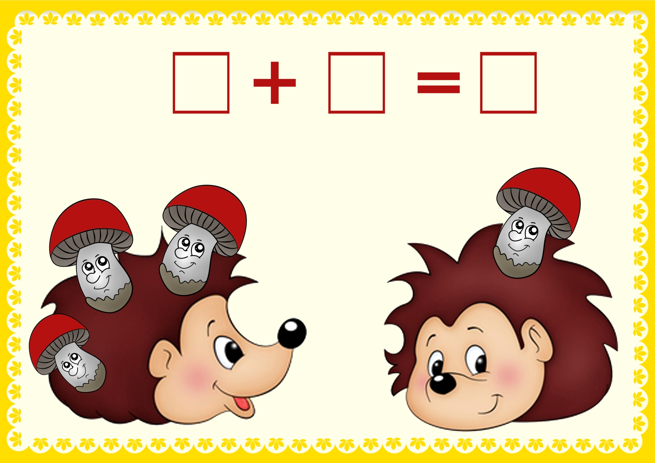

Slide 4
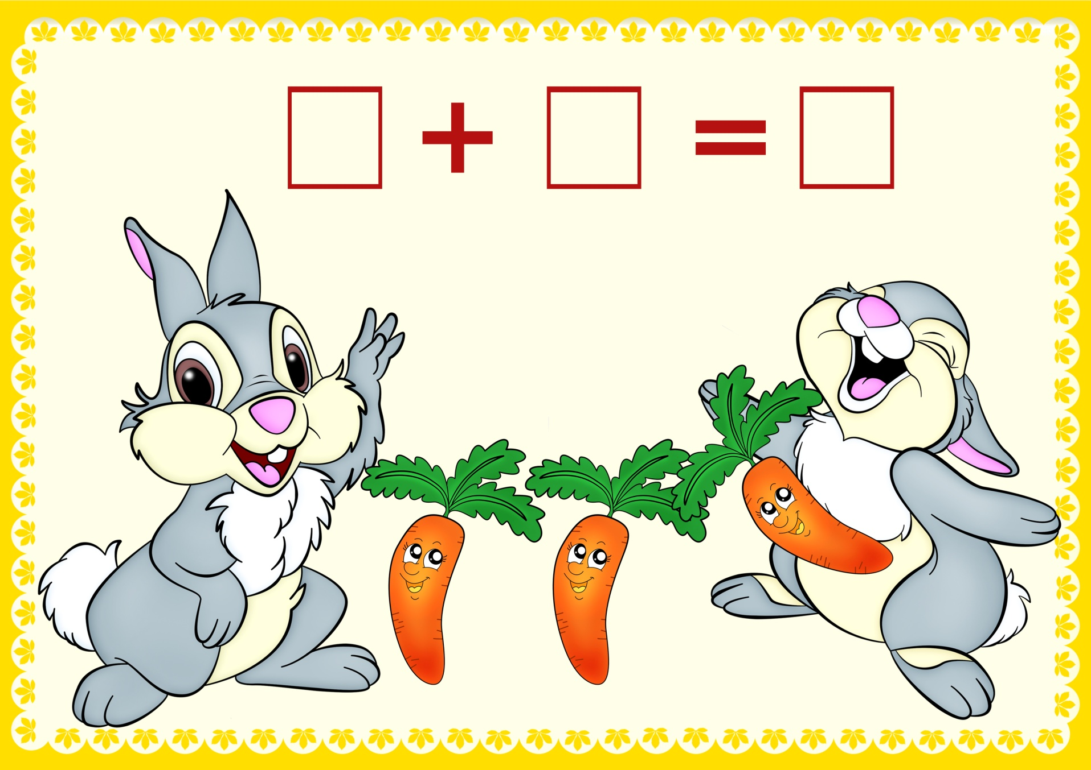

Slide 5
2 + 3 =

Slide 6
4 – 2 =

Slide 8


