Slide 1
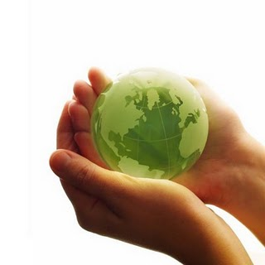
The planet in our hands Author: Shiretorova Lyudmila Galsanovna http://nsportal.ru/shiretorova-lyudmila-galsanovna

Slide 2
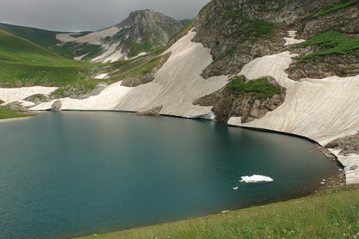
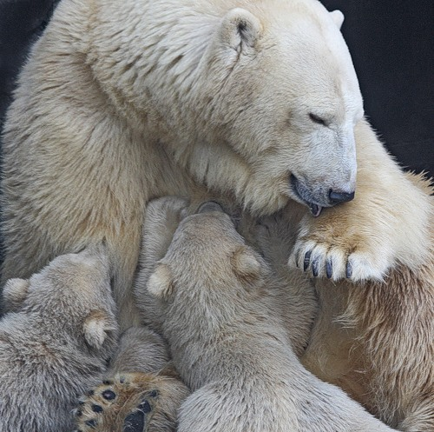
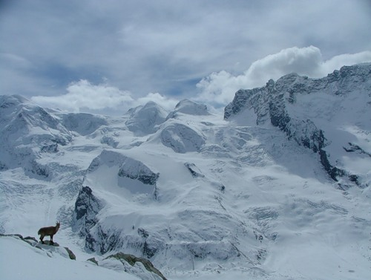
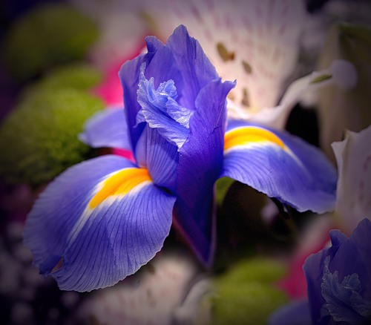
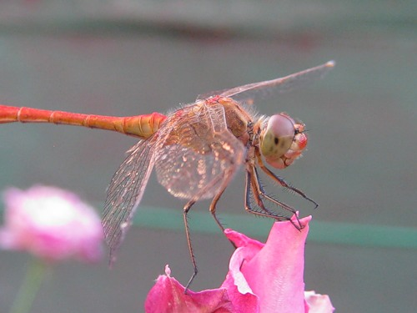
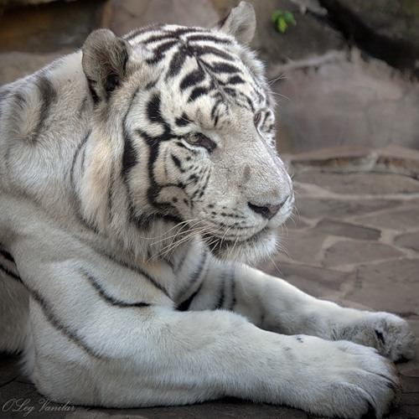
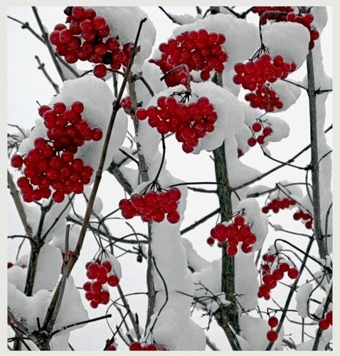
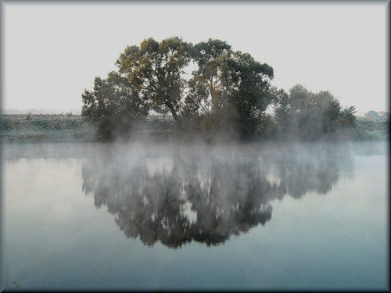

Slide 3
Phonetic and vocabulary exercise
environment | to disappear
wildlife | to cut down
the Earth | to pollute
human beings | to destroy
waste | to be out of danger
chemical pollution | to predict
disaster | to protect
the future | to throw away

Slide 4
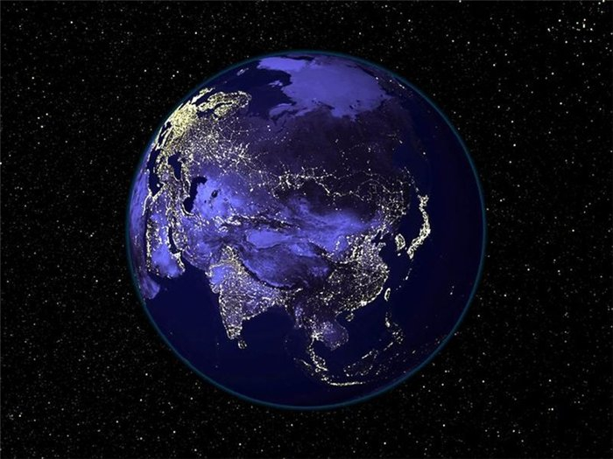
The Baikal is in danger

Slide 5
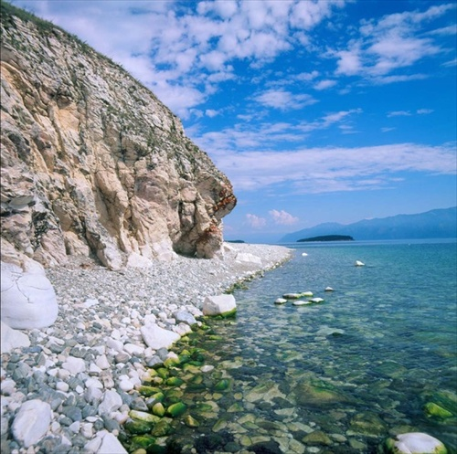
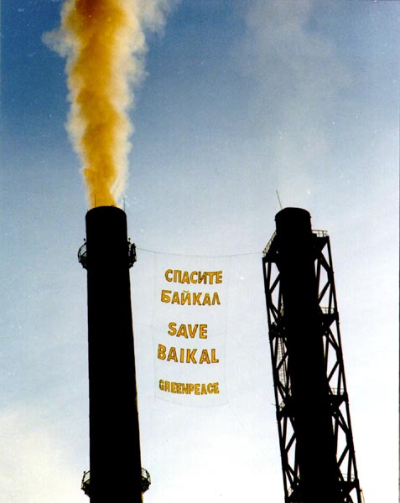
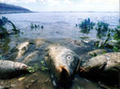
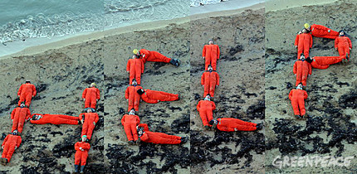

Slide 6
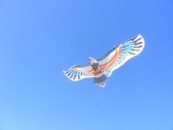
The blue sky above the Baikal

Slide 7
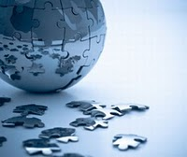
Environmental problems

Slide 8
Ecological problems
Acid rains
Air pollution
Littering
Global warming
Water pollution
Deforestation
Disappearing of animals

Slide 9
Check your answers
Ex.6 p.41
Everest is the highest mountain in the world.
Australia is the smallest continent in the world.
Ottawa is the capital of Canada.
The Atlantic Ocean washes North and South America.
The Nile is the longest river in the world.
The Caspian Sea is the largest lake in the world.
Lake Baikal is the deepest lake in the world.
Russia is the largest country in the world.
Tokyo is the largest city in the world.

Slide 10
Watch the video and answer the next question: Why is a deforestation really a problem?
Is a deforestation really a problem?
When will the rain forests vanish in the world?
How many hectares of forest are cleared annually?
What country has the world’s highest deforestation?

Slide 11
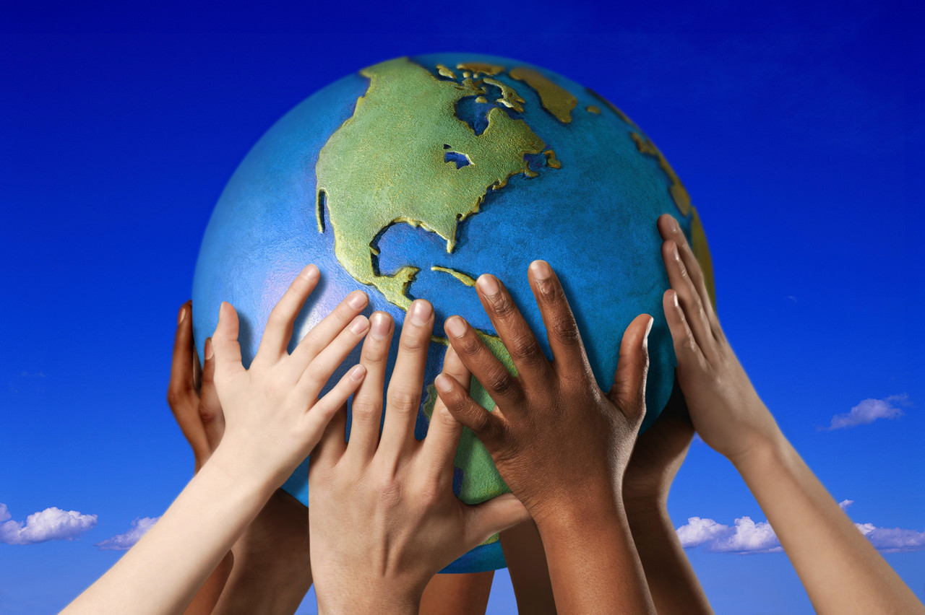
Why Mother Earth?

Slide 12
Materials
http://images.yandex.ru/yandsearch?text
М. З. Биболетова, Н. Н. Трубанева Enjoy English - 5. Student`s Book.
http://images.yandex.ru/yandsearch

