Slide 1
Nobel Prize

Slide 2
Nobel Alfred Bernhard
A. Nobel was a Swedish chemist and inventor.
He was born in Stockholm in 1833.

Slide 3
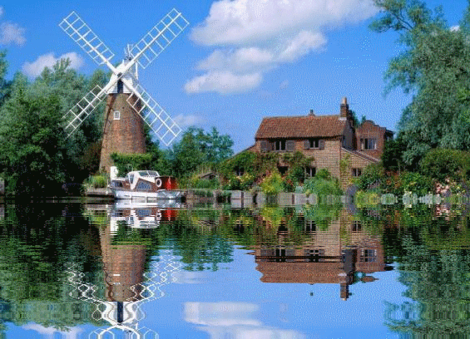
Alfred Nobel (1833-1896) was born in Stockholm, Sweden, on October 21, 1833.

Slide 4
A Merchant of Death?
He invented dynamite in 1867 and a smokeless gunpowder in 1887.
He built a network of factories to manufacture dynamite, and corporations to produce and market his explosives.
His worldwide interests in explosives brought him an immense fortune.
He was labeled “a merchant of death”

Slide 5
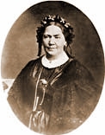
Alfred's mother, born Andriette Ahlsell, came from a wealthy family

Slide 6
His final will

Slide 7
The committee room of the Norwegian Nobel Committee

Slide 8
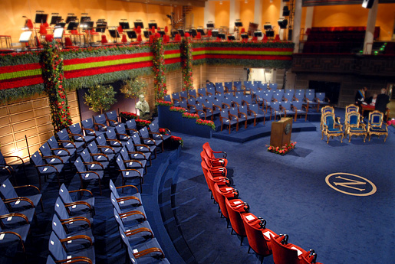
That’s how the ceremony looks like

Slide 9
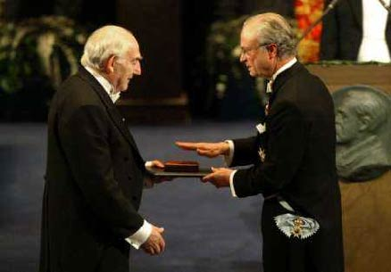
Nobel Prizes
The first Nobel prizes were awarded on December 10, 1901.

Slide 10
Sir Alexander Fleming
Born: 6 August 1881, Scotland
Occupation: biologist and pharmacologist
Best-known achievement: the discovery of penicillin
a Nobel Prize in 1945
Died: 11 March 1955

Slide 11
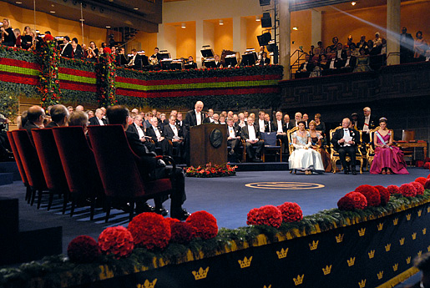
Ceremony

Slide 12
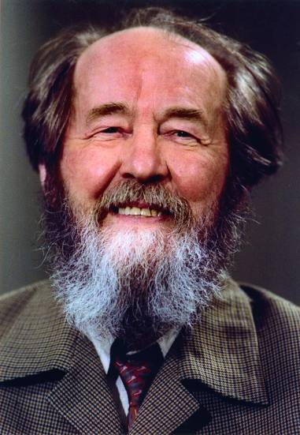
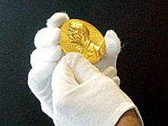
Some of Russian Laureates

Slide 13
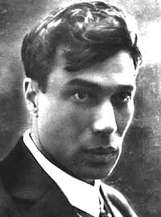

Slide 14
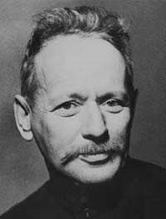
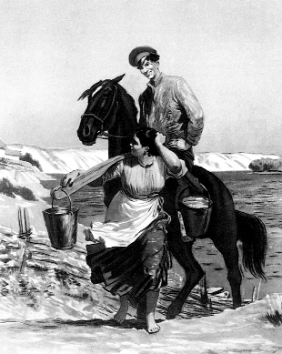

Slide 15
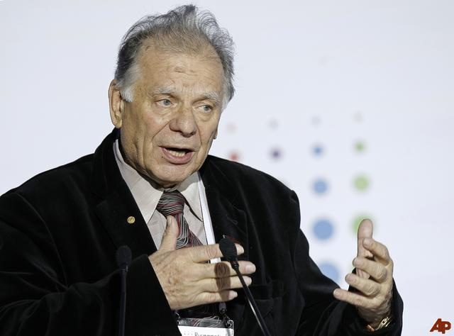
Zhores Alfyorov

Slide 16
