Slide 1
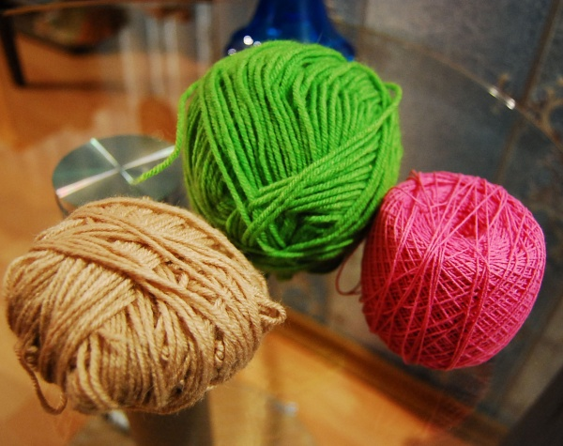
After-school activities
Hi! My name is Marie.
Can you guess what is my hobby?
I think, Marie is fond of … It is …

Slide 2
After-school activities
Hi! My name is Mark.
Can you guess what is my hobby?
I think, Mark is crazy about…

Slide 3
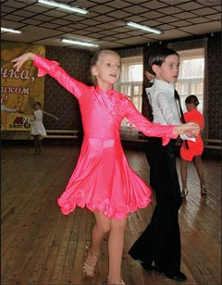
After-school activities
Hi! We are Nick and Jane.
Can you guess what is our hobby?
I think, Nick and Jane get pleasure from…

