Slide 1
Great Britain USA

Slide 2
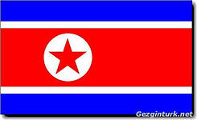
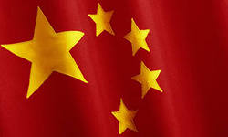
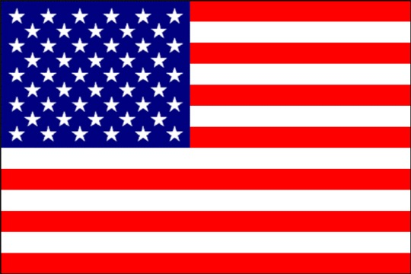
The flag of Great Britain

Slide 3
What is the official Name of Great Britain?

Slide 4
The island, where is England

Slide 5
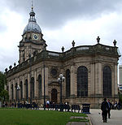
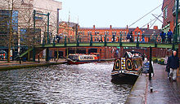
What is the city? It is a city and metropolitan borough in the West Midlands of England.

Slide 6
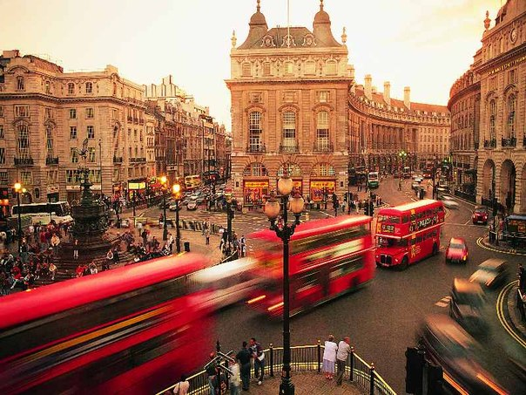
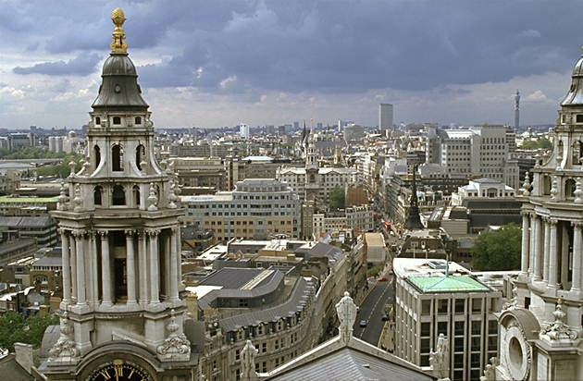
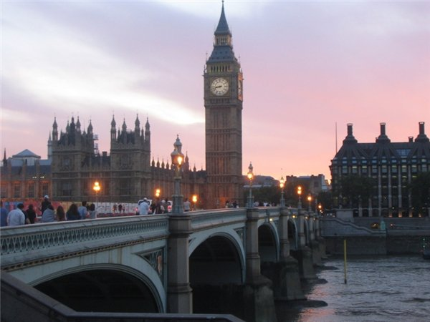
The city in England, what on the Thames

Slide 7
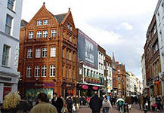
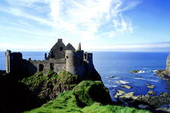
The smallest country on the British islands

Slide 8
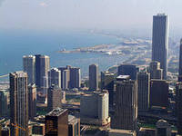
Decipher “the USA”

Slide 9
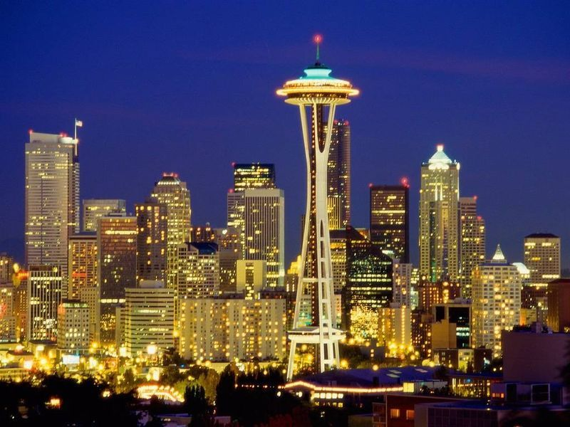
The capital of the USA

Slide 10
How many states has the USA?

Slide 11
The state form of the USA

Slide 12
Where is the Statue of Liberty?

Slide 13
Celebrates beginning of the Gregorian calendar year. Festivities include counting down to midnight (12:00 AM) on the preceding night

Slide 14
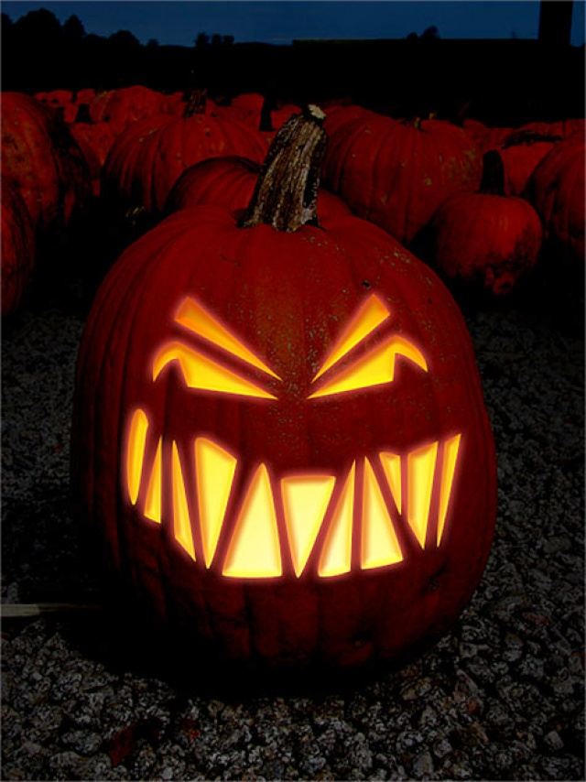
The symbol is the pumpkin

Slide 15
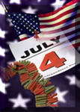
What is the holiday on the July,4

Slide 16
When is the Labor Day?

Slide 17
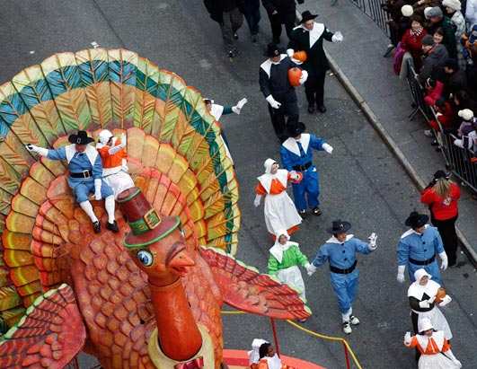
Traditionally includes the sharing of a turkey dinner.

Slide 18
The English writer, often called the national poet of England

Slide 19
The greatest actors

Slide 20
He is an heroic outlaw in English folklore, a highly skilled archer and swordsman. He has become known since the beginning of the 19th century.

Slide 21
He was an English writer and social critic. e created some of the world's most memorable fictional characters and is generally regarded as the greatest novelist of the Victorian period. The publication are The Pickwick Papers, Oliver Twist, A Christmas Carol, David Copperfield, Bleak House, Hard Times, A Tale of Two Cities,Great Expectations

