Slide 1
St. Valentine’s Day
Выполнила: учитель английского языка
МООУ «СШИ №2»
Сорокина Г.В.

Slide 2
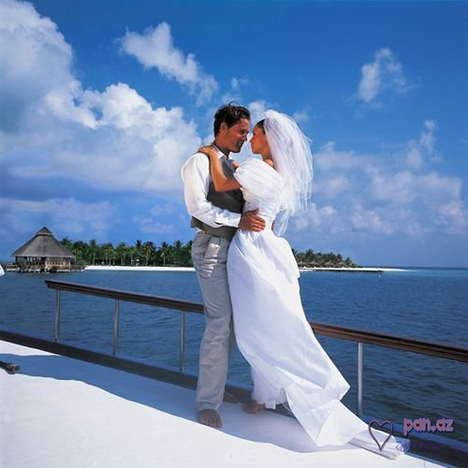
This holiday is a day of love and friendship. We celebrate it on the 14th of February.

Slide 3
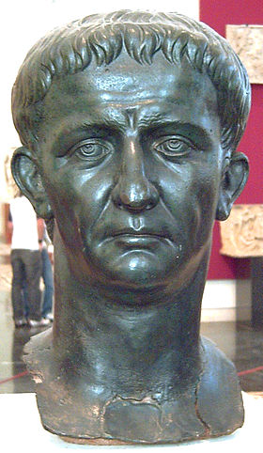
The holiday dates back to around 269 year, while the Roman Empire was ruled by Emperor Claudius II. He was sure that unmarried soldier thought about Roman army much less than about feeding his family.
Тиберий Клавдий Цезарь Август Германик TIBERIVS CLAVDIVS CAESAR AVGVSTVS GERMANICVS

Slide 4
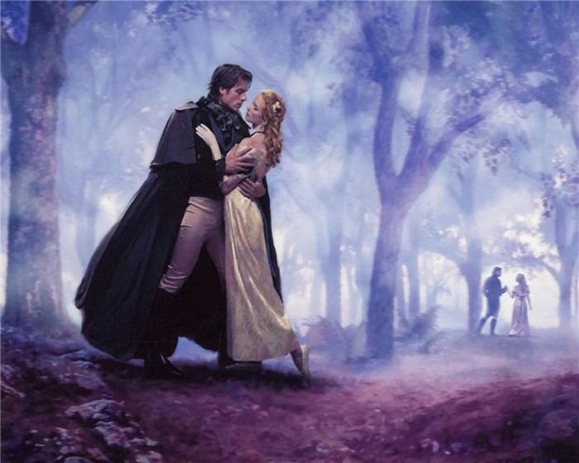
And, in order to keep his soldiers in the military spirit, the Emperor issued a decree prohibiting the legionaries to marry. But the soldiers who fell in love- didn't become smaller.

Slide 5
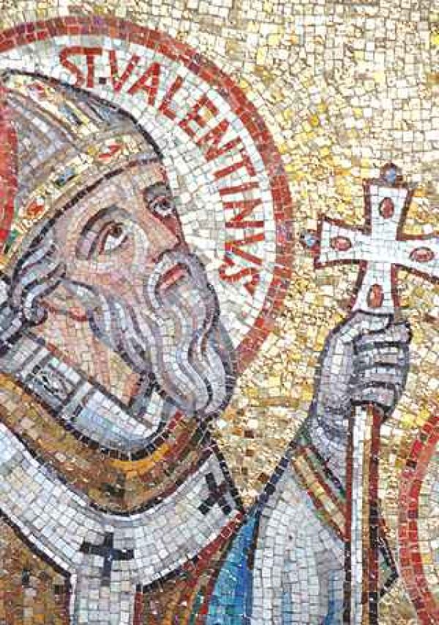
And luckily there was a man who didn’t fear the Imperial’s anger and began to marry the couples secretly. He was a priest named Valentine from the Roman city of Terni. He was a true romantic.

Slide 6
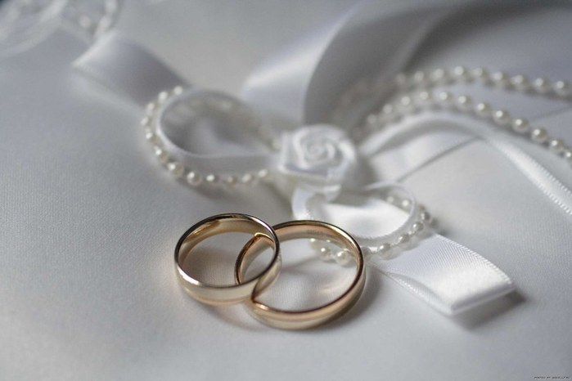
As soon as the Emperor knew about it , he decided to stop these «criminal activities». Valentine was sentenced to death.

Slide 7
The tragedy of this situation was in that Valentine was in love with the jailer's daughter. The day before the execution, the priest wrote the girl a farewell letter, where he spoke of his love, and signed it «Your Valentine». It was read after he was executed.

Slide 8
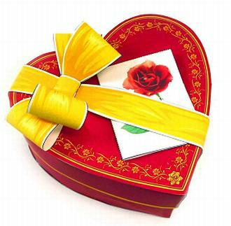
There is the custom to write love notes - «Valentines». People like to arrange the wedding and the wedding party this day. It is believed that this will be the key eternal love.

Slide 9
In Western Europe St.Valentine's Day was widely celebrated in the 13th century, in the USA since 1777. The tradition of giving gifts is getting stronger every year and for some people has become quite a successful business. For example, in the beginning of the last century the Americans had decided to send their lovers marzipans, which were quite expensive.

Slide 10
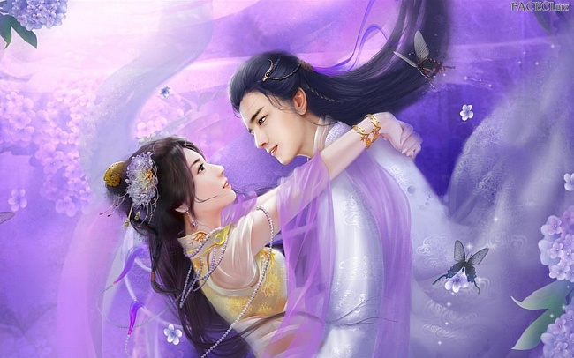
The tradition to give sweets this day appeared in a single large firm for the production of chocolate in Japan. There people began to celebrate Valentine's Day in the 30s, and still chocolate is the most popular gift.

Slide 11
But there are some countries in the world which is particularly distinguished in the celebration of Valentine's Day. This primarily Saudi Arabia, which is the only country in the world where this holiday... officially banned and under penalty of heavy fines.

Slide 12
And in Russia there was the holiday of lovers, here are just celebrated it's not in the winter, and in early summer. He was associated with the legendary love story of Peter and Fevronia and dedicated Kupala - Slavic pagan God, the son of Perun.

Slide 14
Интернет-рессурсы:
http://www.calend.ru/holidays/0/0/15/
http://images.yandex.ru/yandsearch?text=%D0%B4%D0%B5%D0%BD%D1%8C%20%D1%81%D0%B2%D1%8F%D1%82%D0%BE%D0%B3%D0%BE%20%D0%B2%D0%B0%D0%BB%D0%B5%D0%BD%D1%82%D0%B8%D0%BD%D0%B0&stype=image&lr=235&noreask=1&source=wiz

