Slide 1
PAST TENSES FORMS IN SPEAKING
SPOTLIGHT 9
MODULE 3C

Slide 2
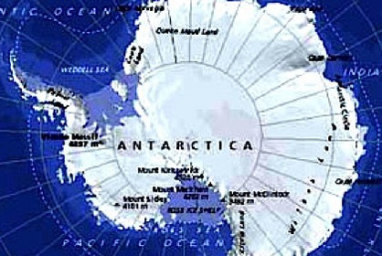
ANTARCTICA

Slide 3
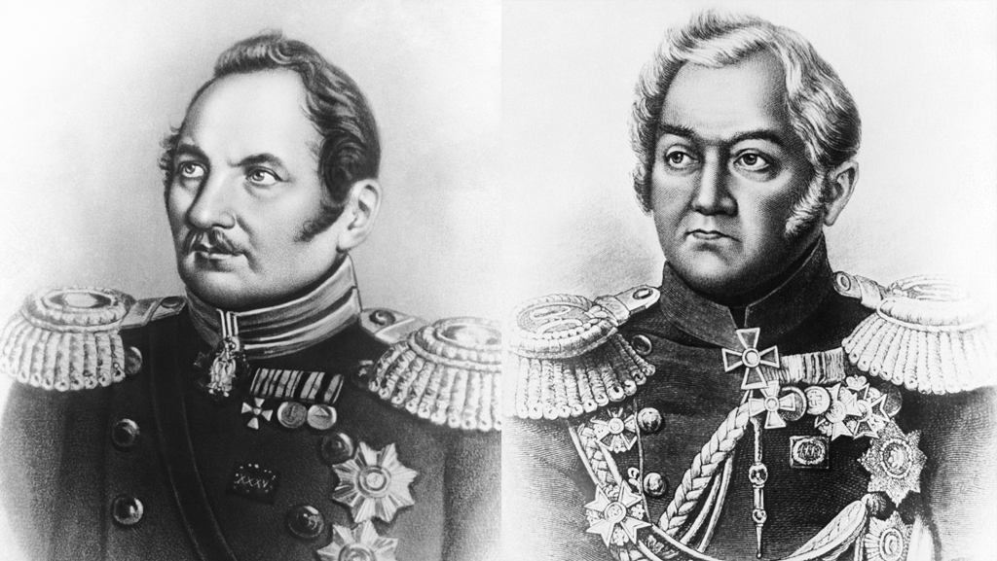
Bellingshausen and Lazarev

Slide 4
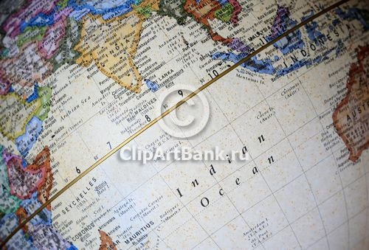
EQUATOR

Slide 5
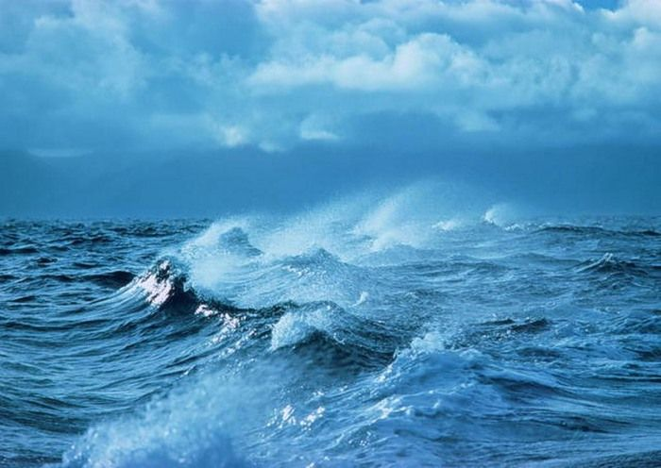
STORM

Slide 6
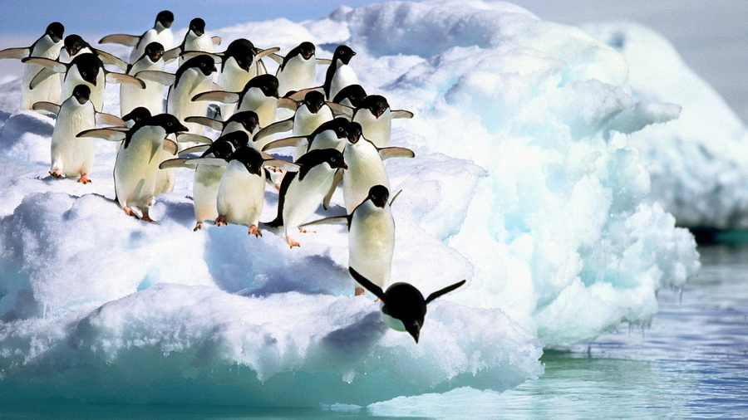
PENGUINS

Slide 7
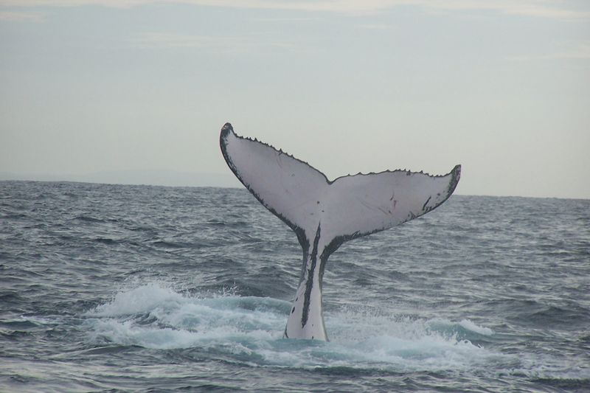
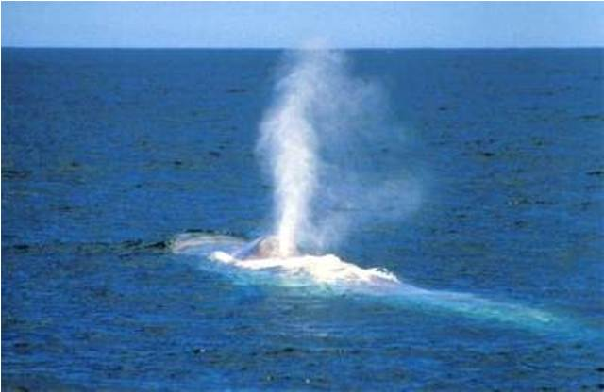
WHALES

Slide 8
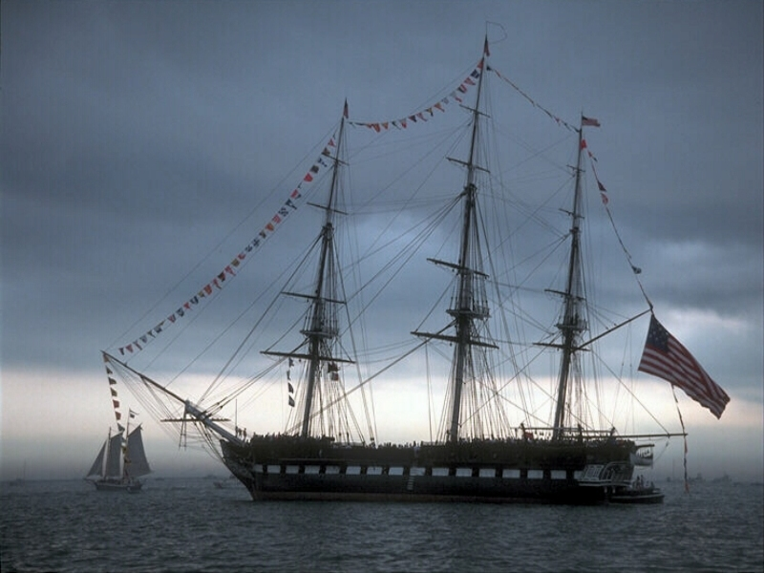
AMERICAN SHIP

Slide 9
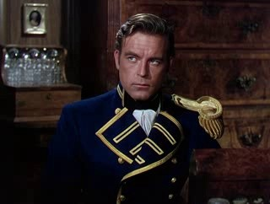
AMEICAN CAPTAIN

Slide 10
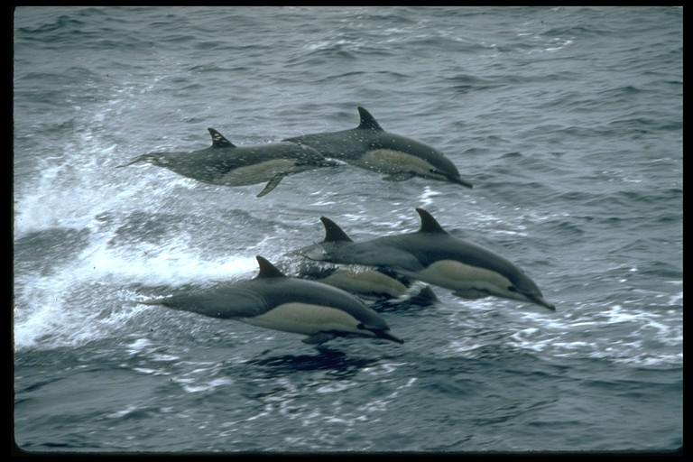
DOLPHINS

Slide 11
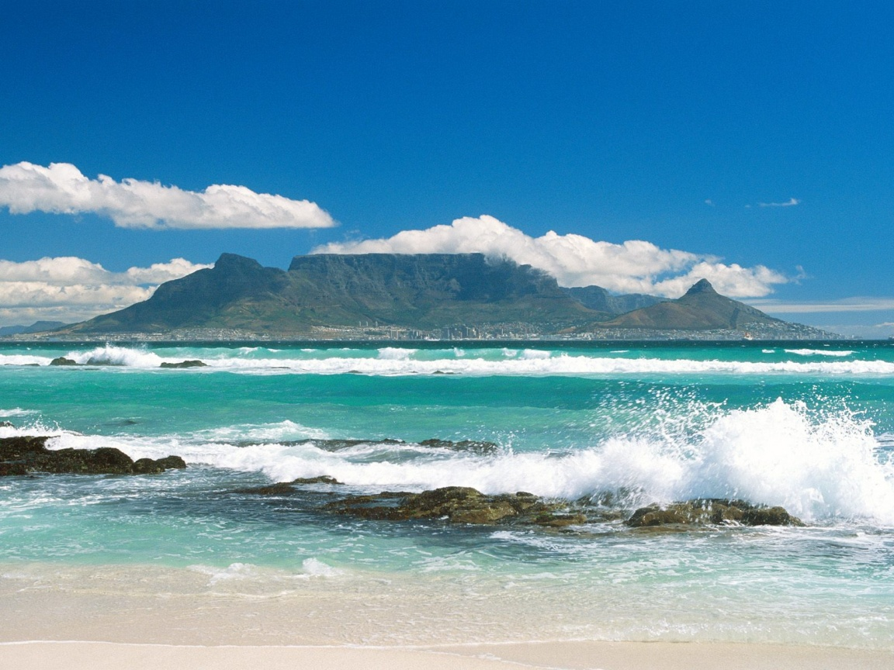
THE CAPE (South Africa)

Slide 12
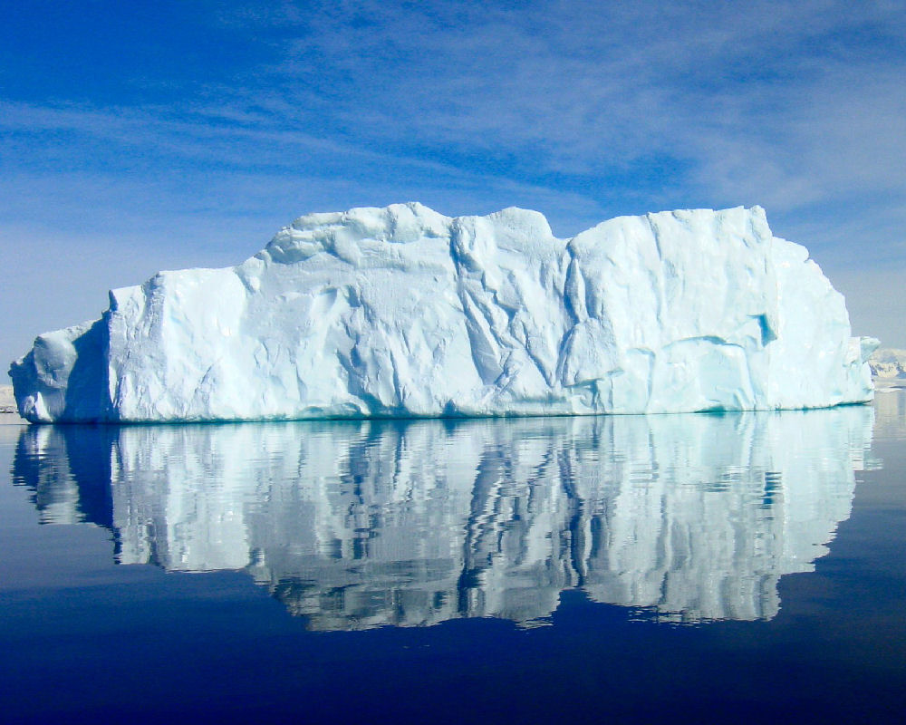
ICEBERG

Slide 13
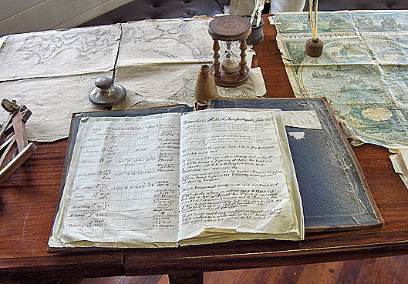
Log book of the ship

Slide 14
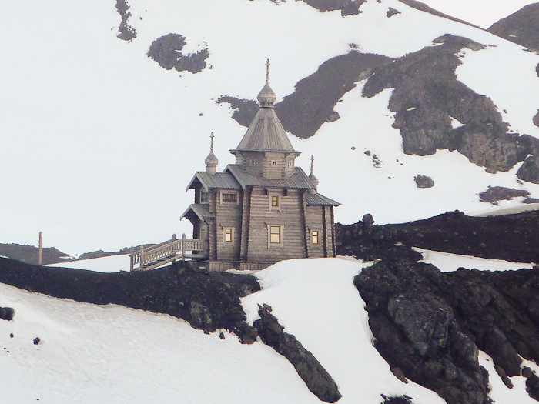
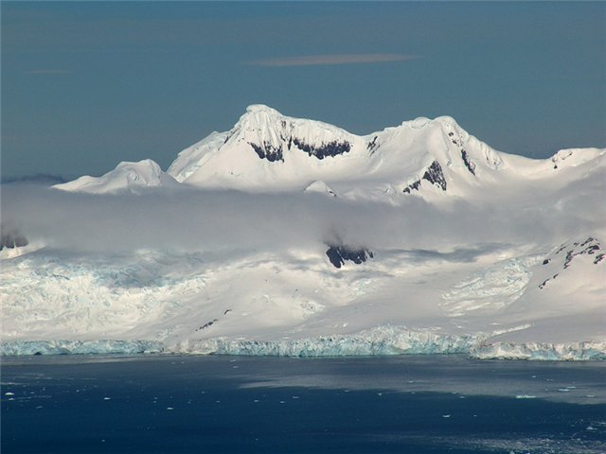
Antarctica. St. Trinity Church
On the territory of Russian expedition

Slide 15
Past Continuous & Past Simple
Past Continuous
Past Simple
Process in the past at the definite moment
Process & process
Facts in the Past

Slide 16
Past Perfect Simple & Past Perfect Continuous
Past Perfect Simple
Past Perfect Continuous
Facts taken place before the moment in the Past
Process in the past before the definite moment

