Slide 1
LONDON
Презентацию выполнила Саркисян Кристина
Юрьевна

Slide 2
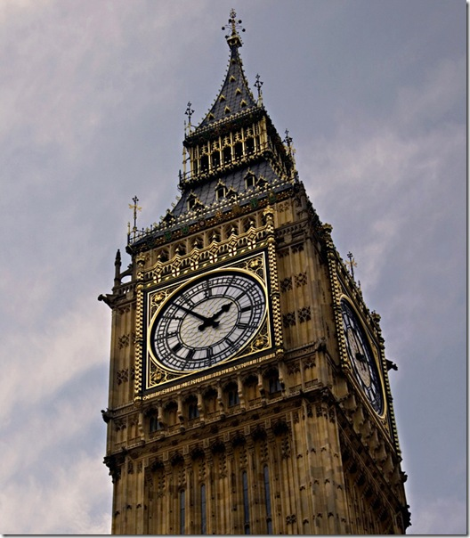
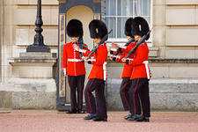
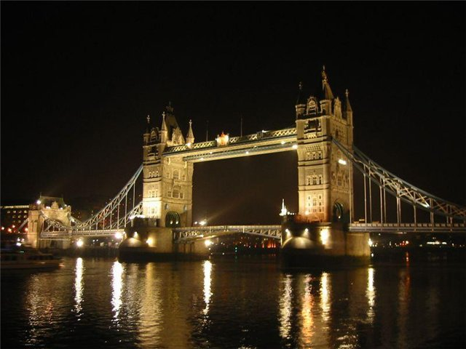
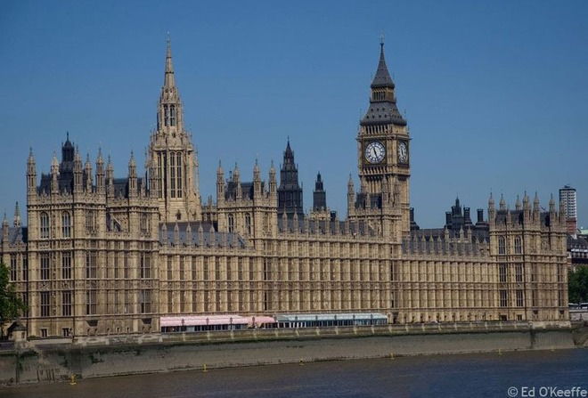

Slide 3
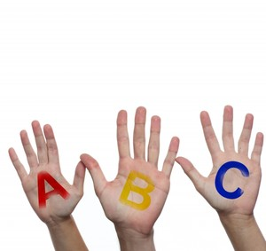
Phonetic drill
Westminster Abbey
the Houses of Parliament
Buckingham Palace
St Paul’s Cathedral
London Bridge
the Tower of London
The National Gallery
Big Ben

Slide 4
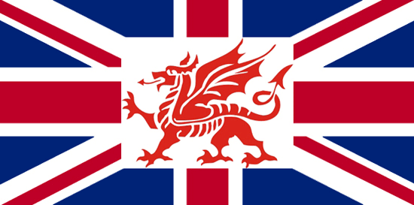
London – the capital of the United Kingdom of Great Britain and Northern Ireland.

Slide 5
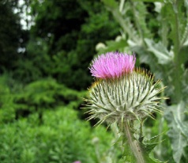
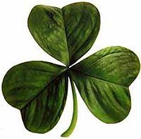
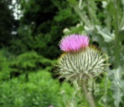
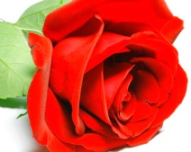
The United Kingdom of Great Britain and Northern Ireland is situated on the British Isles. It consists of four parts: England, Wales, Scotland and Northern Ireland.
The red rose is the national emblem of England.
The thistle is the national emblem of Scotland.
The leek is the emblem of Wales.
The shamrock is the emblem of Northern Ireland.

Slide 6
Лондон расположен на оба банка Реки Темза, это - наибольший город в Великобритании и один из наибольших в мире. Его население - приблизительно 7 миллионов человек.

Slide 7
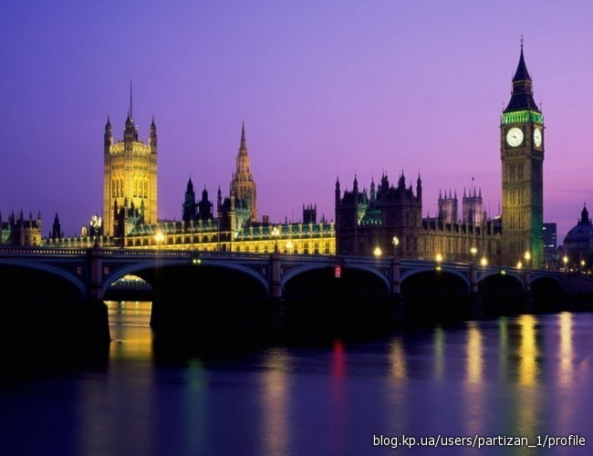
There are a lot of places of interest in London. Among them there are: Westminster Abbey, the Houses of Parliament, Buckingham Palace, St Paul’s Cathedral, London Bridge, the Tower of London, The National Gallery, Big Ben.

Slide 8
London stands on the river Thames. Crossing the river by the Tower Bridge you can see the Tower of London. It is one of the oldest buildings of the city. Many centuries ago it was a fortress, a royal palace and then a prison. Now it is a museum of arms.

Slide 9
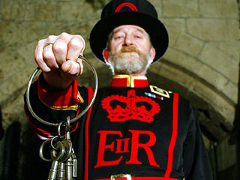
The Tower is guarded by 'Beefeaters', the Yeomen guards.
In principle they are responsible for looking after any prisoners at the Tower and safeguarding the British crown jewels, but in practice they work as guides and tell this story to the visitors.

Slide 10
There are always at least 6 ravens at the Tower.
There is a story that they bring good luck to Britain, if they stay at the Tower. That's why they get "paid" meat and biscuits every day. But their wings are cut so that they can't fly away. They are not very friendly.

Slide 11
On the bank of the Thames, not far from the Tower of London, you can see Westminster Palace, or the Houses of Parliament.

Slide 12
It is the seat of the British government and it is one of the most beautiful buildings in London.

Slide 13
In one of its towers there is famous Big Ben, the largest clock of England. It strikes every quarter of an hour.

Slide 14
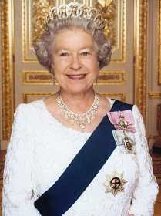
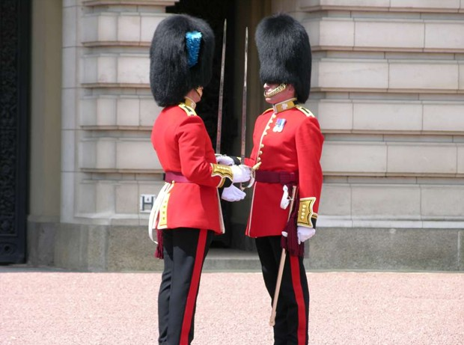
Buckingham Palace is the Queen’s official London residence. Tourists always go to see the ceremony of changing the Guard there, lasting about 30 minutes

Slide 15
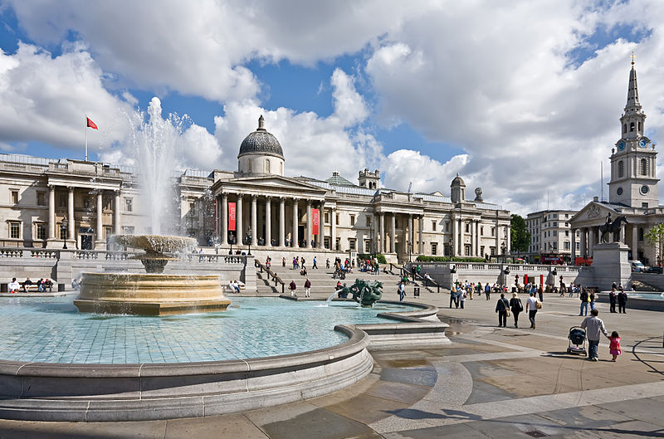
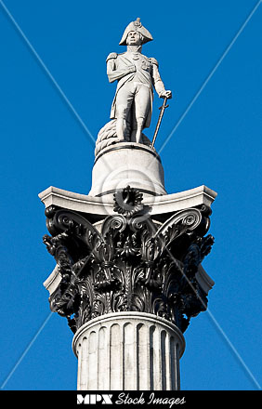
Trafalgar Square
Trafalgar Square is the central square of the city. At its centre is Nelson's Column, which is guarded by four lion statues at its base. There are a number of statues and sculptures in the square.

Slide 16
To the right of the square there is the National Gallery which has a fine collection of European paintings.

Slide 17
St Paul’s Cathedral is the biggest English church.

Slide 18
Another famous church is Westminster Abbey where kings, queens, and many famous people are buried.

Slide 19
Test.
1. Big Ben is …
a) a radio tone;
b) a famous clock;
c) a famous church.
2. Backingham Palace is…
a) a home of Royal Family;
b) a place of interest;
c) a fine cathedral.
3. Westminster Abbey is a large…
a) cathedral;
b) palace;
c) church.
4. The Tower of London was…
a) a prison, a church and a cathedral;
b) a fortress , a prison, a palace;
c) a tower, a prison and a palace.
5. Ravens must live in…
a) Westminster Abbey;
b)The Tower of London;
c) Tower Bridge.

