Slide 2
This is a farm [ðis iz ə fa:m]

Slide 3
Who lives on a farm? [hu: livz ɔn ə fa:m]

Slide 4
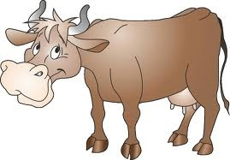
A cow [ə kau ]
It can run fast.
[it kæn rʌn fa:st]
It gives milk
[it givz milk]
It cannot fly
[it kæn nɔt flai]

Slide 5
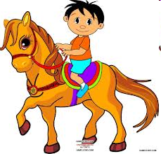
A horse[ə hɔ:s]
It can run fast.
[it kæn rʌn fa:st]
It can swim.
[it kæn swim]
It cannot fly
[it kæn nɔt flai]

Slide 6
A pig [ə pig]
It can run
[it kæn rʌn]
It can not swim.
[it kæn nɔt swim]
It cannot flay
[it kæn nɔt flai]

Slide 7
A dog [ə dɔg]
It can run fast.
[it kæn rʌn fa:st]
It can swim.
[it kæn swim]
It cannot flay
[it kæn nɔt flai]

Slide 8
A rooster [ə ru:stə]
It can run fast.
[it kæn rʌn fa:st]
It can fly
[it kæn flai]
It can not swim.
[it kæn nɔt swim]

Slide 9
A hen [ə hen]
It can run fast.
[it kæn rʌn fa:st]
It can fly
[it kæn flai]
It can not swim.
[it kæn nɔt swim]

Slide 10
It is a little yellow chick
[it iz ə litl jeləu tʃik]
It can not run fast.
[it kæn nɔt rʌn fa:st]
It can not fly
[it kæn nɔt flai]
It can not swim.
[it kæn nɔt swim]

