Slide 1
Presentation
The world in the future

Slide 2
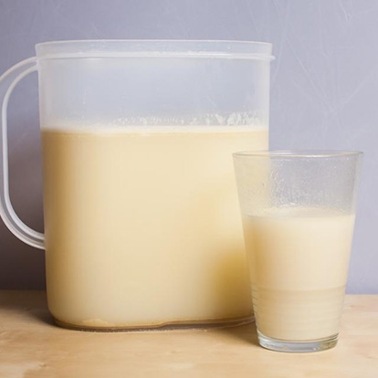
WHAT WILL PEOPLE EAT ?
First what I think
about is what people
are going to eat in the future.
I think people will drink a mixture which will contain
vitamins for health.

Slide 3
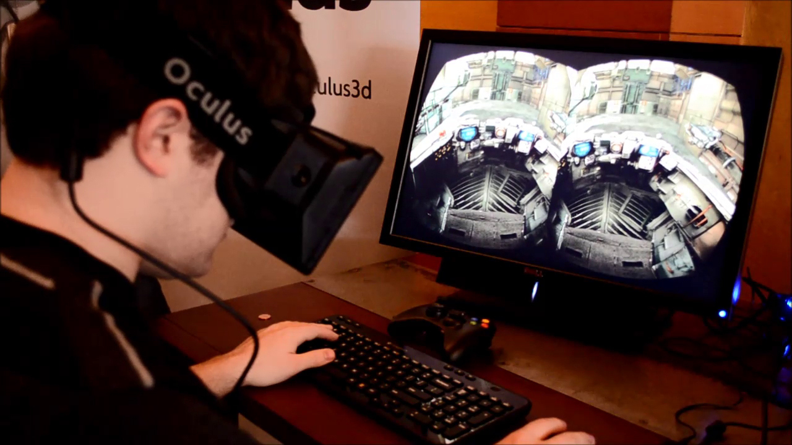
What will people do in their free time ?
Secondly I think about people s it what do in their free time .
People will play games a-new. For example in Glasses of virtual reality. They will put on them on their heads and will see games a-new. The are such technologies already. But they are very expensive.

Slide 4
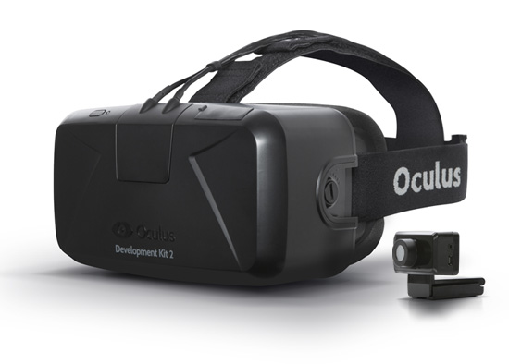
What will people do in their free time ?
They cost 56000.
Now they are called Oculus Rift. It was made of plastic and cloth.

Slide 5
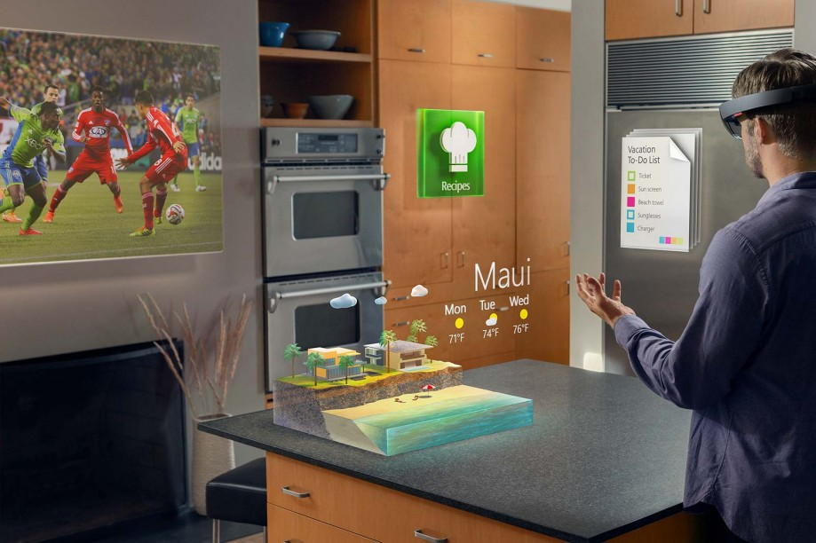
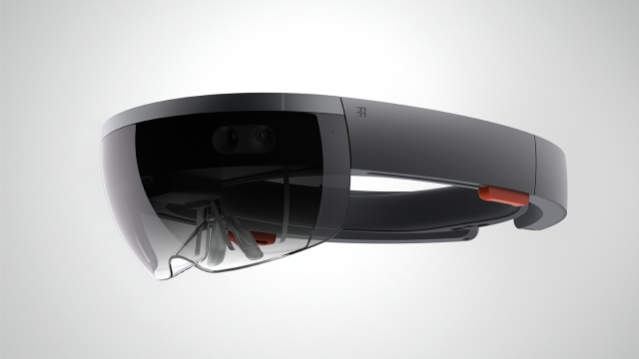
What will people do in their free time?
in Future Microsoft
Will present it .
These are HoloLens

Slide 6
questions ?
What will people eat in future ?
What is Oculus Rift ?

Slide 7
Thank you for watching!
By Fedorov Dmitriy
And Juliya Dobrenkova.

