Slide 1
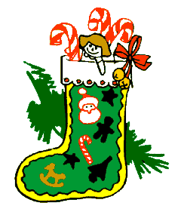
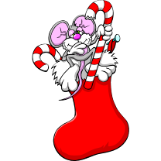
Quiz Game “CHRISTMAS”

Slide 2
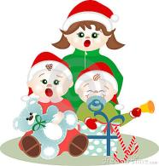
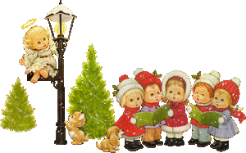
Let’s sing the Christmas song!

Slide 3
«Jingle, Bells!»
Jingle, bells! Jingle, bells!
Jingle all the way!
Oh what fun it is to ride
In a one-horse open sleigh.

Slide 4
End the poem
Уже зима, одень-ка свитер!
Зима – иначе будет …

Slide 5
Decode a Letter!
3 4 1 10 7 6 3 11 !
6 14 6 11 5 15 9 13 1 8 4 10 10 15 2 5 10 6 11 12 8 1 11 !
The Code:
1 2 3 4 5 6 7 8 9 10 11 12 13 14 15
A C D E H I K M O R S T U W Y

Slide 6
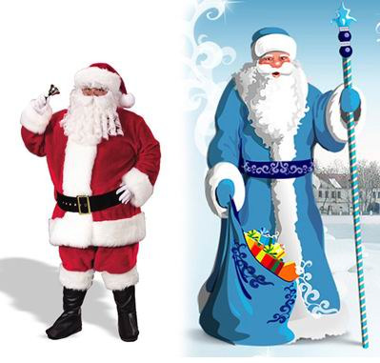
Compare Santa Claus and Grandfather Frost

Slide 7
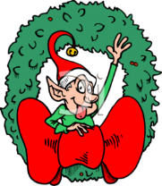
Let’s Have a Rest

Slide 8
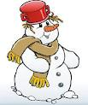
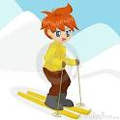
What can you do on winter holidays?
play snowballs
ski
play hockey
skate
make a snowman
toboggan

Slide 9
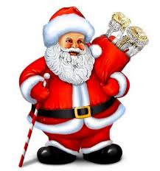
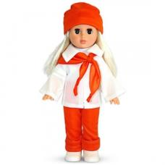
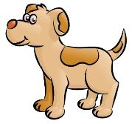
Captain’s Competition
Emily likes pets and…

Slide 10
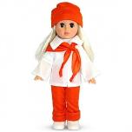
Captain’s Competition
Tommy likes to eat sweets and…

Slide 11
Captain’s Competition
Jack likes to play football and…

