Slide 1
Математика

Slide 2
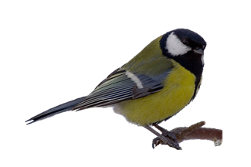
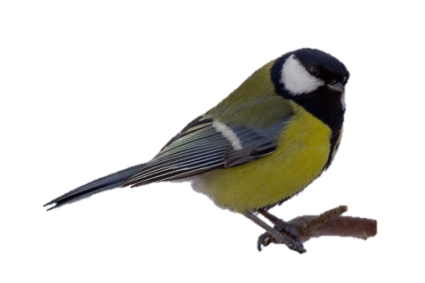
11 – 5 - 4

Slide 3
11 – 4 - 5

Slide 4
11 – (5 + 4)

Slide 5
11 – (5 + 4) = 2
11 – 5 – 4 = 2
11 – 4 – 5 = 2
11 – (5 + 4) = 11 – 5 – 4 = 11 – 4 - 5

