Slide 1
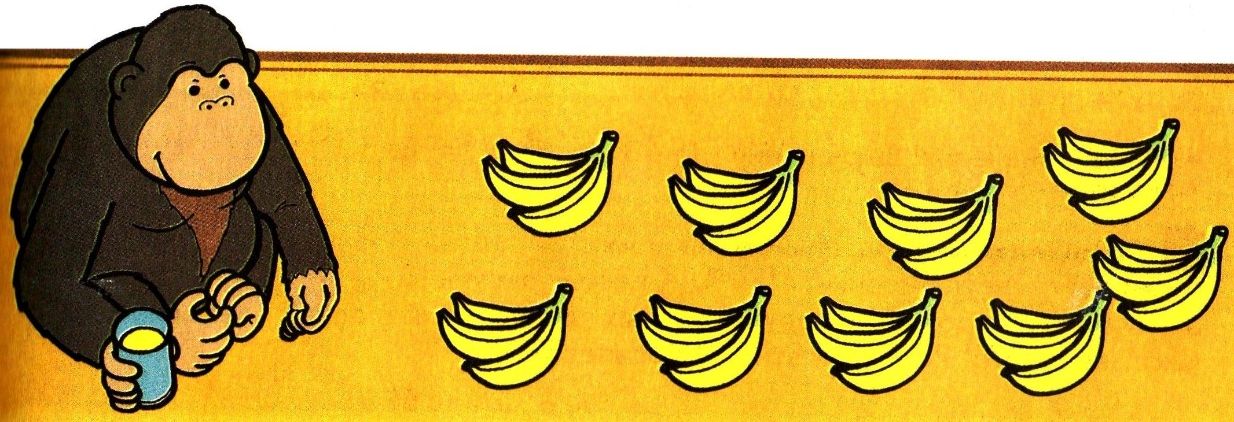
3+3+3+3+3+3+3+3+3= =3•9=27

Slide 2
2+2+2+2+2+2+2+2+2= =2•9=18

Slide 3
3+3+3+3=3•4=12

Slide 4
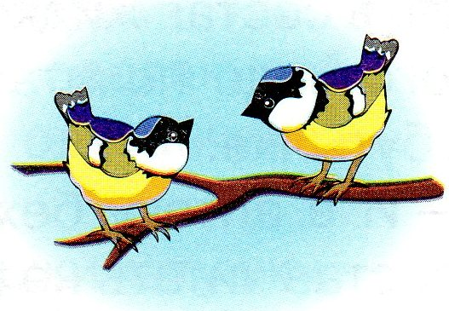
2+2+2+2+2=2•5=10

Slide 5
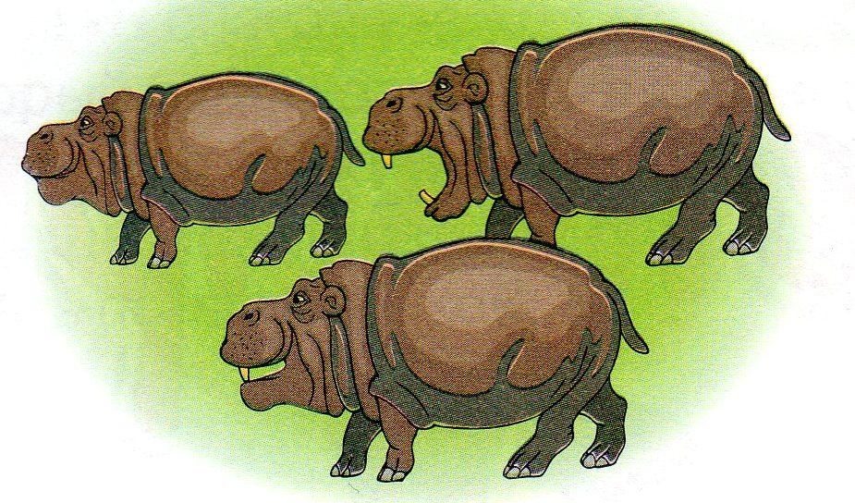
3+3+3=3•3=9

Slide 6
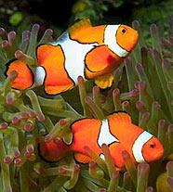
2+2+2+2+2+2=2•6=12

