Slide 1
«Решаем задачи» урок 50
Учитель начальных классов
МБОУ «ООШ с. Ивановки»
МО «Енотаевский район»
Боброва Ирина Владимировна

Slide 2
Заселяем домики
8
9
4
4
3
6
6
2
7
2

Slide 3
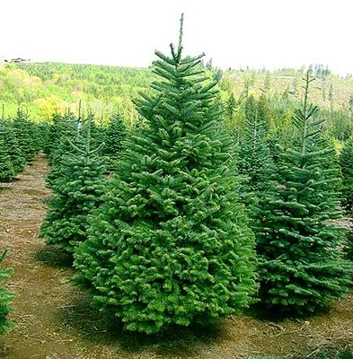
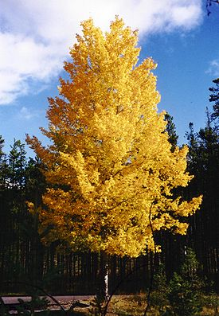
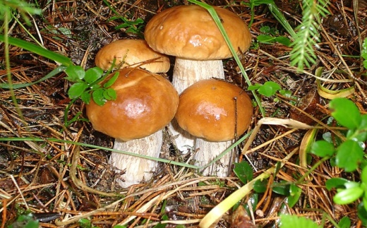
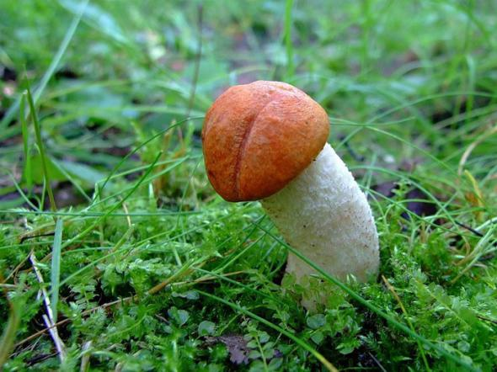

Slide 4
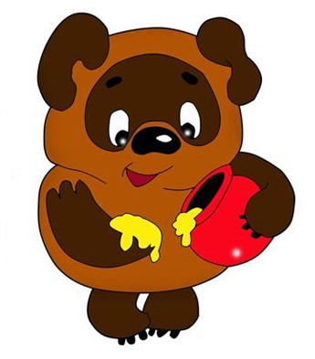
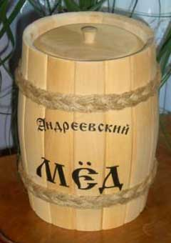

Slide 6
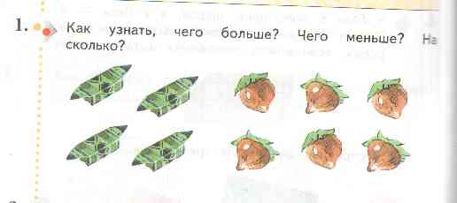
6-4=2

Slide 7
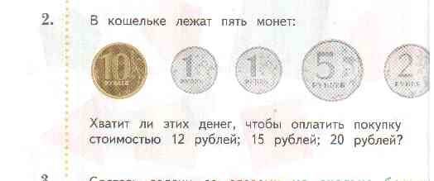
10+1+1+5+2=19

Slide 8
4-3=1
5-2=3

Slide 9
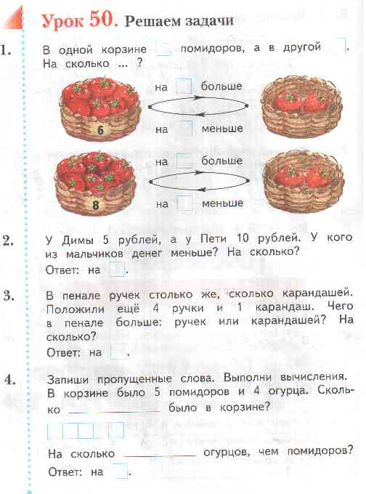

Slide 10
http://go.mail.ru/search_images?q=%D0%BA%D0%B0%D1%80%D1%82%D0%B8%D0%BD%D0%BA%D0%B0+%D0%B5%D0%BB%D0%BA%D0%B0+%D0%B2+%D0%BB%D0%B5%D1%81%D1%83&us=20&usln=1&usstr=%D0%BA%D0%B0%D1%80%D1%82%D0%B8%D0%BD%D0%BA%D0%B0+%D0%B5%D0%BB%D0%BA%D0%B0+%D0%B2+%D0%BB%D0%B5%D1%81%D1%83&hasnavig=0#urlhash=6194650931576643664
http://go.mail.ru/search_images?q=%D0%BA%D0%B0%D1%80%D1%82%D0%B8%D0%BD%D0%BA%D0%B0++%D0%BE%D1%81%D0%B8%D0%BD%D1%8B#urlhash=379234203090826989
http://go.mail.ru/search_images?q=%D0%BA%D0%B0%D1%80%D1%82%D0%B8%D0%BD%D0%BA%D0%B0+%D0%B3%D1%80%D0%B8%D0%B1%D0%BE%D1%87%D0%BA%D0%B0&us=17&usln=1&usstr=%D0%BA%D0%B0%D1%80%D1%82%D0%B8%D0%BD%D0%BA%D0%B0+%D0%B3%D1%80%D0%B8%D0%B1%D0%BE%D1%87%D0%BA%D0%B0&hasnavig=0#urlhash=9072436281411539721
http://go.mail.ru/search_images?q=%D0%BA%D0%B0%D1%80%D1%82%D0%B8%D0%BD%D0%BA%D0%B0+%D0%B3%D1%80%D0%B8%D0%B1%D0%BE%D1%87%D0%BA%D0%B0&us=17&usln=1&usstr=%D0%BA%D0%B0%D1%80%D1%82%D0%B8%D0%BD%D0%BA%D0%B0+%D0%B3%D1%80%D0%B8%D0%B1%D0%BE%D1%87%D0%BA%D0%B0&hasnavig=0#urlhash=1994089994657125057
http://go.mail.ru/search_images?q=%D0%BA%D0%B0%D1%80%D1%82%D0%B8%D0%BD%D0%BA%D0%B0+%D0%B2%D0%B8%D0%BD%D0%BD%D0%B8+%D0%BF%D1%83%D1%85%D0%B0&us=14&usln=1&usstr=%D0%BA%D0%B0%D1%80%D1%82%D0%B8%D0%BD%D0%BA%D0%B0+%D0%B2%D0%B8%D0%BD%D0%BD%D0%B8&hasnavig=0#urlhash=3846609065489650999

