Slide 1
Symbols of Great Britain: Flowers

Slide 2
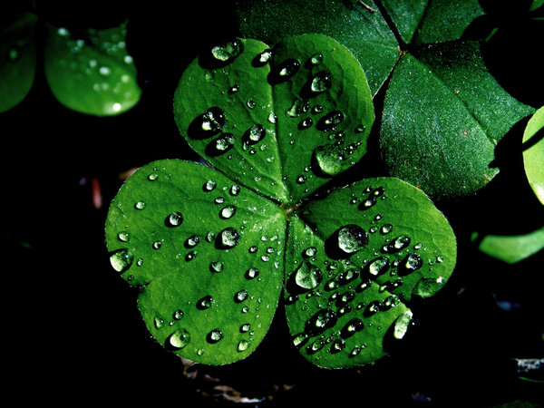
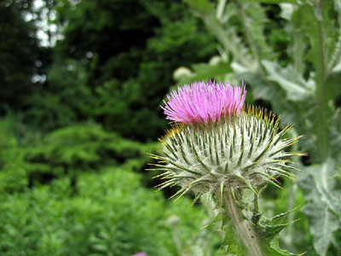
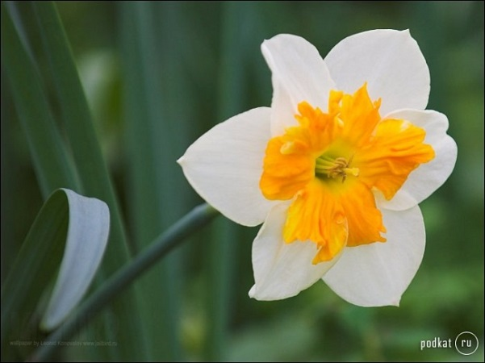
1
R
O
S
E
2
D
A
F
F
O
D
I
L
3
T
H
I
S
T
L
E
4
S
H
A
M
R
O
C
K
3.Symbol of Scotland
2.Symbol of Wales
4.Symbol of Northern Ireland
1.Symbol of England

Slide 3
Well-done !

