Slide 1
Capitals. England. Scotland. Wales. Northern Ireland.

Slide 2
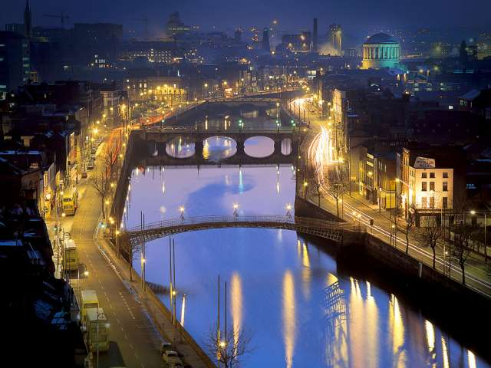
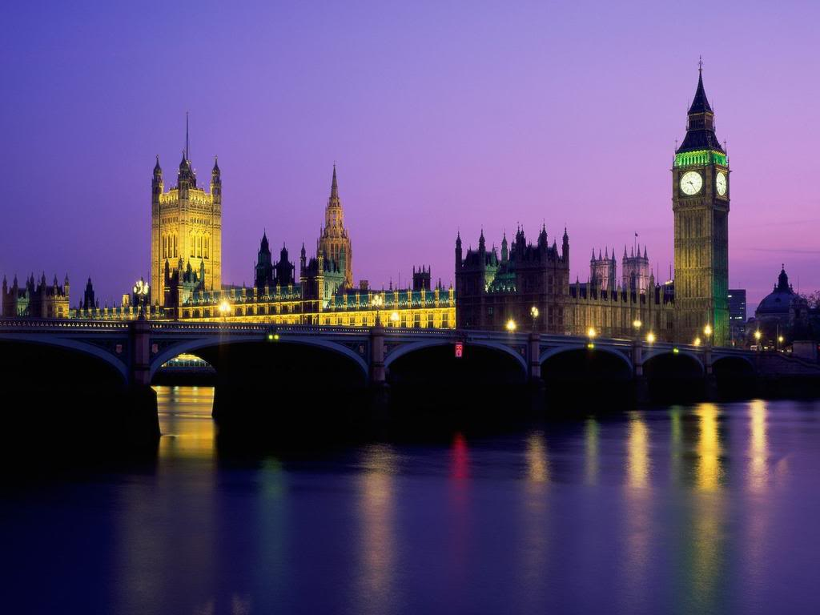
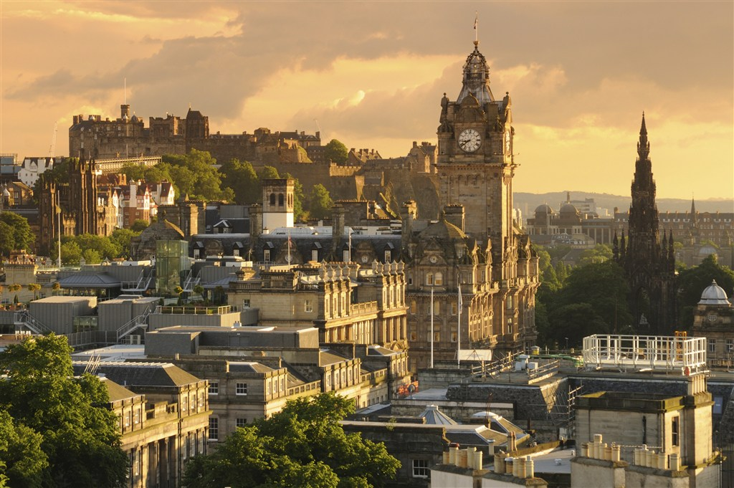
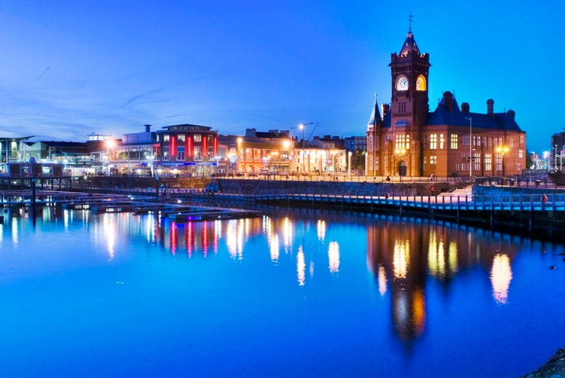
1
L
O
N
D
O
N
2
E
D
I
N
B
U
R
G
H
3
D
U
B
L
I
N
4
C
A
R
D
I
F
F
1. The capital of England
2. The capital of Scotland
3. The capital of
The Northern Ireland
4.The capital of Wales

Slide 3
Well-done !

