Slide 1
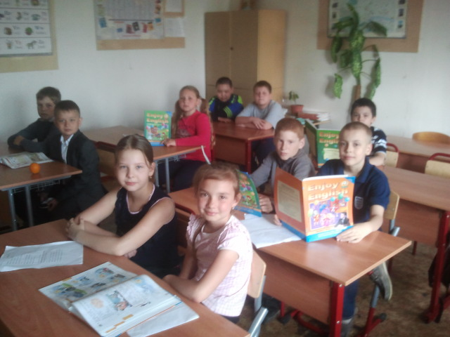
Our English lesson

Slide 2
We can:
Write
Read English words
Speak English
Sing songs
Translate words

Slide 3
I am
My name is…
My age…
I am…
I am not…
I have got…
I can…
I can not…
I like…

Slide 4
At the table
Now we are going to have lunch

Slide 5
Seasons

Slide 6
Winter is white!

Slide 7
Spring is green!

Slide 8
Summer is bright!

Slide 9
Autumn is yellow!

Slide 10
At the shop
We learn the topic “Clothes” and now we can go to the shop and buy a lot of new clothes for every season. We know how to speak with sellers in English.

Slide 11
We are going to sunny Spain
Beautiful dress
Bright T-Shirt
Shorts
Skirt
Cap
Beach shoes

Slide 12
We are going to rainy London
Raincoat
Gloves
Scarf
Boots
Trousers
Sweater
Umbrella

