Slide 1
Domestic Animals

Slide 2
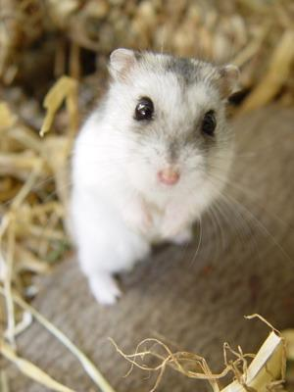
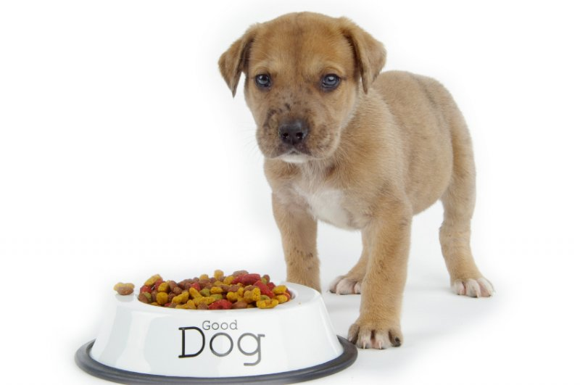
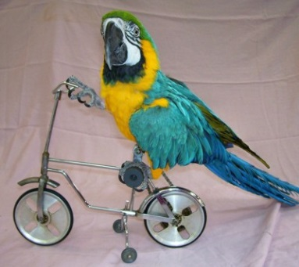
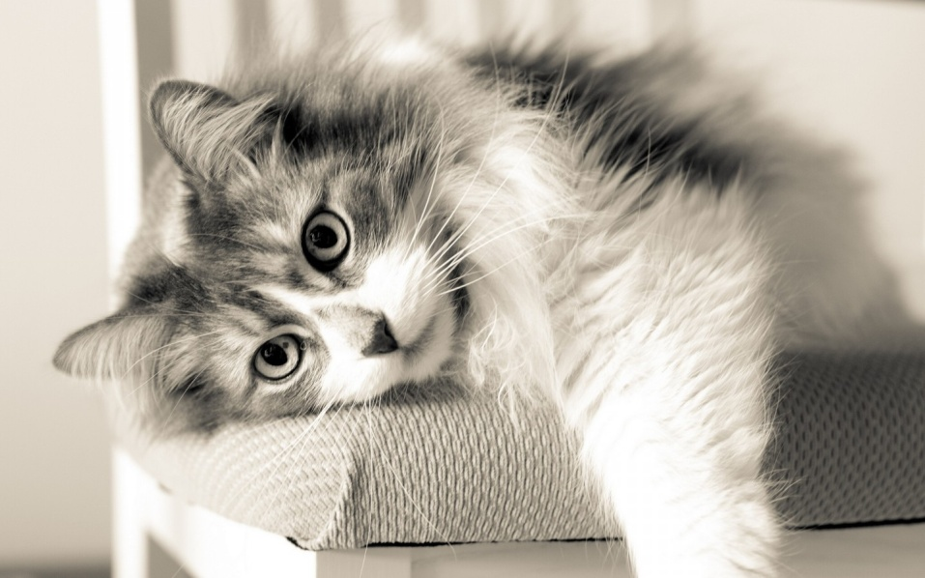
1
C
A
T
2
D
O
G
3
P
A
R
R
O
T
4
H
A
M
S
T
E
R
1.It’s an animal. It can jump, run and play with a ball. It eats mice and drinks milk.
4. It’s an animal. It can run and sleep a lot. It eats seeds and grass, drinks water. It lives in cages at home.
3. It’s a bird. It can fly and sometimes talk. It eats seeds and drinks water.
2. It’s an animal. It can run and bark. It eats bones and meat.

