Slide 1
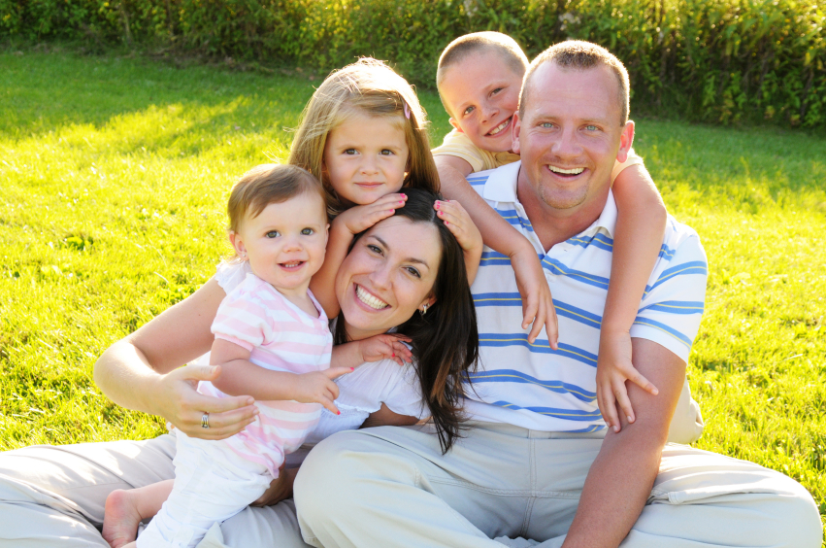
ОТКРЫТЫЙ УРОК ПО АНГЛИЙСКОМУ ЯЗЫКУ ВО 2-ОМ «Б» Учитель: Курятникова А.В.

Slide 2
Цель урока:
Систематизировать знания учащихся по теме «Семья»

Slide 3
Фонетическая зарядка
^{Good morning, father!}
^{Good morning, mother!} ^{Kiss your little son!} ^{Good morning, sister!}
^{Good morning, brother!} ^{Good morning, everyone!}

Slide 4
Crossword puzzle
^{D} | ^{A} | ^{U} | ^{G} | ^{H} | ^{T} | ^{E} | ^{R}
^{T} | ^{U} | ^{N} | ^{S} | ^{S} | ^{O} | ^{N} | ^{F}
^{B} | ^{N} | ^{C} | ^{I} | ^{F} | ^{K} | ^{P} | ^{A}
^{R} | ^{T} | ^{L} | ^{S} | ^{A} | ^{C} | ^{A} | ^{M}
^{O} | ^{H} | ^{E} | ^{T} | ^{T} | ^{O} | ^{R} | ^{I}
^{T} | ^{I} | ^{L} | ^{E} | ^{H} | ^{U} | ^{E} | ^{L}
^{H} | ^{V} | ^{F} | ^{R} | ^{E} | ^{S} | ^{N} | ^{Y}
^{E} | ^{J} | ^{W} | ^{S} | ^{R} | ^{I} | ^{T} | ^{A}
^{R} | ^{W} | ^{A} | ^{R} | ^{X} | ^{N} | ^{S} | ^{B}
^{J} | ^{M} | ^{O} | ^{T} | ^{H} | ^{E} | ^{R} | ^{D}

Slide 5
Задание на распознавание лексических единиц Join the Parts of the Words!
MO TER BRO CLE
FAT THER NT MOTHER
SIS HER AU THER
FA TER UN
DAUGH MILY GRAND

Slide 6
Употребите глагол Have or Has в следующих предложениях:
^{1. Tom … got a small family.}
^{2. I…got a nice ball.}
^{3. Kate …got a mother.}
^{4. You …got a little brother.}
^{5… she got a sister?}

Slide 7
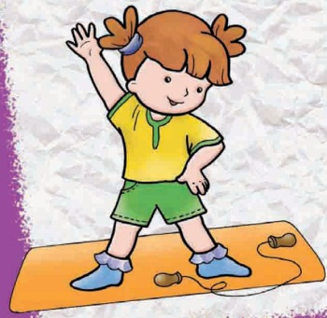
Динамическая пауза
.
.
^{Hands up, hands down.}
^{Hands on hips, sit down.}
^{Stand up, hands to the sides.}
^{Bend left, bend right,}
Hands on hips, one, two, three, hop.
One, two, three, stop. Stand still

Slide 8
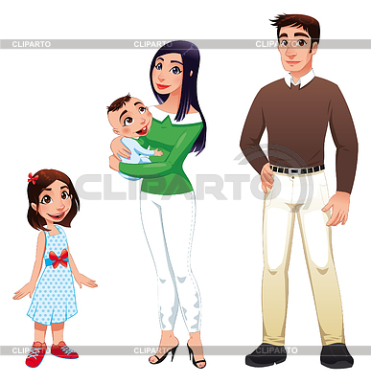
Составьте предложения используя следующие слова:
^{1. got, mother, a, has, Kate.}
^{2. you, Have, family, a got?}
^{3. have, I, got, a, brother.}
^{4. father, Have, you, a, got?}

Slide 9
Make up a story about your family.
My name is…
I have got a family.
I have got a
My mother’s name is…
My father’s name is…
I have got……..
My brother’s name is…

Slide 10
Thank you for your work today. It was fantastic!
Now the lesson is over, good-bye!

