Slide 1
Lesson 5
English letters

Slide 2
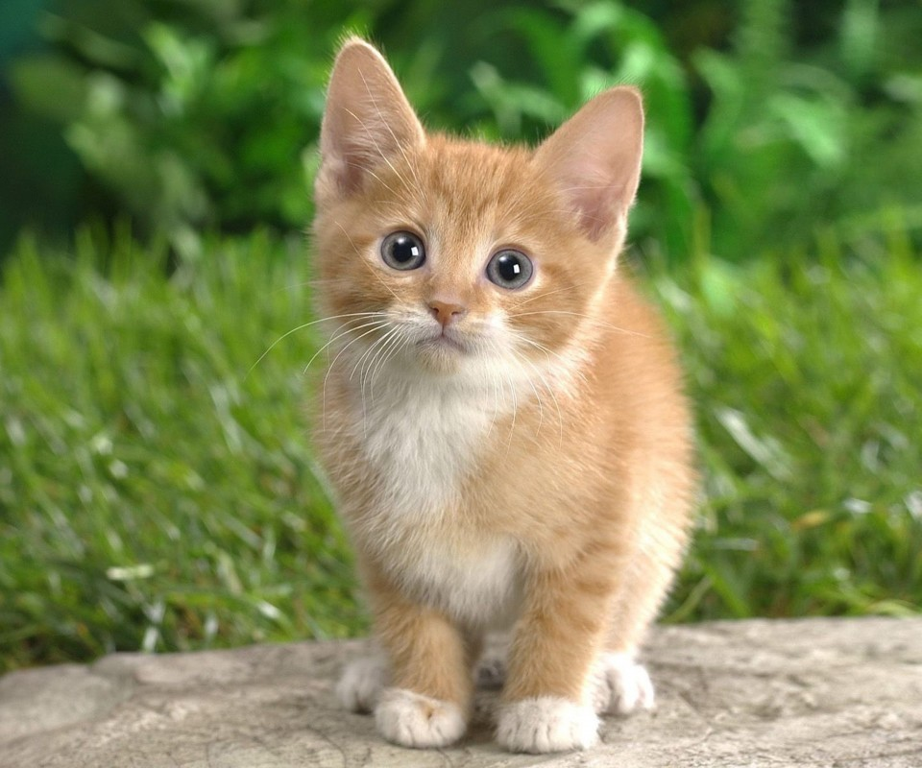
K k
K k

Slide 3
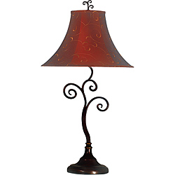
L l
L l

Slide 4
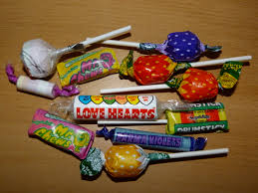
S s
S s

Slide 5
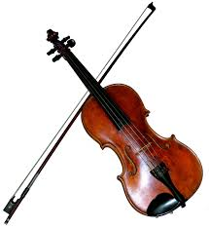
V v
V v

Slide 6
A Fox

Slide 7
Jam

Slide 8
A box

Slide 9
A frog

Slide 10
A kitten

Slide 11
A kiss

Slide 12
Sweets

Slide 13
A lamp

Slide 14
Let’s read
A dog and a fox.
A star and a gun.
A cat and a kitten.
A vase and a lamp.
A box and a bed.
A vase and a box.

Slide 15
Let’s read
A hen and a fox.
A hat and a cap.
A dog and a pig.
A pen and a cup.

Slide 16
Let’s read
One vase and two cups.
One box and five lamps.

Slide 17
Let’s play

Slide 18
A vase
and a cup

Slide 19
A kitten
and a rat

Slide 20
A gun and
a star

Slide 21
and a box
A lamp

Slide 22
Excellent!

