Slide 1
Lesson 4
English letters

Slide 2
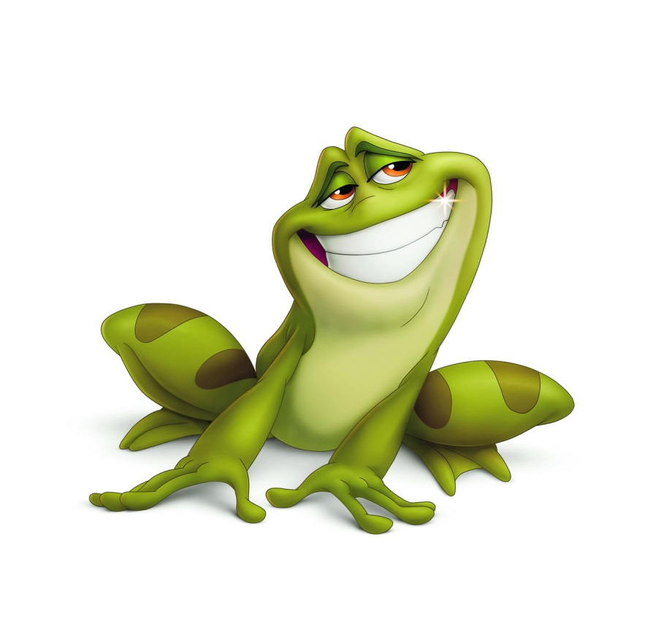
F f
F f

Slide 3
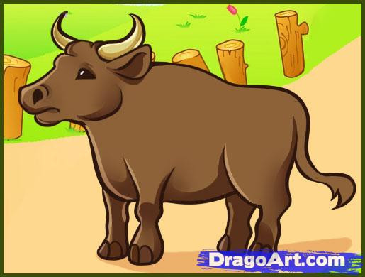
X x
X x

Slide 4
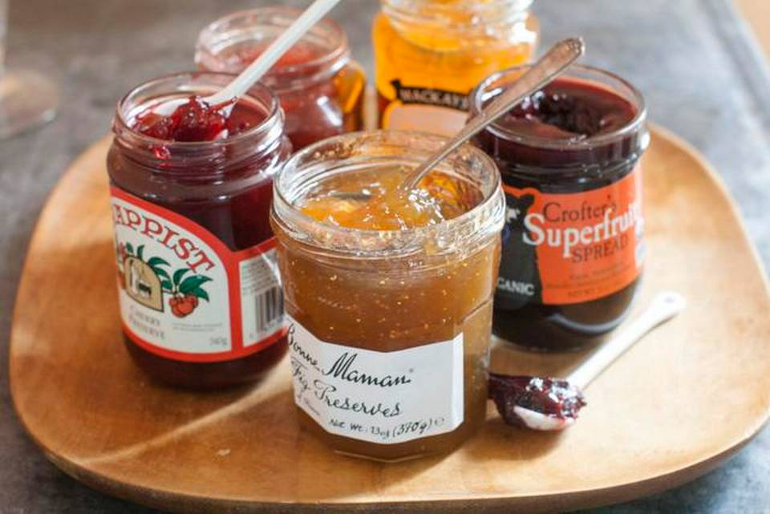
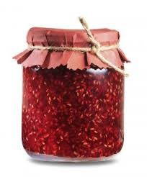
J j
J j

Slide 5
M m
M m

Slide 6
A Fox

Slide 7
Jam

Slide 8
A box

Slide 9
A frog

Slide 10
Let’s read
A fox, a pig, a box, a hen,
a pen, a cup, a gun, a cap, a bat,
a rat, a bed, a hat, a dog.

Slide 11
Let’s read
One box, one fox, one hen, one pen, one hat, one bat and jam

Slide 12
Let’s read
One, two, three, four

Slide 13
Let’s play

