Slide 1
Lesson 3
English letters

Slide 2
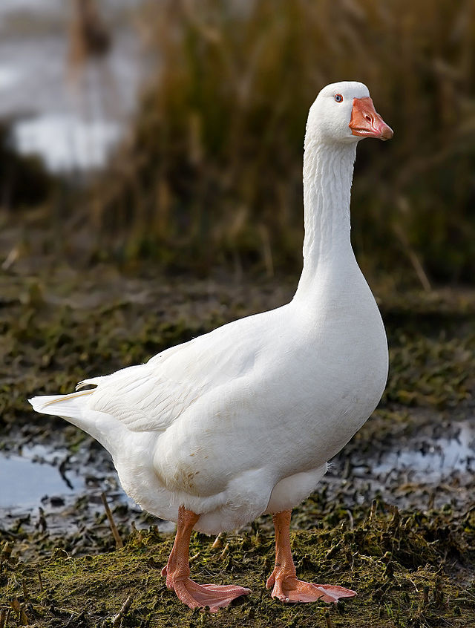
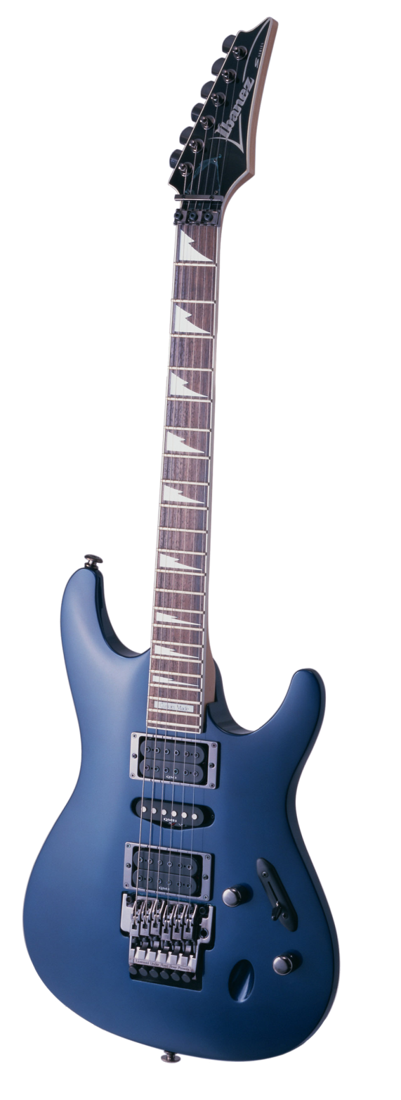
G g
G g

Slide 3
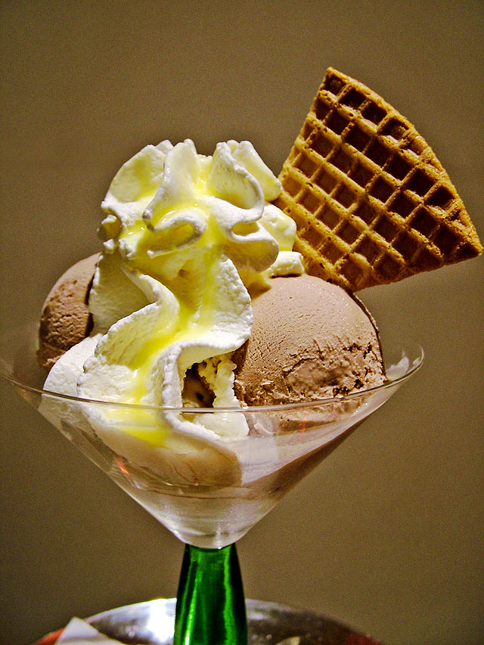
I i
I i

Slide 4
U u
U u

Slide 5
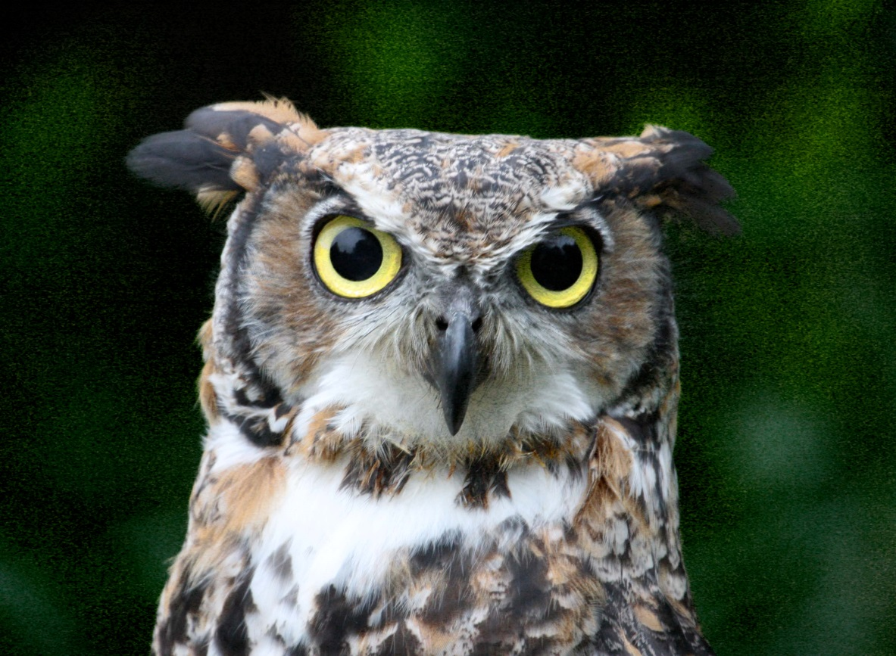
O o
O o

Slide 6
A dog

Slide 7
A pig

Slide 8
A cup

Slide 9
A gun

Slide 10
Let’s read
A dog and a pig.
A cap and a cup.
A bat, a dog and a pig.
A gun and a cup.
A hat and a hen.
A gun, a cup and a hat.

Slide 11
Let’s read
One gun, one dog and one rat.

Slide 12
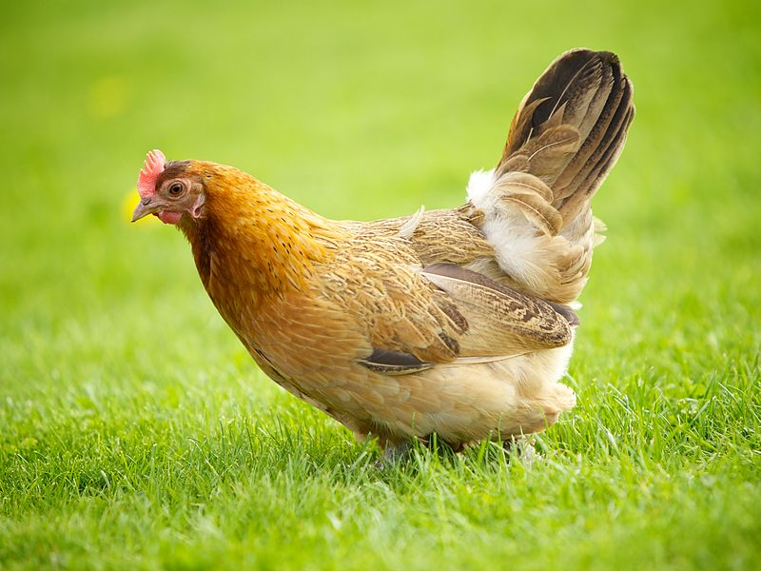
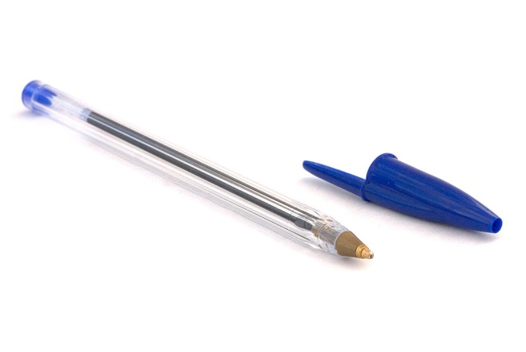
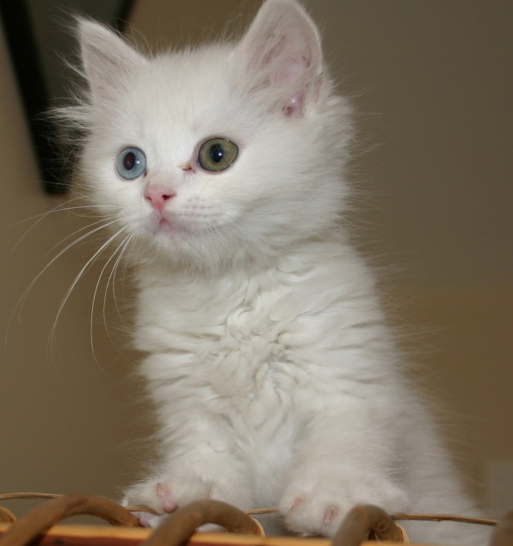
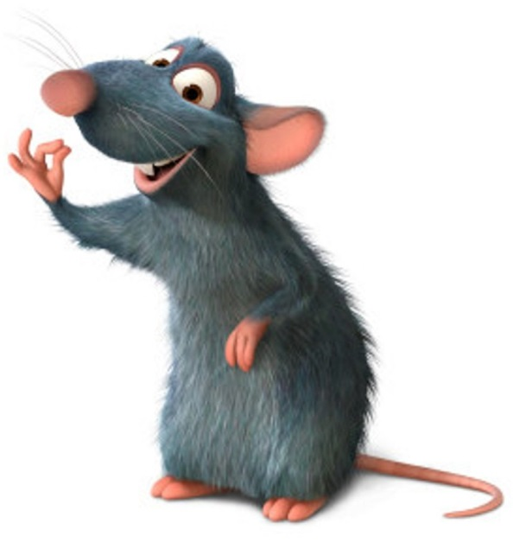
Remember the pictures

Slide 13
Find the picture

Slide 14
Find the picture

Slide 15
Find the picture

Slide 16
Find the picture

Slide 17
Find the picture

Slide 18
Find the picture

