Slide 1
Физминутки на уроках английского языка
Учитель английского языка
МБОУ «Тюльганская средняя школа №1»
Архипова Мария Анатольевна

Slide 3
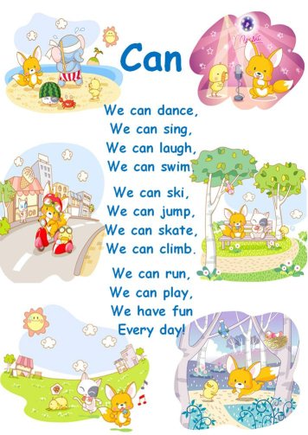

Slide 4
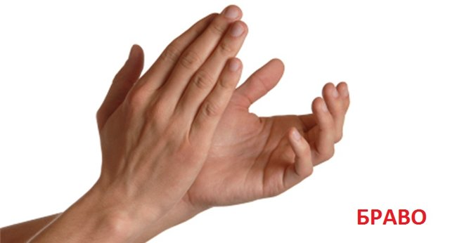
Clap, clap, clap your hands Clap your hands together. Stamp, stamp, stamp your feet Stamp your feet together. Dance, dance, dance a dance Dance a dance together.

Slide 5
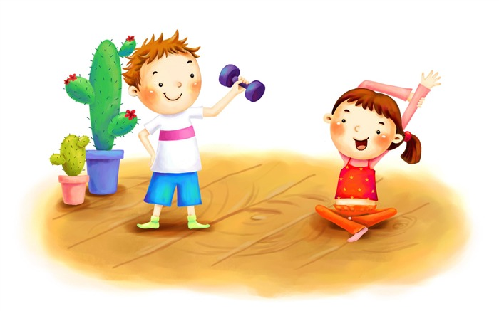
Arms up! Arms down! Arms on hips! Arms down! Clap your hands, Clap, clap! Tap your feet, Tap, tap!

Slide 6
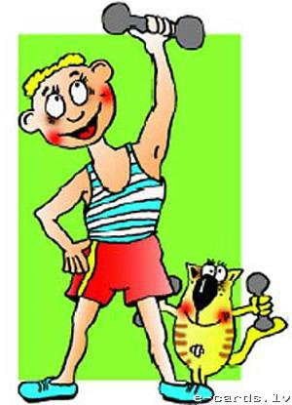
Two little feet Go tap, tap, tap, Two little hands Go clap, clap, clap. One little leap up from the chair Two little arms Go up in the air. Two little hands Go thump, thump, thump. Two little feet Go jump, jump, jump. One little body Goes, round and round. One little child Sits quietly down.

Slide 7
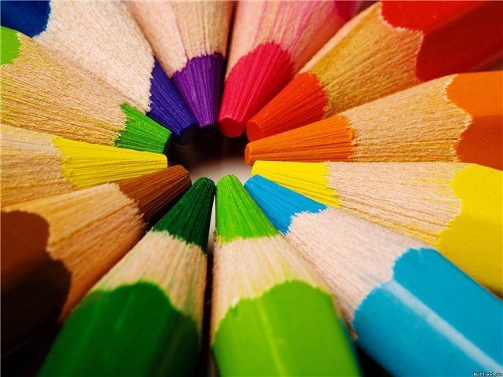
Stand up and show me orange! Hands up and show me blue! Clap! Clap! Show me yellow! Sit down. Nice of you! Stand up and show me blue! Hop! Hop! Show me red! Sit down. Nice of you! Stand up and show me grey! Sit down and point to the green. Clap! Clap! Show me pink. Stop! Very nice of you.

