Slide 1
Patter скороговорка

Slide 2
New words
a stork [stɔːk] аист
a sparrow [ˈspærəʊ] воробей
pea [piː] горох
an owl [aʊl] сова
grain [ɡreɪn] зерно

Slide 3
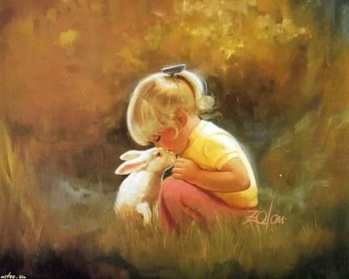
I like my Bunny

Slide 4
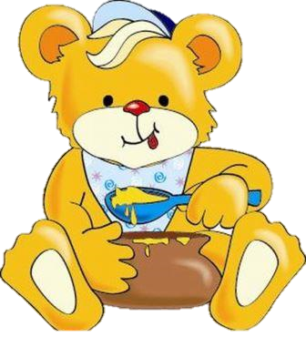
Bear likes honey.

Slide 5
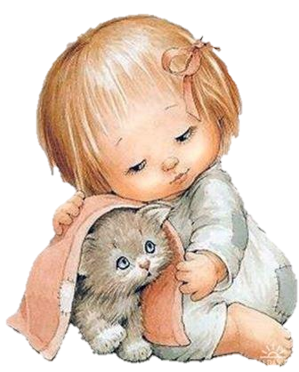
Girls like cats.

Slide 6
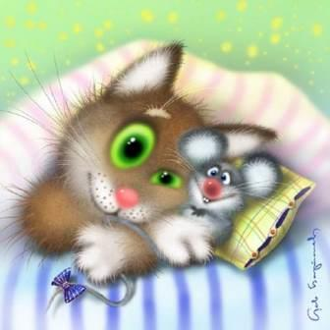
Cats like rats.

Slide 7
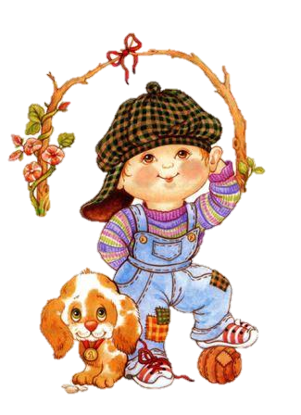
Boys like dogs.

Slide 8
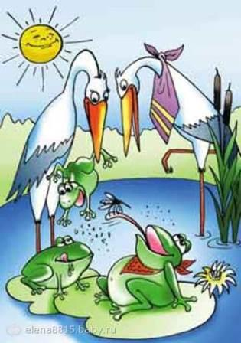
Storks like frogs.

Slide 9
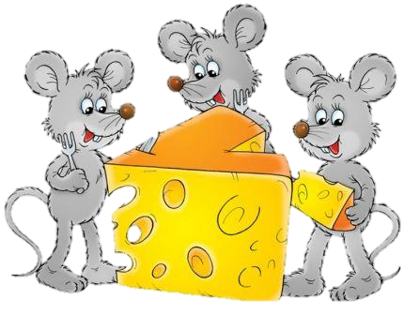
Mice like cheese.

Slide 10
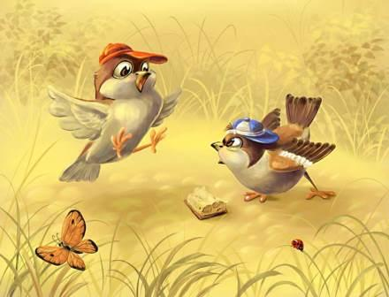
Sparrows like peas.

Slide 11
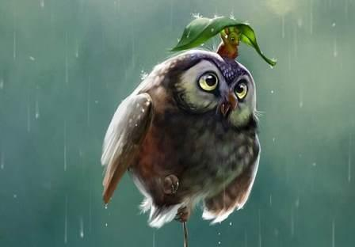
Owls like mice.

Slide 12
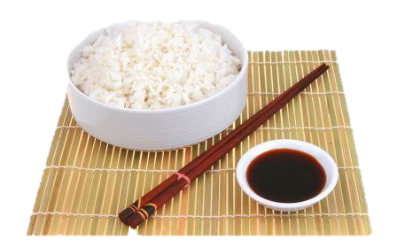
I like rice.

Slide 13
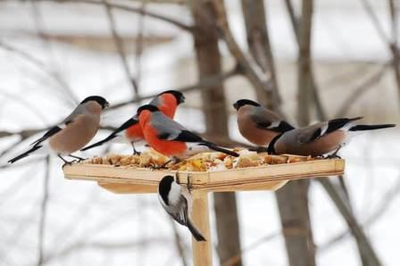
Birds like grain.

Slide 14
Say it all again.

Slide 15
Источники.
http://www.stihi.ru/pics/2012/12/17/6682.jpg
http://im1-tub-ru.yandex.net/i?id=79c4dc648c3ee0661dfb4fcc752e9068-25-144&n=21
http://crosti.ru/patterns/00/02/04/ec05963fe8/preview.jpg
http://www.fau.com.ua/images/stories/Bartenev/8.jpg
http://im3-tub-ru.yandex.net/i?id=641359a9139c11b9087611a55be00ab9-11-144&n=21
http://www.kondice.cz/wp-content/uploads/2012/02/shutterstock_2408236.jpg
http://znayka1.ru/wp-content/uploads/2011/12/Vorobi.jpg
http://a.pix.ge:81/z/vh72u.jpg
http://www.motto.net.ua/old_site/img/food/1297611906_F0E8F120F120F1EEF3F1EEEC.jpg
http://www.volgabirds.ru/forum/attachments/907.jpg
http://www.echo.msk.ru/att/element-727739-misc-0.jpg
http://static1.babysfera.ru/6/6/b/a/55980674.m.jpeg

