Slide 1
Family & Friends!
1b

Slide 2
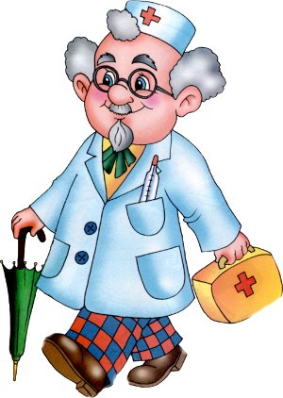
Take roles and read out.
Denis: Who’s this?
Valentina: This is my uncle Danil.
Denis: Where does he live?
Valentina: He lives in Great Britain.
He’s a doctor.
Denis: How old is he?
Valentina: He’s forty-five.
Denis: What’s he like?
Valentina: He’s very kind and
friendly.

Slide 3
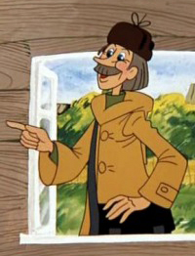
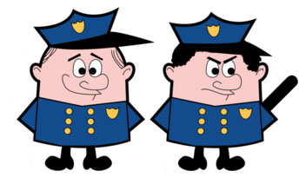
Act out similar dialogues.

Slide 4
Writing Practice
Find 9 mistakes.
This is my best friend vera. She’s ten years old. Vera has got blonde hair and green eyes. she’s tall and slim. her mum is from italy. Every tuesday we go sailing. it’s great fun. Vera lives two blocks from my house at 45 perich street. Our dream is to travel to africa and see wild animals.

Slide 5
New words
CD – диск
hairbrush – расческа
keys – ключи
roller blades – ролики
gloves – перчатки
mobile phone – мобильный телефон
helmet – шлем
watch – часы
camera – фотоаппарат
guitar - гитара

Slide 6
A: Where’s my hairbrush? B: It’s next to the clock.

Slide 7
Let’s play!

