Slide 1
School again!!!
2b

Slide 2
Using capital letters
Write the sentences.
my name’s John. – My name’s John.
my name is eva and i’m nine years old.
i’m ida and i’m from russia.
her favourite subject is art.
she lives in the uk. she speaks english.

Slide 3
New words!
English – англ. яз.
Maths – матем.
Geography – география
PE – физ-ра
History – история
Science – окр. Мир
Аrt - изобразительное искусство
Music – музыка
Russian - русск. яз.

Slide 4
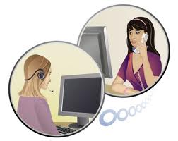
Read!
A: What’s your name?
B: My name’s Maria Smirnova.
A: Sorry? Can you spell that, please?
B: Yes, it’s S-M-I-R-N-O-V-A.
A: How old are you, Maria?
B: I’m 10.
A: What’s your favourite subject?
B: Art.
Act out similar dialogues.

Slide 5
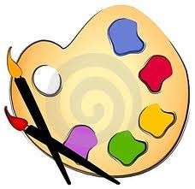
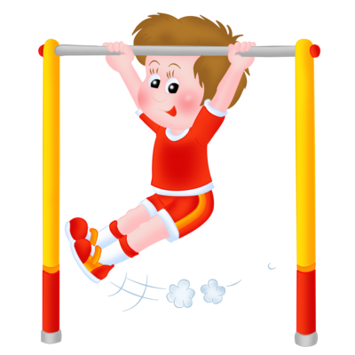
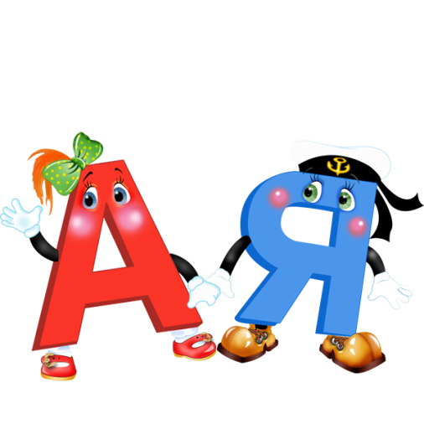
School again!
Guess the subject!!!

Slide 6
Homework!

