Slide 1
GREETING
ГБОУ СОШНО № 265
Г. Москва
Учитель английского языка
Немтинова Людмила Сергеевна

Slide 2
HOW IS YOUR MOTHER?
SHE IS FINE, THANKS.

Slide 3
HOW IS YOUR FATHER?
HE IS FINE, THANKS.

Slide 4
HOW IS YOUR SISTER?
SHE IS FINE, THANKS.

Slide 5
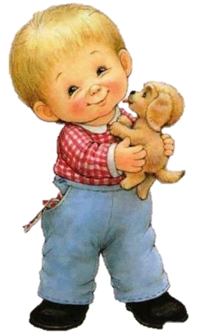
HOW IS YOUR BROTHER?
HE IS FINE, THANKS.

Slide 6
AND HOW ARE YOU?
I AM FINE TOO. THANK YOU.

Slide 7
Источники
http://im0-tub-ru.yandex.net/i?id=b10b4669f586ab69e5af5d834d59e00c-131-144&n=21
http://ok.ya1.ru/uploads/posts/2008-07/1215229549_25_06_2008_0967860001214409650_happy_fatherss_day.jpg
http://static.smeha.net/s/otkrytki/gvtuVfNnCJEperb.jpg
http://lvkr.ru/pA0Gyt.jpg
http://www.fahrettincicek.com/wp-includes/css/crazy-smiley-faces-text-565.jpg

