Slide 1
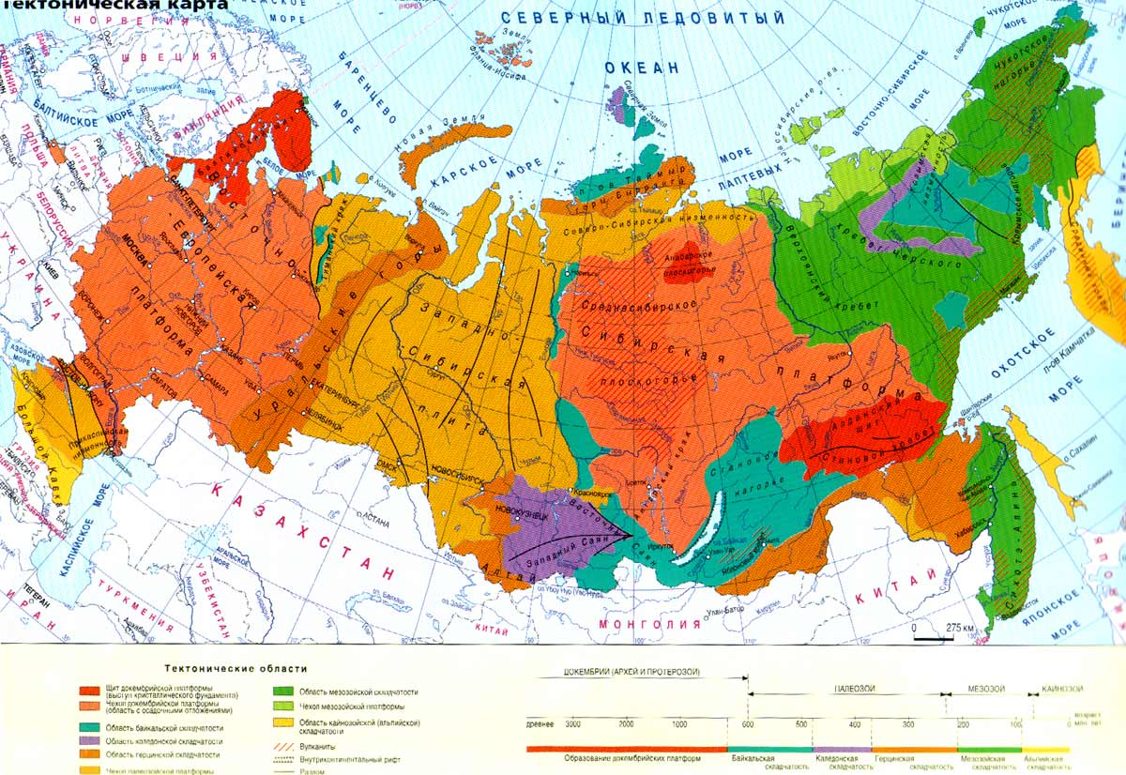
What country is it ?

Slide 3
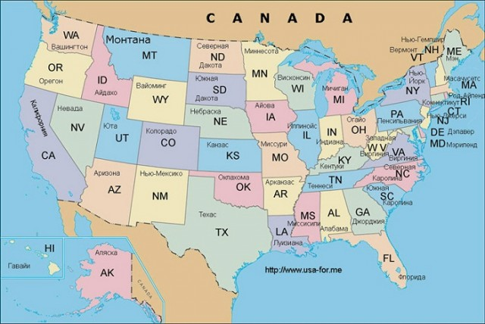
1. Name the countries. 2. Which country is bigger?

Slide 4
What country is bigger: Russia or the USA?

Slide 5
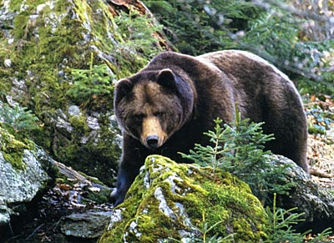
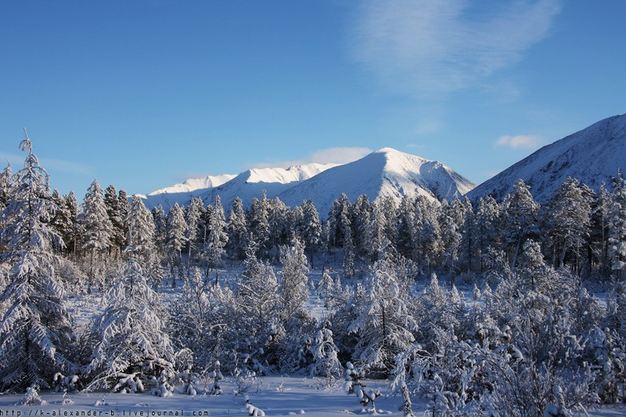
What part of Russia is it?

Slide 6
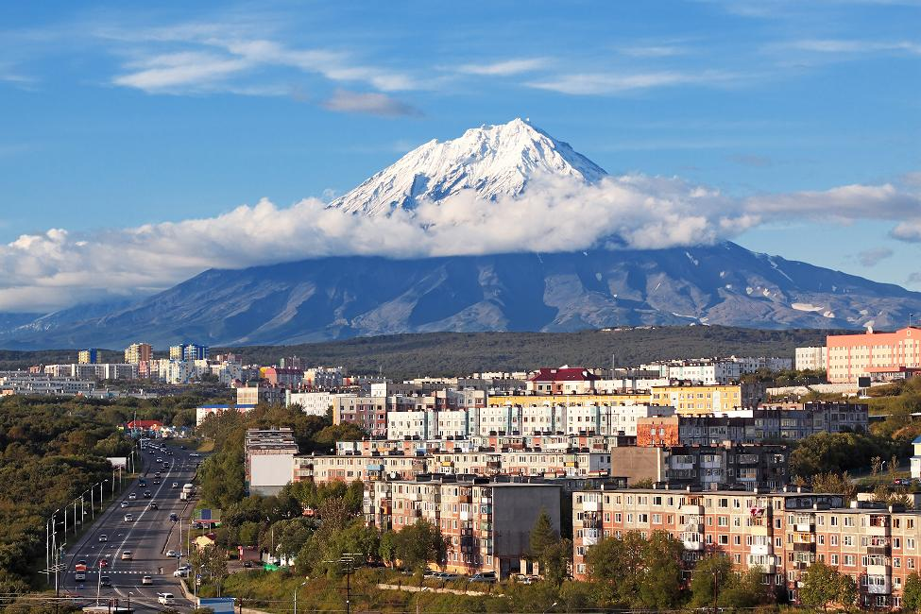
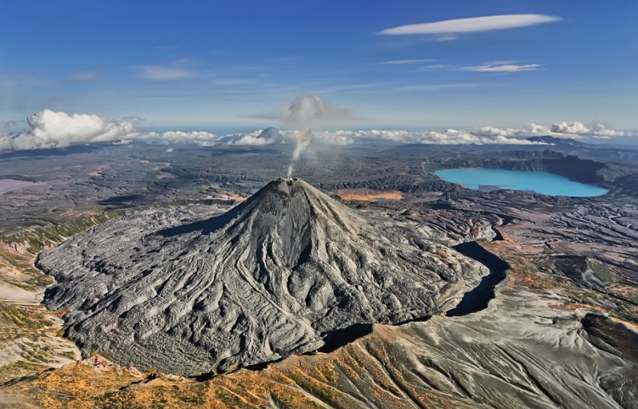
What is Kamchatka famous for?

Slide 7
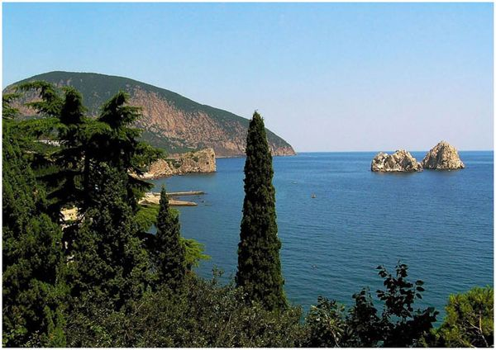
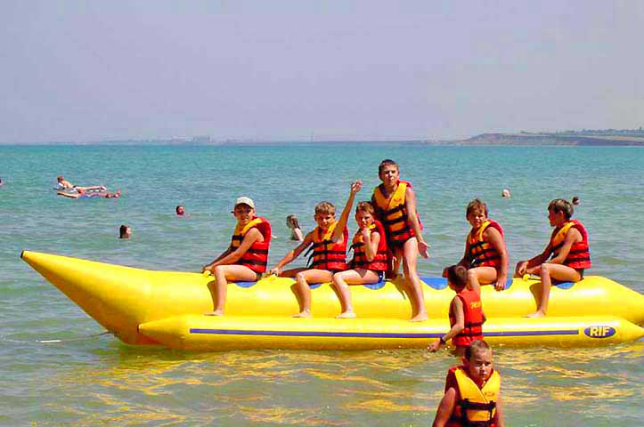
What sea is it? What is it famous for?

Slide 8
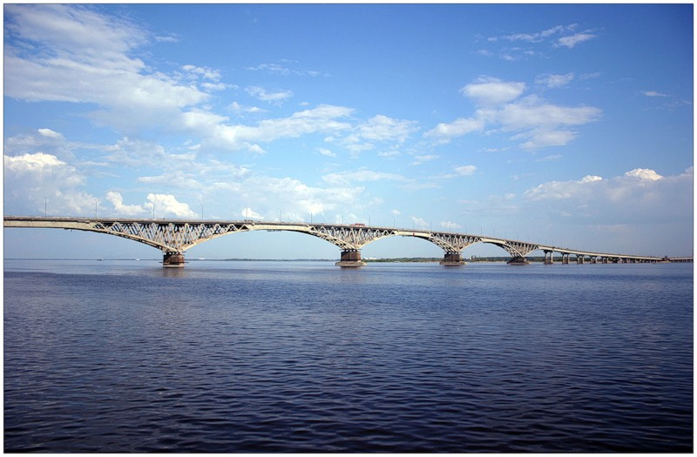
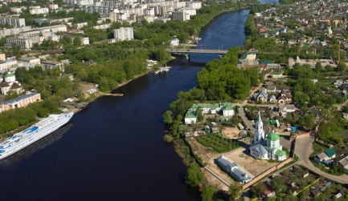
How many cities are there on the Volga?

Slide 9
What place in Russia would you like to visit? Why?

Slide 10
