Slide 1
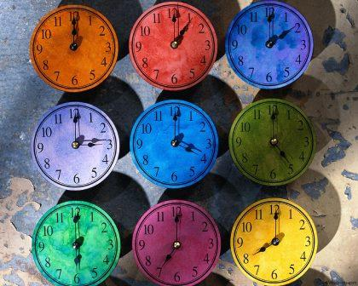
It’s time for me!
ГБОУ СОШНО 265
Г.Москва
Учитель английского языка
Немтинова Людмила Сергеевна

Slide 2
later позднее
to use [ju:z] пользоваться
to appear [əˈpɪə] появляться
a tower [ˈtaʊə] башня

Slide 3
accurate ['aekjarot] точный, правильный
bell [bel] n 1) колокол 2) звонок (звук)
early [ˈɜːlɪ] ранний, древний
first [fɜ:st] первый, сначала

Slide 4
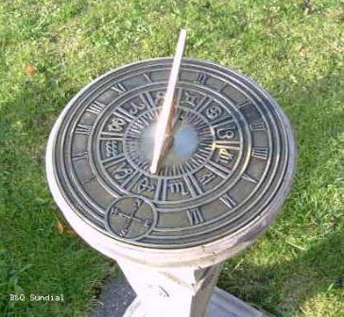
Early people did not have clocks. But they had many ideas of how to tell the time. First, they told the time by the sun and later, they began to use sun clocks.

Slide 5
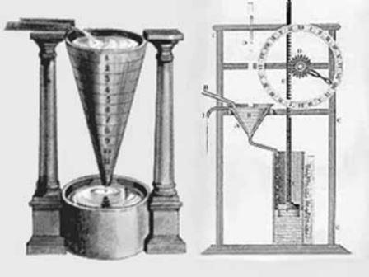
But sun clocks were good only on sunny days and people made water clocks. Water clocks were better than sun clocks because they told the time during the day and at night. They were more accurate than sun clocks.

Slide 6
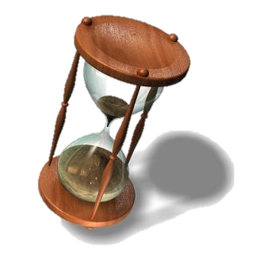
People also used the hourglass or sandglass to tell the time.

Slide 7
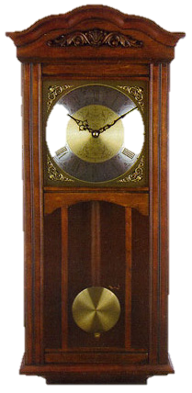
Then the first mechanical clocks appeared. They were very big and heavy. Some of them were with bells and people put them in large towers. Later clocks became smaller.

Slide 8
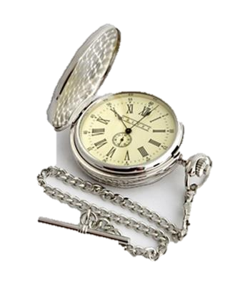
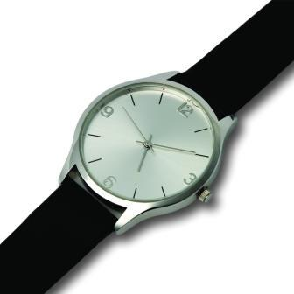
Soon the first watches appeared — pocket watches and wristwatches.

Slide 9
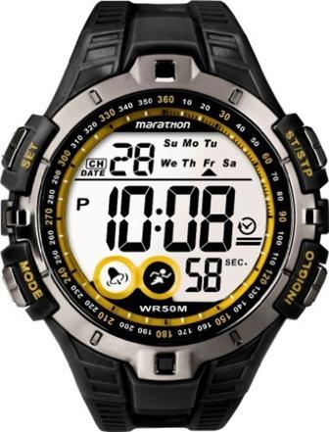
Later people made the electric clock.

Slide 10
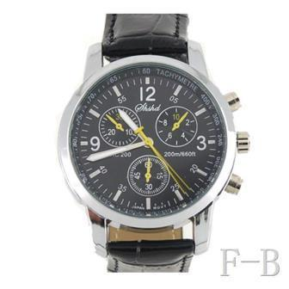
Today, quartz clocks* and watches are popular. Quartz clocks are very accurate. You can see quartz clocks in calculators and computers.

Slide 11
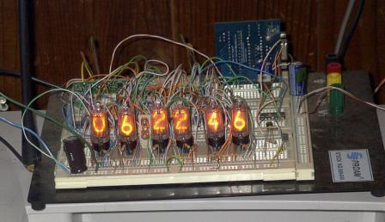
But the most accurate clock is the atomic clock.

Slide 12
Источники
http://www.ikirov.ru/files/1201/Kompozicija-iz-chasov-5988.jpg
http://s6.hostingkartinok.com/uploads/images/2013/04/6610180fef2e879309a80f5adc5c7bba.jpg
http://cdn1.imhonet.ru/photos/out/310594cd/1271491_source.jpg
http://www.kisa-bilgi.com/resim/su-saati.jpg
http://www.bhpsnj.org/cms/lib5/NJ01001806/Centricity/Domain/351/hourglass.jpg
http://www.idealtime.ru/admin/pictures/45026b.jpg
http://www.rpknavigator.ru/img/db/29366.jpg
http://l-goods.ru/uploads/images/brendy/dalvey/chasy-ohotnika-karmannye-na-tsepochke-kvartsevye-00421.jpg
http://www.ifoundwatch.com/cj/large/T5K421.jpg
http://www.brilliantstore.com/pimagesl/l_fp-yw364b.jpg
http://blog.walii.es/wp-content/uploads/2010/04/nixie_clock_big_1.jpg
http://im3-tub-ru.yandex.net/i?id=376a851e52c8e6f96e0deae0d4f08aaf-82-144&n=21

