Slide 1
Read the words:
Beach, seal, cream, stream, peach, meal, green, feet, queen, sheep, sweet, sleep, bear, pear, wear, hair, chair, scared, stare, hare.

Slide 3
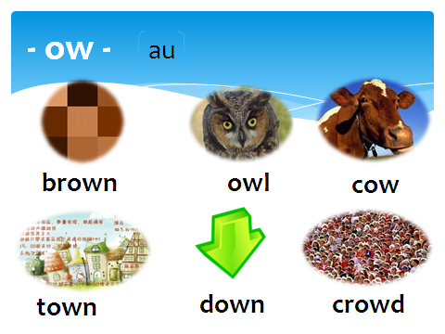

Slide 4
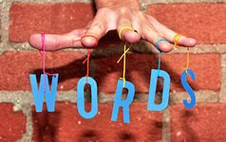
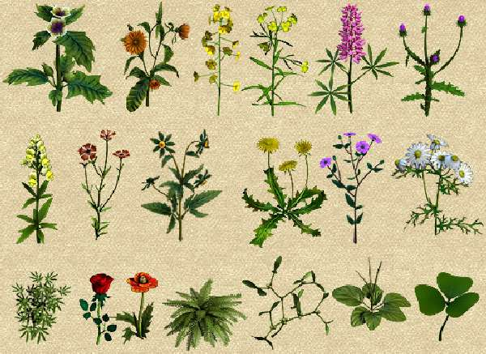
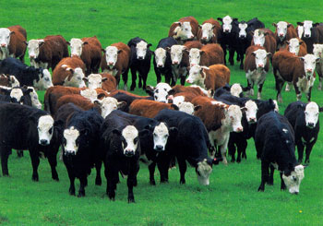
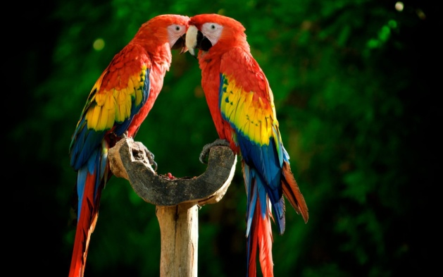
- or - - er -
3:
word
worm
homework
herb
herd
perch

Slide 5
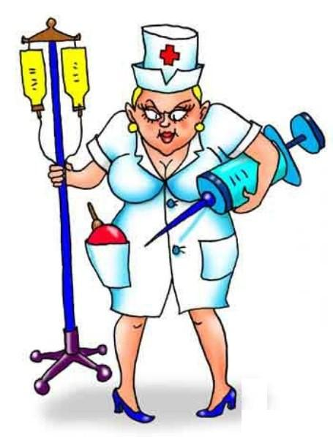
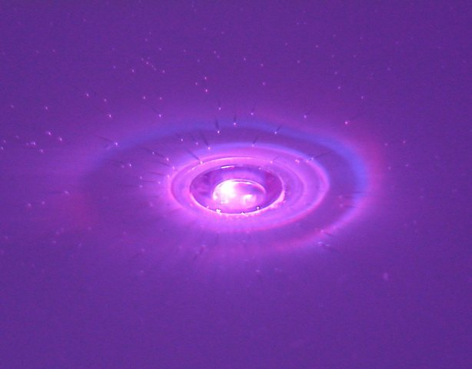
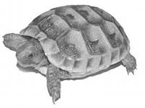
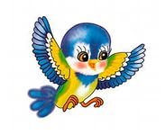
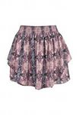
- ur - - ir -
3:
purple
turtle
nurse
girl
bird
skirt

