Slide 1
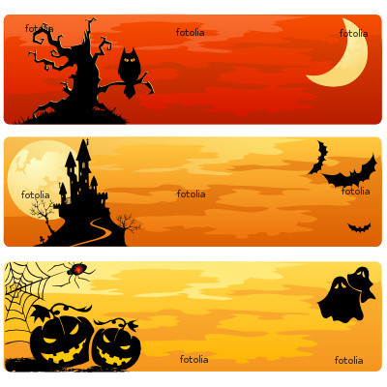
October, 31

Slide 2
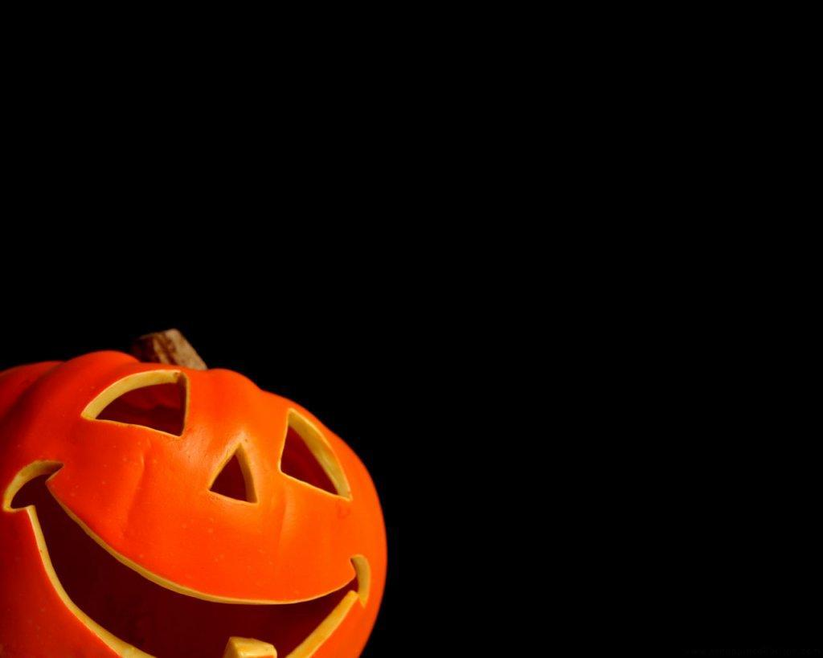
Halloween
Halloween is celebrated on the 31 of
October in the United States,
Canada, Ireland and England.

Slide 3
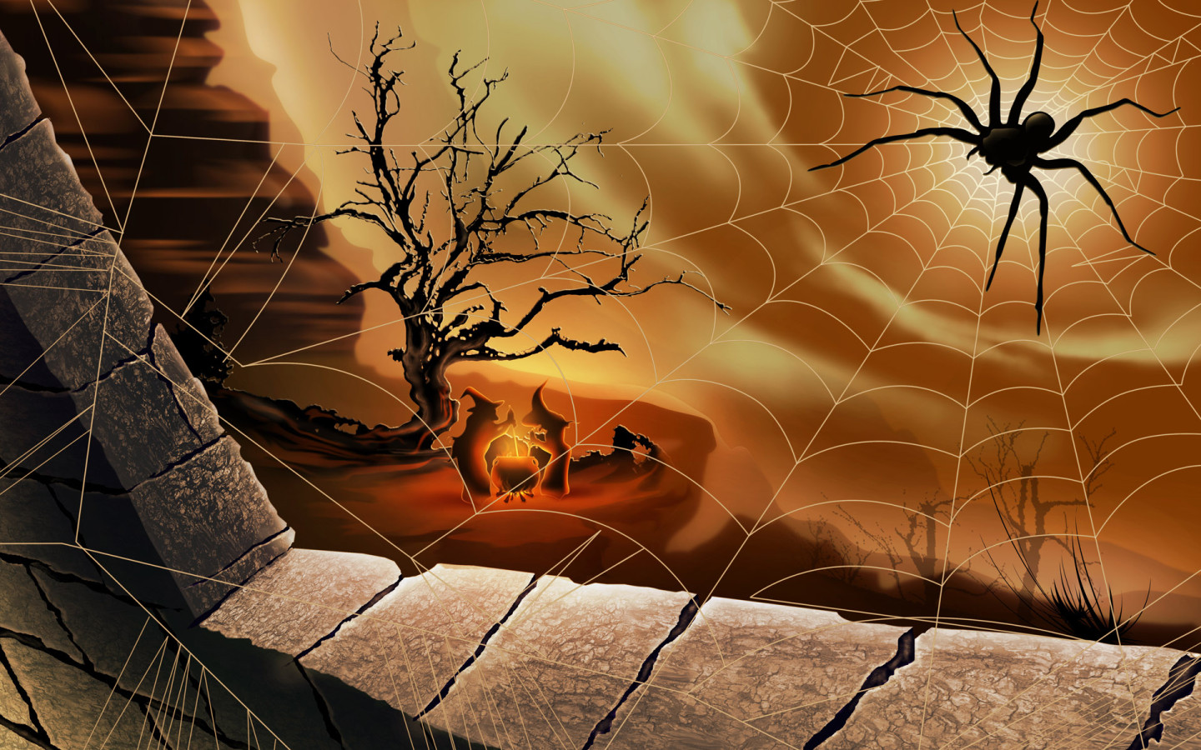
It has roots in the Celtic
festival of Sambain
and the Christian
holiday All Saint’s Day

Slide 4
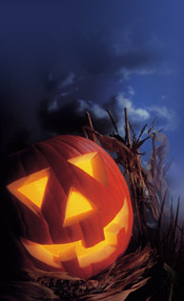
The name Sambain comes from Old Irish
and means "summer's end“.
It celebrates the end of the "lighter half“
of the year and beginning of the "darker half",
and is sometimes regarded as the "Celtic New Year“.

Slide 5
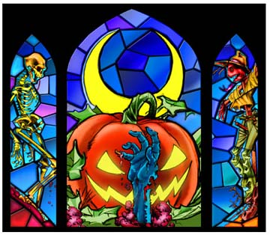
The ancient Celts believed that
the border between this world and the Other World
became thin on Samhain, allowing spirits
(both harmless and harmful) to pass through.

Slide 6
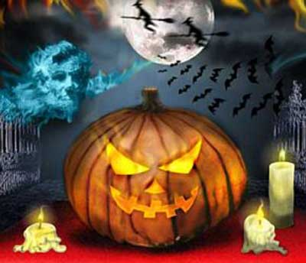
The word Halloween comes from
All-Hallows-Even ("evening"),
that is, the night before All Hallows Day.
And the phrase All Hallows is found in Old English
(ealra hālgena mæssedæg, mass-day of all saints).

Slide 7
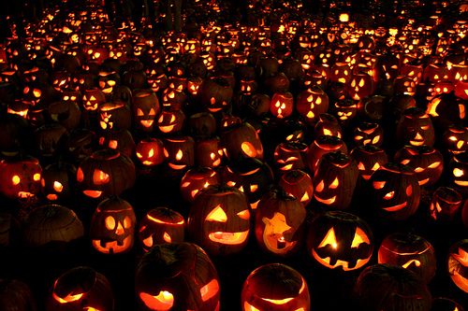
The main symbol of Halloween
is a lantern* made of a pumpkin.
In traditional Celtic Halloween festivals,
it was not a pumpkin, but a turnip**.
Large turnips were hollowed out, carved***
with faces, and placed in windows to ward off**** evil spirits
*a lantern – фонарь
**a turnip – репа
***to carve – вырезать
**** to ward off – держать на расстоянии

Slide 8
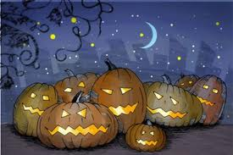
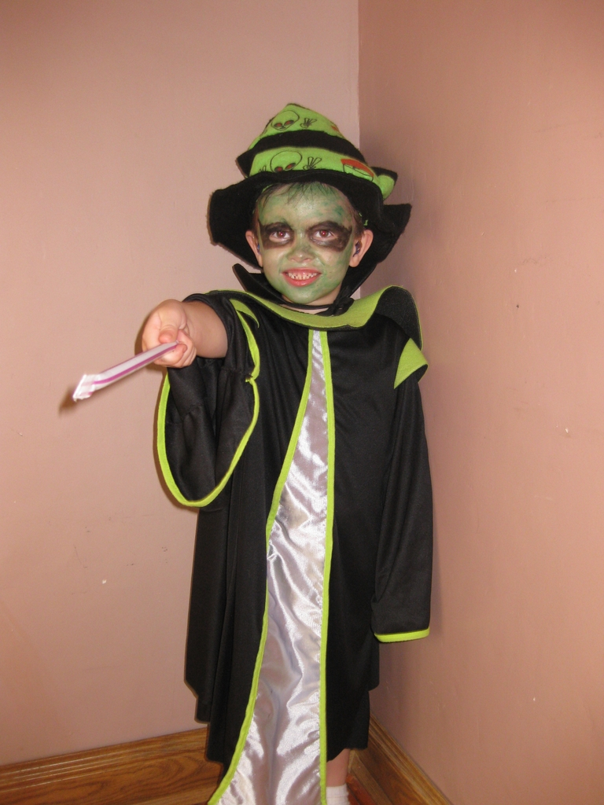
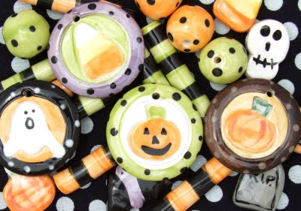
Trick-or-treating is a customary celebration
for children on Halloween.
Children go in costume from
house to house, asking for treats
such as candy or sometimes
money, with the question -

Slide 9
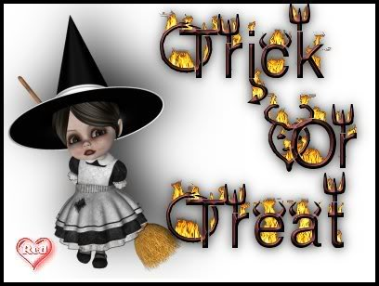

Slide 10
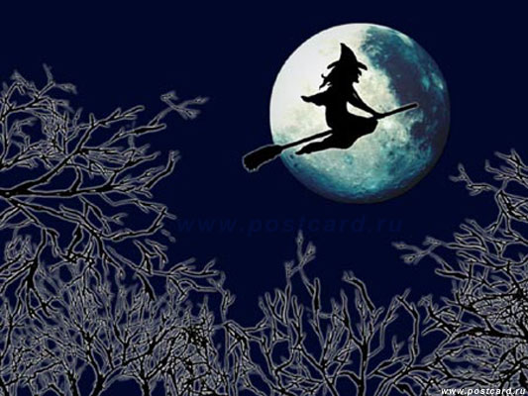
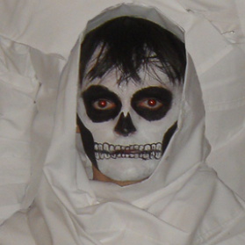
Halloween costumes are traditionally
modeled after monsters such
as ghosts, skeletons, witches,
and devils. Over time, the costume
selection extended to include
popular characters from fiction,
сelebrities.

Slide 11
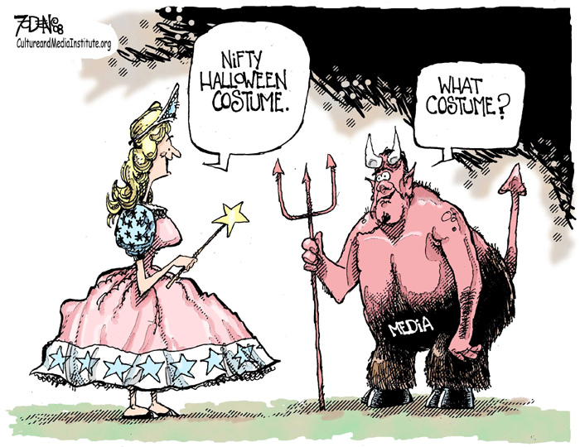
*
*Nifty – модный, щёгольской; стильный

Slide 12
