Slide 1
STEP 5 Unit 2
Rainbow English 3 класс

Slide 2
Запомни!
Very well – очень хорошо
But not very well – не очень хорошо

Slide 3
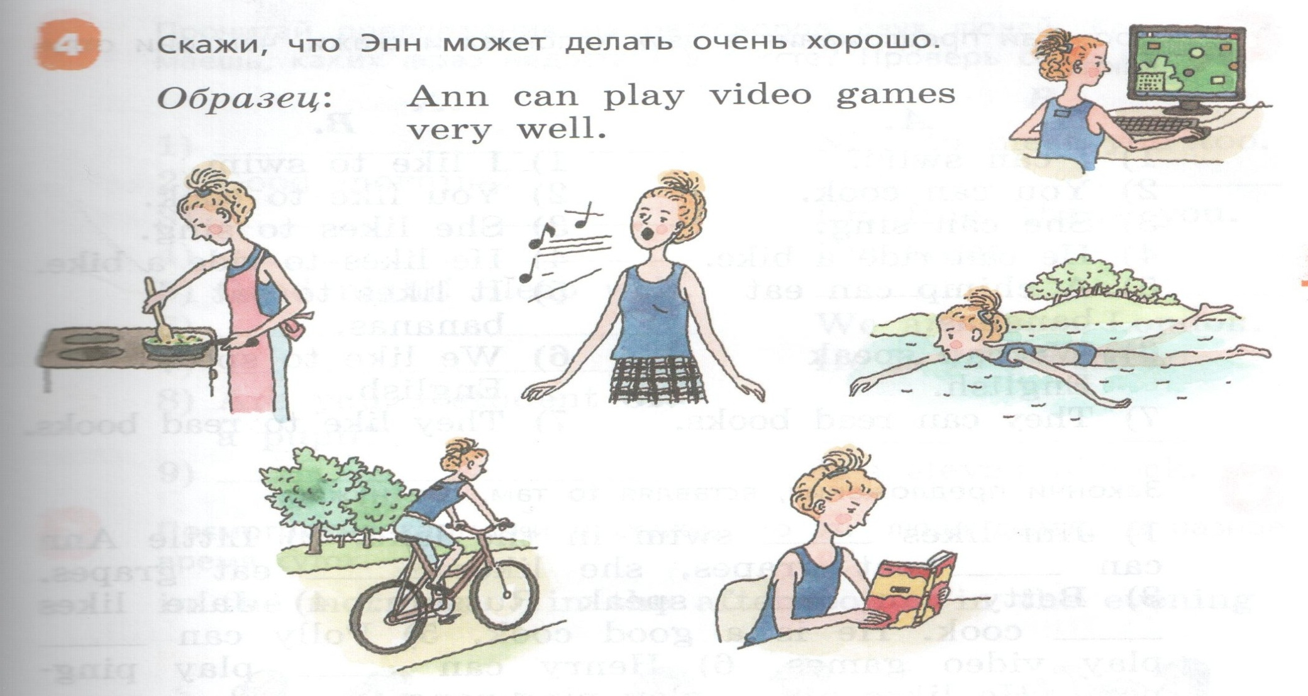
Ann can cook very well.
Ann can sing a song very well.
Ann can swim in the lake very well.
Ann can ride a bike very well.
Ann can read a book very well.
Ann can cook but not very well.
Ann can sing a song but not very well.
Ann can swim in the lake but not very well.
Ann can ride a bike but not very well.
Ann can read a book but not very well.

Slide 4
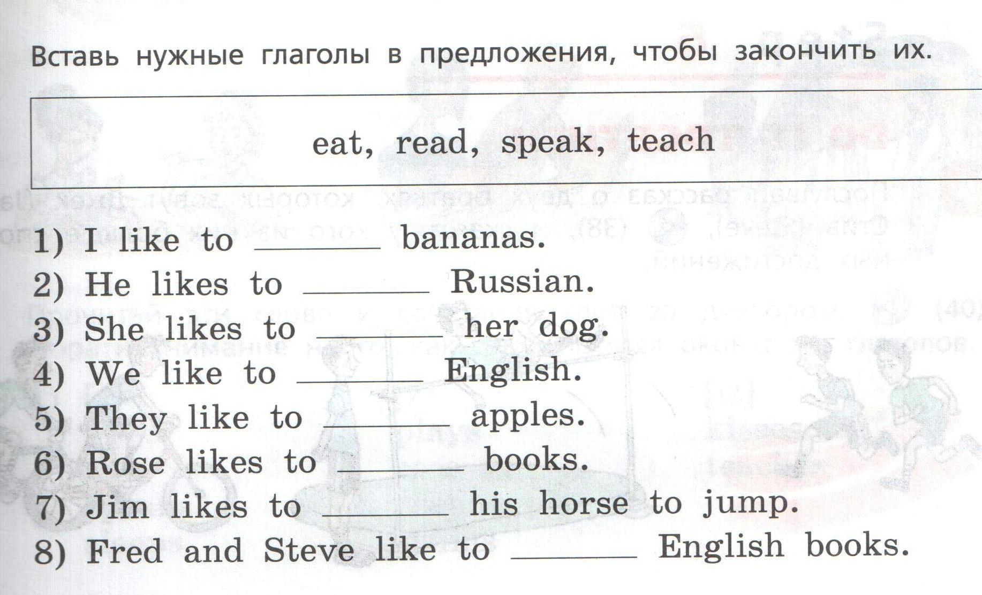
Кушать, читать, говорить, учить(ся)
eat
speak
teach
teach
eat
read
teach
read

Slide 5
