Slide 1
STEP 6 Unit 2
Rainbow English 3 класс

Slide 2
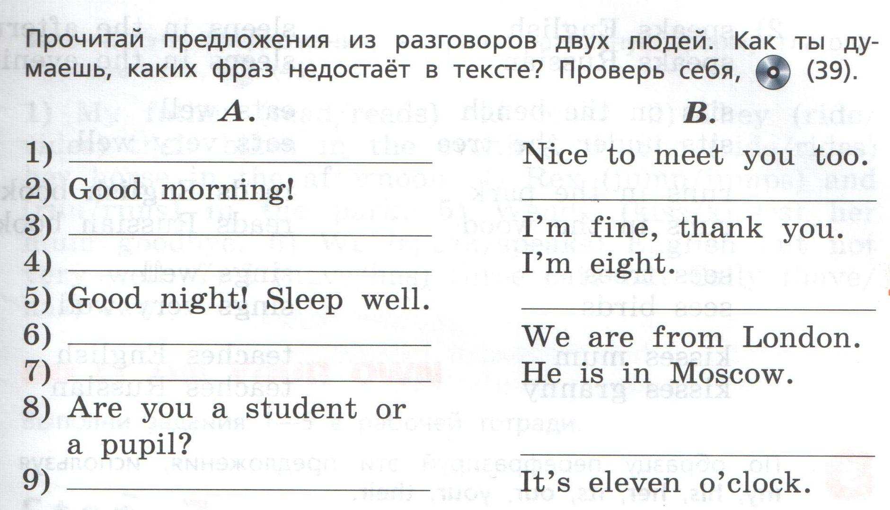
Nice to meet you!
Good morning!
How are you?
How old are you?
Good night!
Where are you from?
Where is he?
I am a pupil.
What’s the time?

Slide 3
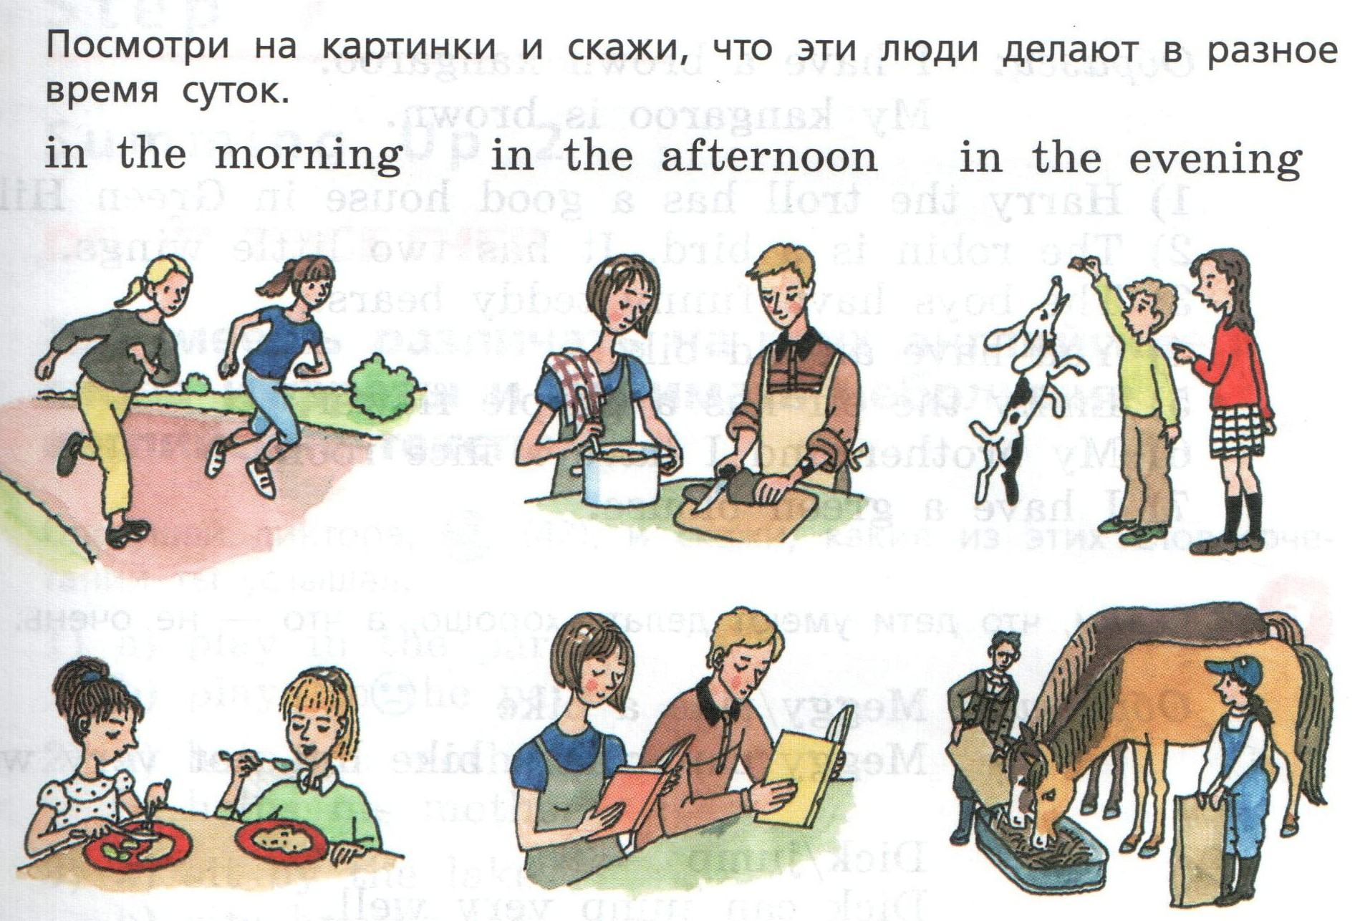
They run in the park in the morning.
They cook in the afternoon.
They feed the dog in the evening.
They read books in the afternoon.
They feed the horse in the evening.
They eat in the morning.

Slide 4
His house is good.
Its wings are little.
Their teddy bears are funny.
Your bike is old.
Her flower is purple.
Our room is nice.
My blouse is green

Slide 5
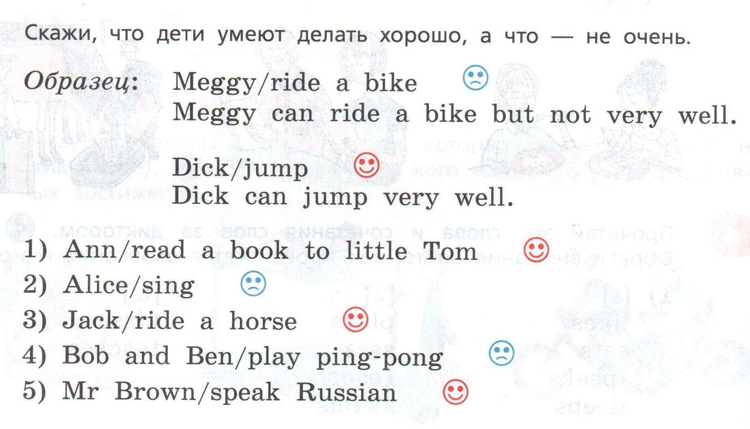
Ann can read a book to little Tom very well.
Alice can sing but not very well.
Jack can ride a horse very well.
Bob and Ben can play ping pong but not very well.
Mr Brown can speak Russian very well.

Slide 6
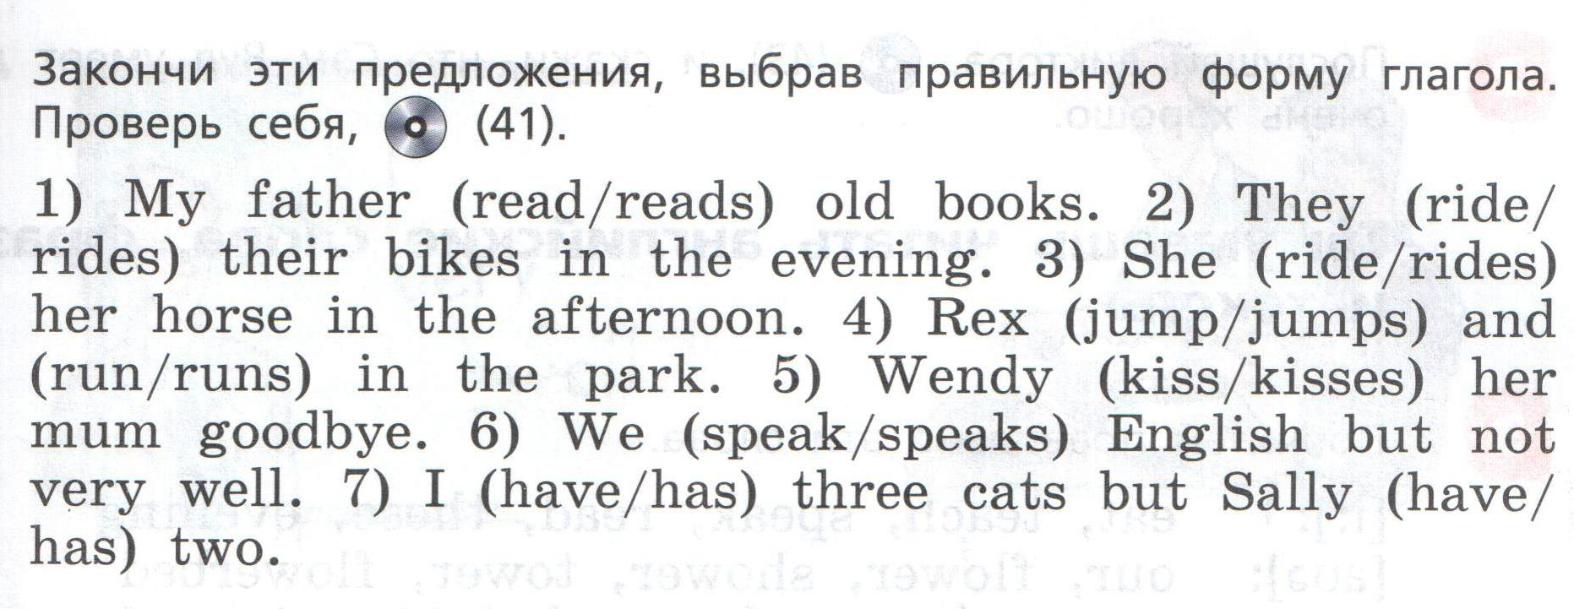
Только в 3-ем лице (He,she,it) – окончание s/es

