Slide 1
STEP 1 Unit 3
Rainbow English 3 класс

Slide 2
Yes, it is.
Its name is Raddy.
It is a very big horse.
It is on the farm
No, he can not. He ride a horse but not very well.

Slide 3
окно
радуга
воробей
жёлтый

Slide 5
is
Are
am
is
are
are
are
are
are
are
is
is

Slide 6
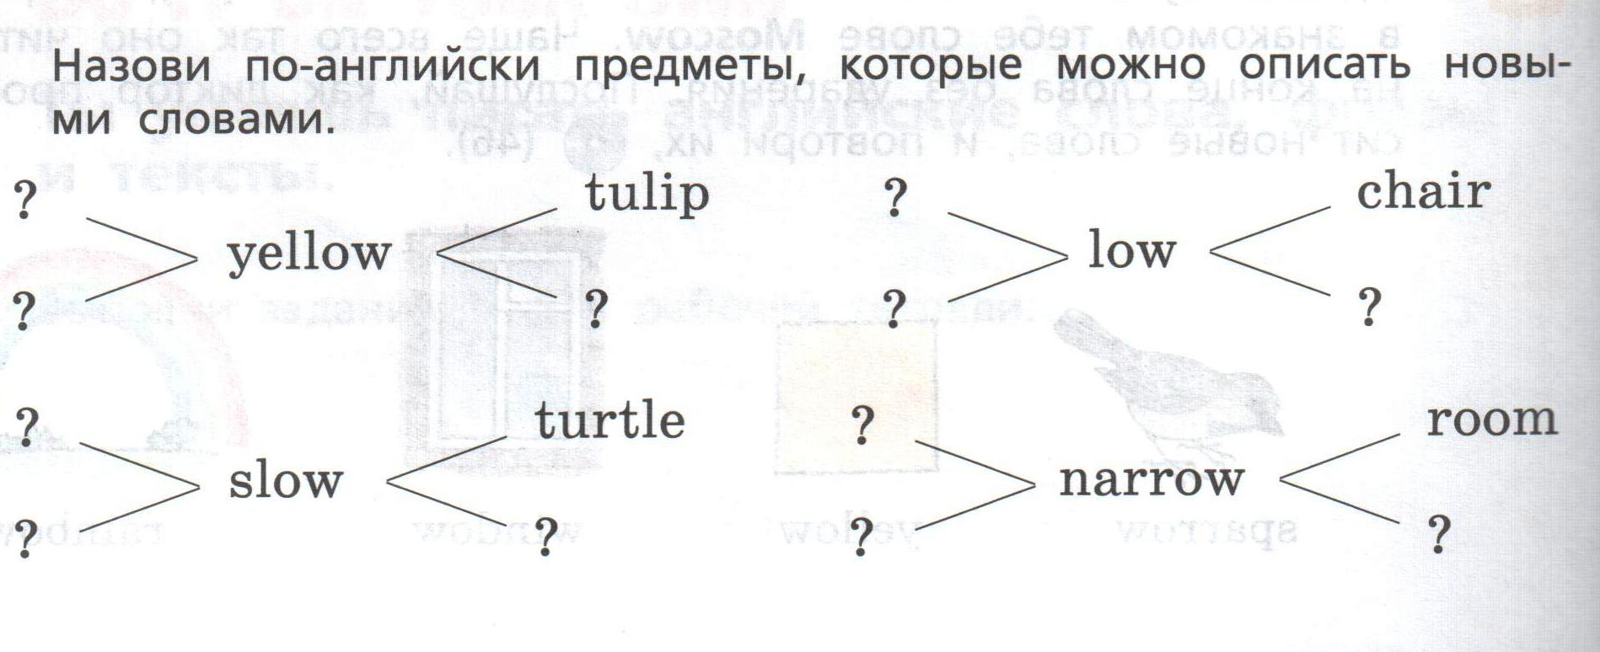
banana
Teddy bear
bell
throne
hill
ant
ship
street
shop
Желтый
Медленный
Низкий
Узкий

Slide 7
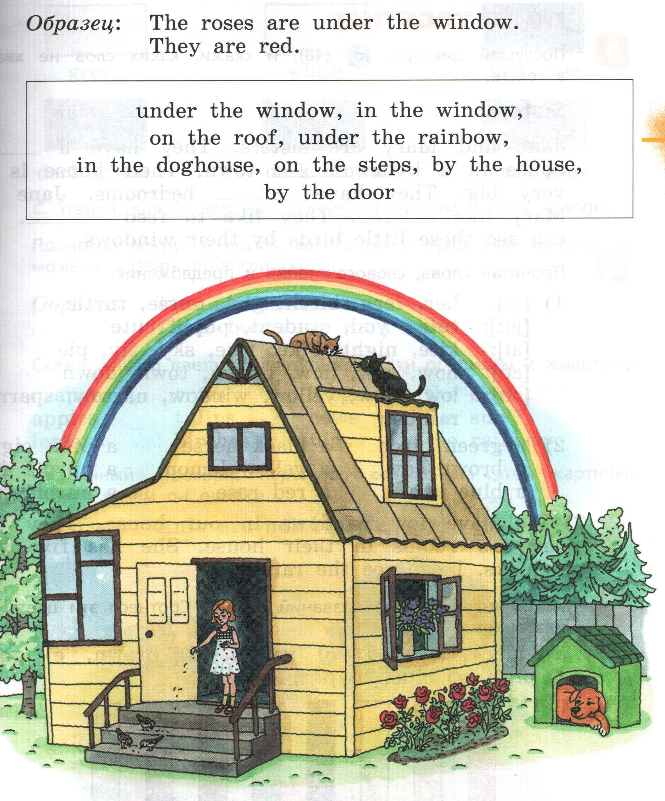
Розы под окном. Они красные.
Под окном, в окне
На крыше
Под радугой
В будке
На лестнице, у дома
У двери

