Slide 1

MY FAMILY

Slide 2

MY MOTHER

Slide 3
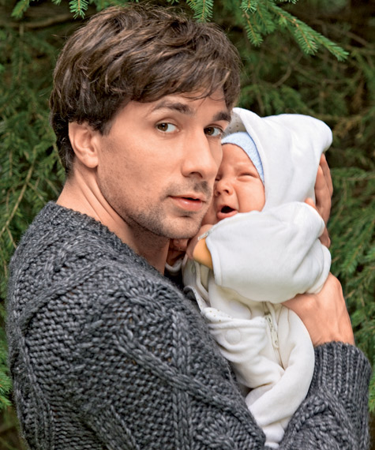
MY FATHER

Slide 4
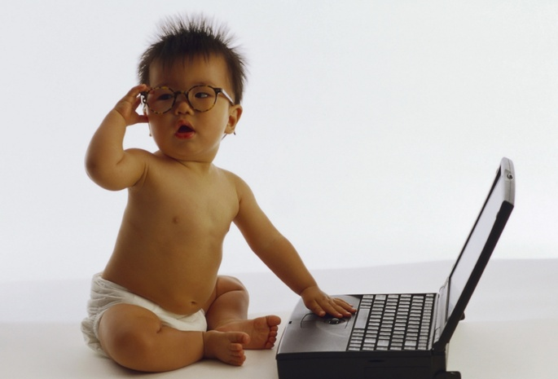
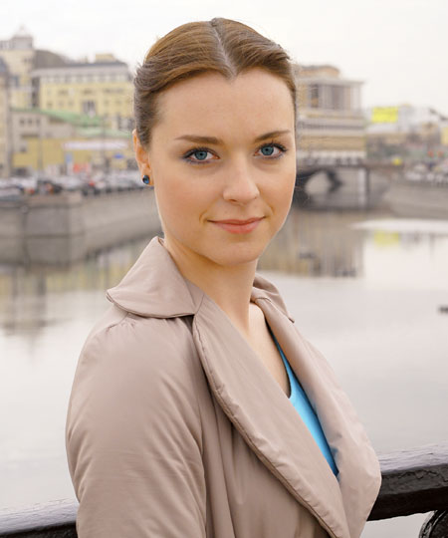
BROTHER
SISTER

Slide 5
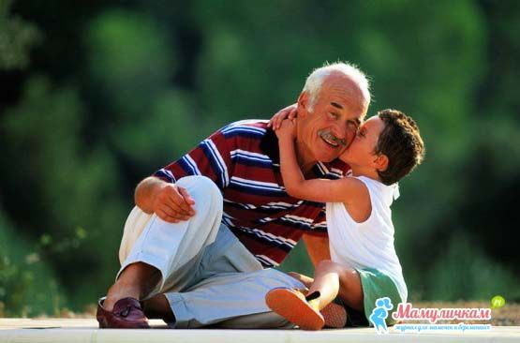
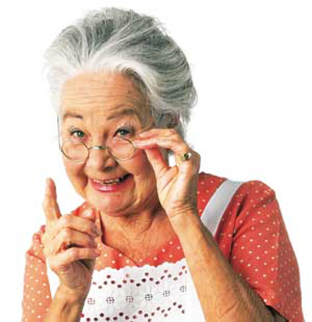
GRANDFATHER
GRANDMOTHER

Slide 6
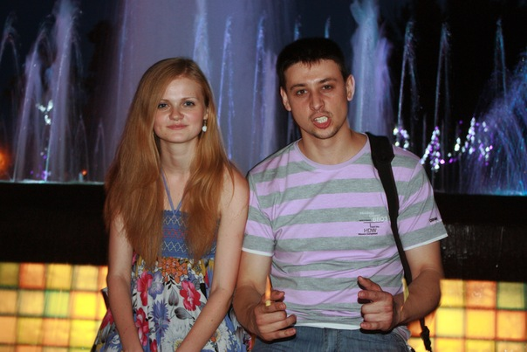
MY AUNT AND MY UNCLE

Slide 7
SISTER
MOTHER
FATHER
BROTHER
I have got …
GRANDPARENTS
AN UNCLE
AN AUNT

Slide 8

I LOVE MY FAMILY.

