Slide 1
The 24 th of September

Slide 2
Good morning!

Slide 3
Good morning! Good morning!
Good morning to you!
Good morning! Good morning!
I am glad to see you!
I am glad to see you, too.

Slide 4
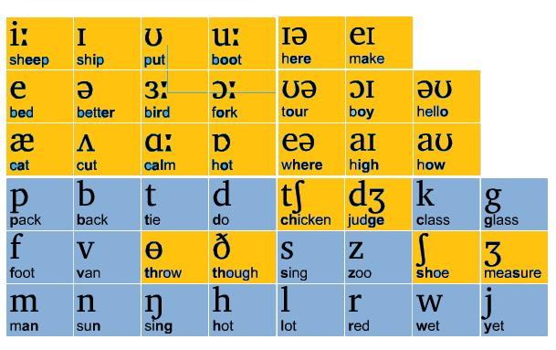
- Let’s warm up:
[w] – window, we, what.
[ɔː ] – door, floor,blackboard.
[i:] – he, she, we.

Slide 5
I am at the window,
He is at the door,
She is at the blackboard,
We are on the floor.

Slide 6
Where is the ball?
Where is the ball?
Oh ,where, oh, where?
Is it in the box
Or under the chair?
Oh, this is my blue
And yellow ball!
Under the table
Near the wall.

Slide 7
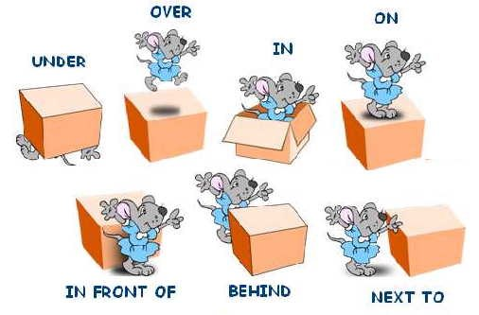
Prepositions of place

Slide 8
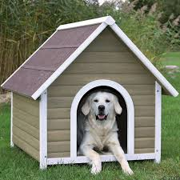
Where is the dog?

Slide 9
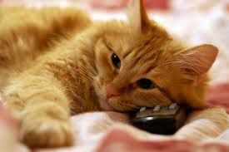
Read and draw!

Slide 10
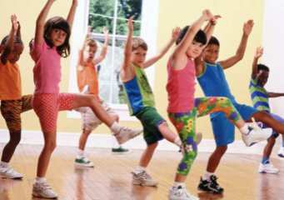
One hand up,
Two hands up,
Two hands down,
Sit down and stand up.
Hands on your head,
Hands behind your back,
Hands on your nose,
Stand up and sit down.

Slide 11
Granddaughter [ɡræn(d)ˌdɔːtə(r)]

Slide 12
Grandson [ˈɡræn(d)ˌsʌn]

Slide 13
Word search

Slide 14
Home task

Slide 15
Do you like the lesson?

Slide 16
The lesson is over!
Good Bye!

