Slide 1
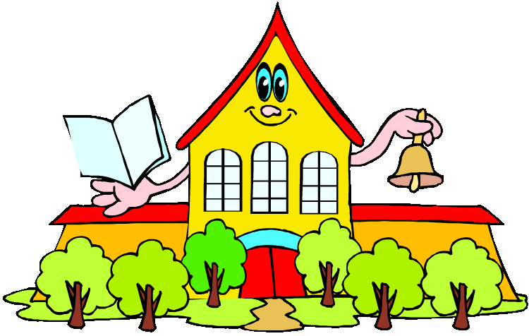
Любимое занятие в воскресенье

Slide 2
Фонетическая зарядка
- Look at the slide, please. You can see a new poem there. Let’s read it.
Apple-tree, apple-tree,
Give your apples, please, to me!
Shake your branches, don’t wait,
Put the apples on the plate.

Slide 3
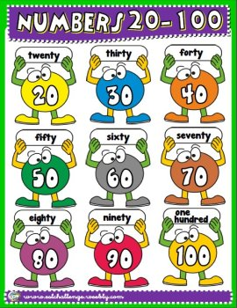
Let’s learn to count from 21 to 100

Slide 4
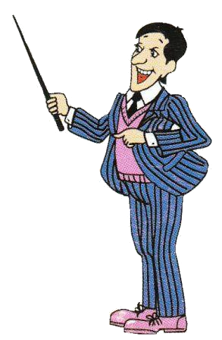
Mr Rule has written the numerals in your textbooks, page 45.

Slide 5
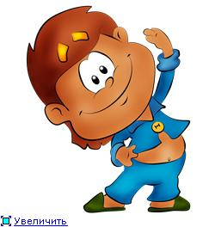
Физкультминутка
- It’s time to have a rest and do our exercises. Stand up, please.
Hands up! Hands down! Shake! Shake!
Stand up! On the tiptoes
Turn around. Step aside,
Step left! Step right!

Slide 6
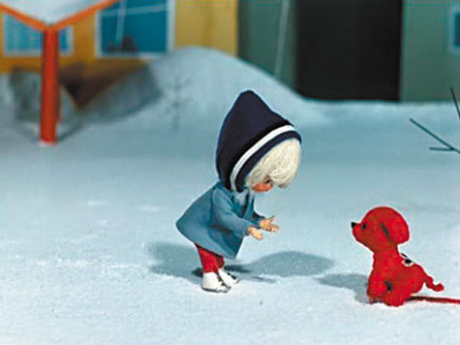
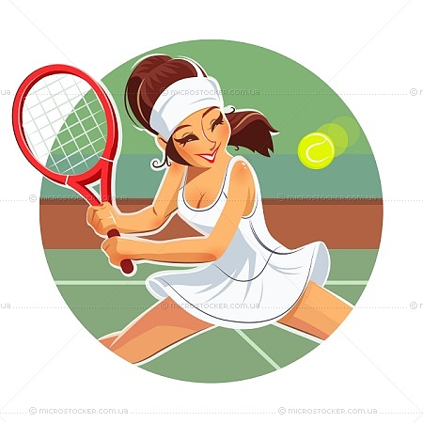
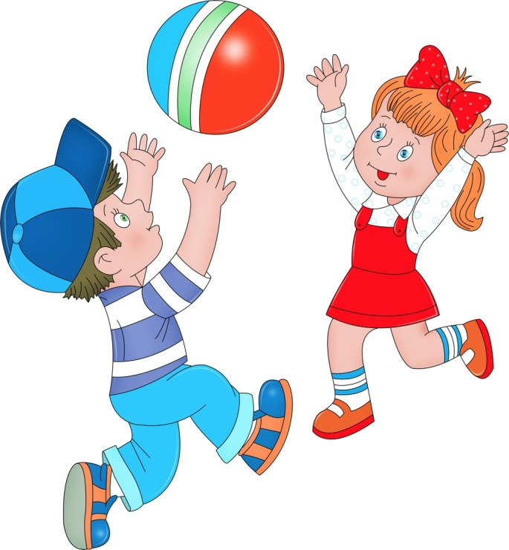
Введение новой лексики и ее первичное закрепление.
play tennis [pleɪ ˈtɛnəs]
play with a friend [pleɪ wɪð ə frɛnd]
walk with a dog [wɔk wɪð ə dɔg]
do homework [du ˈhoʊmˌwɜrk]

Slide 7
Развитие навыков устной речи по теме
Read the task of exercise 6 on page 47. You will ask and answer the questions.

Slide 8
Подведение итогов урока
Yellow picture I painted for mum:
Yellow beach under the yellow sun,
Yellow, yellow, yellow rays,
Yellow yacht on the yellow waves!

Slide 9
Homework
Workbook: Lesson 26 (p. 30).

