Slide 1
Фонетическая разминка
[z] – [z] – [z] [ ei ] – [ei] – [ei] [ ai ] - [ ai ] – [ ai ] [ m ] - [m ] - [m ] [ o ] – [ o ] – [ o ]

Slide 3
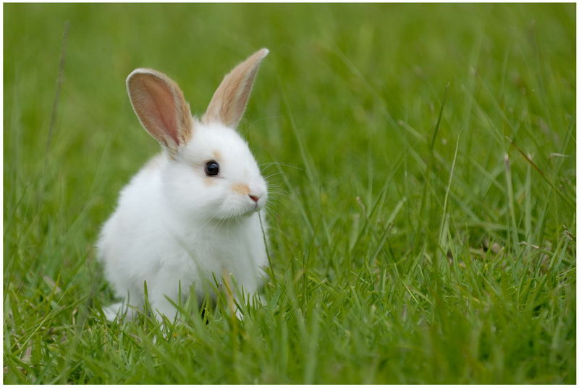

Slide 4
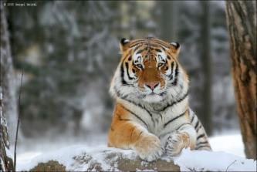

Slide 5
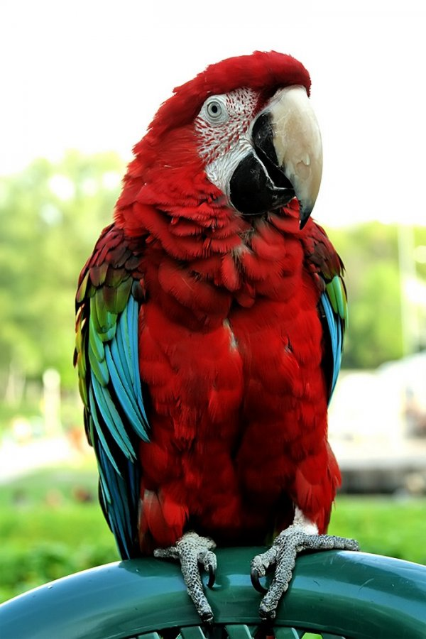

Slide 6
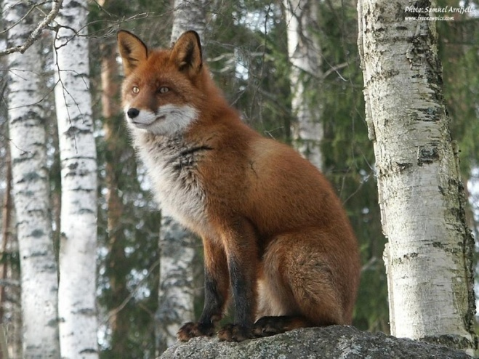

Slide 7
-Who are you? -I’m Barney. -What game do you like playing? -I like playing tag. -How old are you? -I’m three/

Slide 8
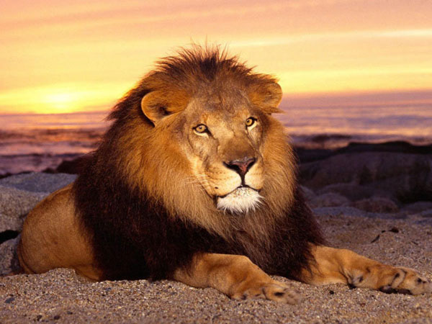

Slide 9
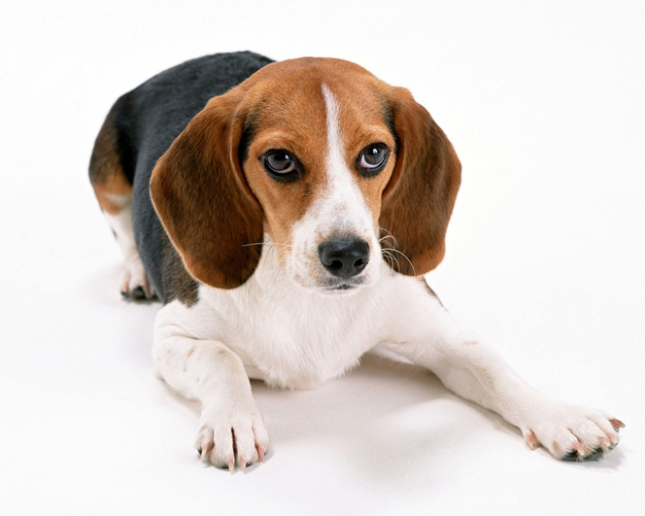

Slide 10
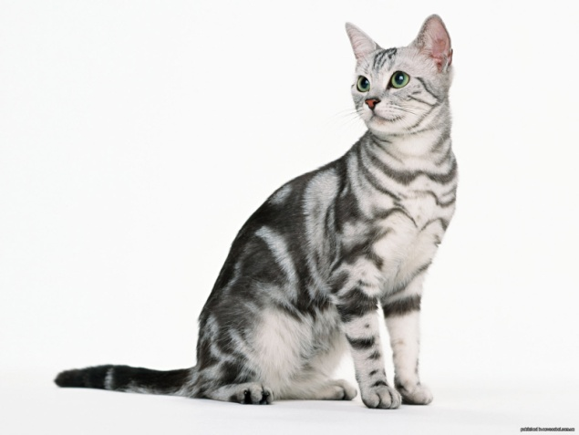

Slide 11
They like playing…

Slide 12
-Who are you? -I’m Barney. -What game do you like playing? -I like playing tag. -How old are you? -I’m three.

Slide 13
We like playing…

Slide 14
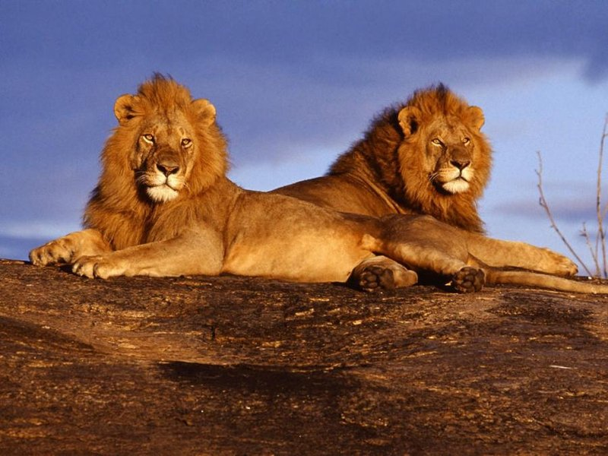

Slide 15
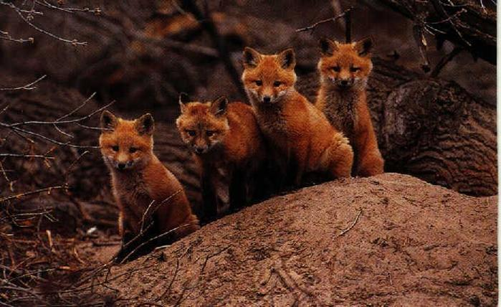

Slide 16
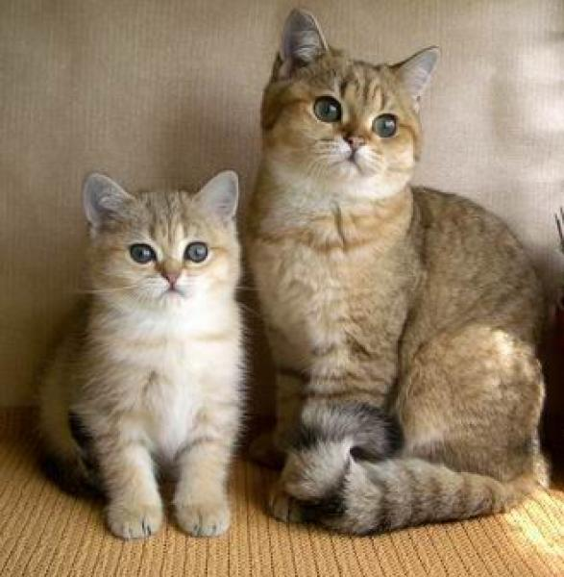

Slide 17
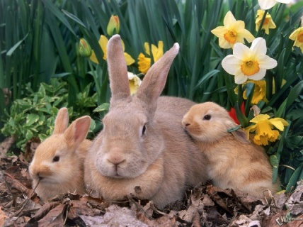

Slide 18
I’m cat. I’m five.

Slide 19
-I’m dog. -I like playing tag. -I’m 2.

Slide 20
Homework: AB page 104

Slide 21
The lesson is over. Good-buy.

