Slide 1
I can/ I can`t
English lesson in second form
Saint-Petersburg
School: № 349
Teacher: Borisova M. A.

Slide 2
Let`s remember (Давайте вспомним)

Slide 3
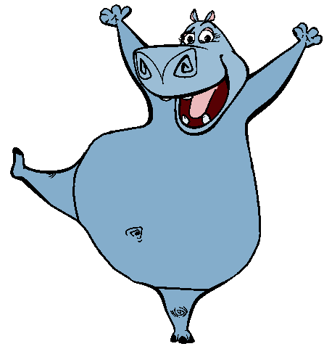
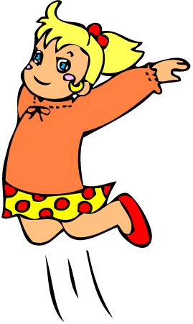
I can…
I can jump!
I can hop!

Slide 4
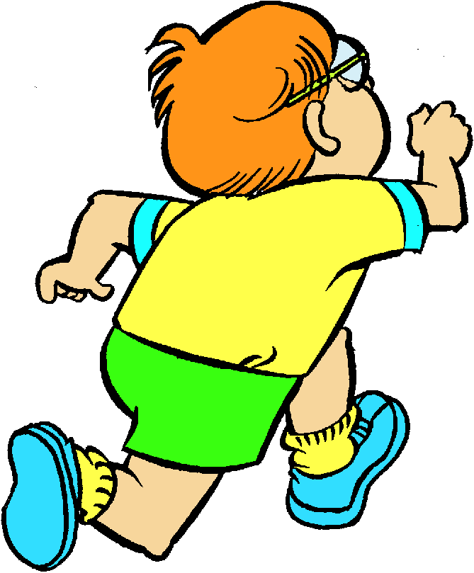
He can…
He can swim!
He can run!

Slide 5
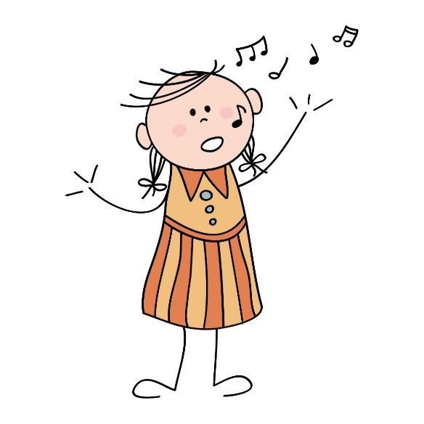
She can…
She can sing!
She can skip!

Slide 6
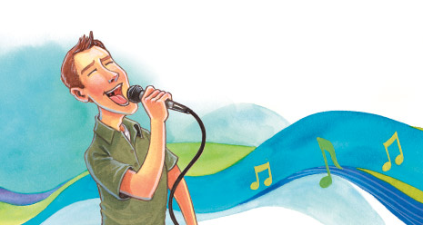
How to ask the question?
Can + You/He/She + verb (глагол)
Can he sing?
(он умеет петь?)

Slide 7
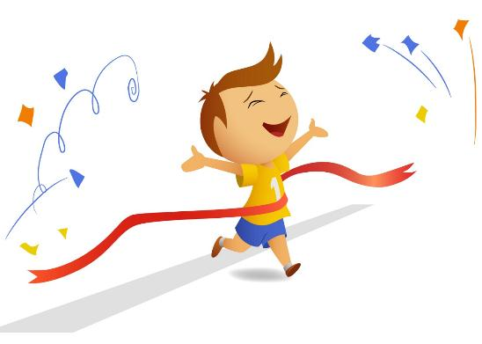
How to answer the questions?
+ Yes, I/ He/ She can.
Can he run?
Yes, he can!

Slide 8
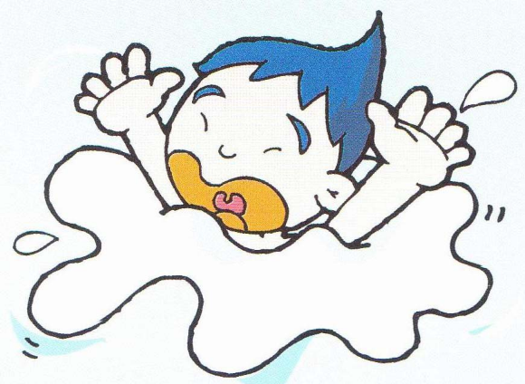
How to answer the questions?
- No, I/ He/ She can`t.
Can he swim?
No, he can`t!

Slide 9
Answer:
Can you dance?
Can you sing?
Can you swim?
Can you skip?
Can you hop?
Can you jump?
Can you run?

Slide 10
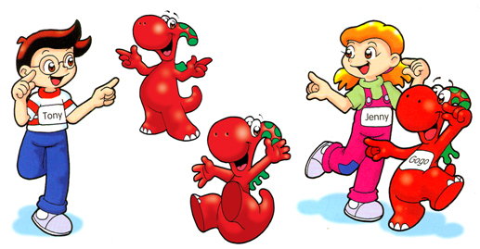
Let`s watch “Gogo” and learn the new words: to climb, to catch, to act, to fly, to read

Slide 11
Let`s watch a song “I can run”. Listen and repeat!

Slide 12
Translate into English:
Я умею бегать.
Он не умеет танцевать.
Она умеет прыгать через скакалку.
Я не умею плавать.
Я умею играть.
Гого умеет летать.
Гого не умеет петь.
Гого умеет читать. Я умею читать. Он умеет читать. Она умеет читать.

